Slide 1
Adolescent STI Epidemiology, Testing & Treatment

Slide 2
Objectives
By the end of this presentation, participants will be able to:
Describe
Describe the scope and risk factors for sexually transmitted infections (STIs) in adolescents.
Discuss
Discuss the STIs affecting adolescents.
Assess
Assess, treat, and prevent STIs in adolescent patients.

Slide 3


CDC 2013 Report:
STIs and Young People
  ~20 Million new cases/year:
    50% occur in people ages 15–24
Incidence
Prevalence
Increased Risk
Cost
Total Infections:
110 Million
  New Analysis:
  # of new infections equal among young
  (49% v. 51%)
  Direct Medical costs: ~$16 billion/year
Notes:
http://www.cdc.gov/std/stats/STI-Estimates-Fact-Sheet-Feb-2013.pdf
1 Satterwhite CL, et al. Sexually transmitted infections among U.S. women and men: Prevalence and incidence estimates, 2008. Sex Transm Dis 2013; 40(3): pp. 187-193.
2 Owusu-Edusei K, et al. The estimated direct medical cost of selected sexually transmitted infections in the United States, 2008. Sex Transm Dis 2013; 40(3): pp. 197-201.
Though young people aged 15–24 make up 25% of sexually active individuals, they comprise half of new STI infections each year.
A CDC study released in March 2008 estimates that one in four young women ages 14 to 19 in the US are infected with at least one of the most common sexually transmitted infections (human papillomavirus, Chlamydia, herpes simplex virus, and trichomoniasis). Data were based on an analysis of the 2003–2004 National Health and Nutrition Examination Survey.[ii]
A 2004 study investigating the annual cost of STIs in American young people found that the total estimated burden STIs occurred among 15–24 year olds in 2000 was $6.5 billion (in year 2000 dollars). [iii]
In 2006, the incidence of HIV in young people ages 13–29 was 26.8 per 100 000, representing 34% of the total infections. More than half of the infections in this age group were in men who have sex with men (MSM). [iv] However, the 2006 CDC data includes reporting from 33 states and represents 14% of the persons diagnosed that year. Based on back reporting, researchers estimate that the percentage of total infections in young people may be as high as 50%. [v]
Sources:
[ii] CDC Press Release. 2008 National STD Prevention Conference. Nationally Representative CDC Study Finds 1 in 4 Teenage Girls Has a Sexually Transmitted Disease. http://www.cdc.gov/STDConference/2008/media/release-11march2008.htm
[iii] Hall HI, Song R, Rhodes P, Prejan J, et al. Estimation of HIV Incidence in the United States. JAMA 2008;300:520–529.
[Iv] Chesson H, et al. The Estimated Direct Medical Cost of Sexually Transmitted Diseases Among American Youth, 2000. Perspect Sex Repro Health 2004;36;1
[v] Morris M, et al. Prevalence of HIV Infection Among Young Adults in the United States: Results From the Add Health Study AJPH 2006; 96(6): 1091–1097

Slide 4
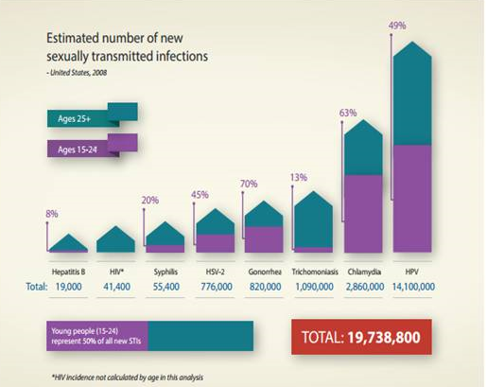
Half of New STIs: Ages 15-24
Notes:
http://www.cdc.gov/std/stats/STI-Estimates-Fact-Sheet-Feb-2013.pdf
While the consequences of untreated STIs are often worse for young women, the new analysis reveals that the annual
number of new infections is roughly equal among young women and young men (49 percent of incident STIs occurs among
young men, vs. 51 percent among young women).
**HIV incidence not calculated by age in the analysis
CDC estimates that HPV accounts for the majority of newly acquired STIs. While the vast majority (90 percent) of HPV
infections will go away on their own within two years and cause no harm, some of these infections will take hold and
potentially lead to serious disease, including cervical cancer

Slide 5
Adolescents Face Increased Risk for STIs
Biological
Cognitive
Behavioral
Societal
Risk for Sexual Abuse
Notes:
“Persons who initiate sex early in adolescence are at higher risk for STDs, along with persons residing in detention facilities, attending STD clinics, young men having sex with men (YMSM), and youth who use injection drugs. Factors contributing to this increased risk during adolescence include having multiple sexual partners concurrently, having sequential sexual partnerships of limited duration, failing to use barrier protection consistently and correctly, having increased biologic susceptibility to infection, and experiencing multiple obstacles to accessing health care (92).
Source: Forhan SE, Gottlieb SL, Sternberg MR, et al. Prevalence of sexually transmitted infections among female adolescents aged 14 to 19 in the United States. Pediatrics 2009;124:1505–12.

Slide 6
Biological Risk Factors:
Females
Adolescent cervix
Lack of immunity from prior infections
Smaller introitus
Lack of lubrication can lead to dry, traumatic sex
Notes:
In general, women are at greater risk of acquiring an STI than men. Because female reproductive anatomy is internal, it is more susceptible to infection and infection is more difficult to recognize.
Teenage women may be even more susceptible to a sexually transmitted infection than older women due to increased cervical ectopy (most STIs infect columnar cells in ectopy and not squamous cells covering surrounding cervix and vagina). Adolescent women are also likely to have fewer protective antibodies to STIs, a biologically immature cervix, a smaller introitus, and a higher likelihood of dry sex.
Extent of cervical ectopy was not associated with HPV acquisition in healthy adolescents and young women. Biological vulnerabilities may lie in immune function or other characteristics of the cervical epithelium. (Source: Obstet Gynecol. 2012 Jun;119(6):1164-70. doi: 10.1097/AOG.0b013e3182571f47. Cervical ectopy and the acquisition of human papillomavirus in adolescents and young women.
Hwang LY, Lieberman JA, Ma Y, Farhat S, Moscicki AB.)
Sources:
Shafer M, Sweet RL. Pelvic Inflammatory Disease in Adolescent Females Adolescent Medicine: State of the Art Reviews 1990;1:545–564.
D.R. Ostergard. The Effect of Age, Gravidity, and Parity on the Location of the Cervical Squamocolumnar Junction as Determined by Colposcopy American Journal of Obstetrics and Gynecology 1977:129:59–60.
Moscicki A. Differences in Biologic Maturation, Sexual Behavior, and Sexually Transmitted Disease Between Adolescents With and Without Cervical Intraepithelial Neoplasia Journal of Pediatrics 1989;115:487–493.

Slide 7
Biological Risk Factors: Males
Circumcision may help prevent STIs and HIV
Notes:
Randomized controlled trials conducted with men in Africa have shown that male circumcision reduces the likelihood of female-to-male transmission of human immunodeficiency virus (HIV) infection by 50% to 60%.[i][ii][iii]
Observational studies also suggest that male circumcision may protect heterosexual men against acquisition of other sexually transmitted infections (STI), such as syphilis, chlamydial infection, or genital ulcer disease.[iv][v]
[i]Auvert B, Taljaard D, Lagarde E, et al. Randomized, controlled intervention trial of male circumcision for reduction of HIV infection risk: the ANRS 1265 trial. PLoS Med. 2005;2(11):e298.
[ii] Bailey RC, Moses S, Parker CB, et al. Male circumcision for HIV prevention in young men in Kisumu, Kenya: a randomised controlled trial. Lancet. 2007; 369(9562):643–656.
[iii] Gray RH, Kigozi G, Serwadda D, et al. Male circumcision for HIV prevention in men in Rakai, Uganda: a
randomised trial. Lancet. 2007;369(9562):657–666.
[iv] Weiss HA, Thomas SL, Munabi SK, et al. Male circumcision and risk of syphilis, chancroid, and genital
herpes: a systematic review and meta-analysis. Sex Transm Infect. 2006;82(2):101–110.
[v] Moses S, Bailey RC, Ronald AR. Male circumcision: assessment of health benefits and risks. Sex
Transm Infect. 1998;74(5):368–373.

Slide 8

Cognitive Risk Factors for STIs in Adolescents
Early adolescence: concrete thinking
  Often unable to plan ahead for condoms
Serial monogamy in relationships leading to multiple partners
Personal fable
  Unable to judge risk for STIs
  “Other people get STIs”
Notes:
There are several cognitive factors that place adolescents at disproportionate risk for STIs. Early adolescence is characterized by concrete thinking. This can inhibit an adolescent’s ability to plan ahead for the need for condoms. Additionally, it may affect an adolescent’s understanding of the future ramifications of an STI.[i]
Having multiple partners is a major risk factors for STIs. In adolescence, most teens are only sexually active with one person at a time which may imply safety from infection. However, adolescent romantic relationships are often very short. Serial monogamy can lead to many lifetime partners and an increase in risk.[ii]
Elkind’s (1967) theory of adolescent egocentrism proposes two distinct but related constructs—the imaginary audience and the personal fable. These two concepts are interrelated. The imaginary audience describes an adolescent’s egocetrism and perception that everything they do is being watched and scrutinized by others. The personal fable is an adolescent’s sense of personal uniqueness which can yield a sense of invulnerability commonly associated with behavioral risk-taking. [ii]
Sources:
Elkind D. Egocentrism in adolescence. Child Development 1967;38: 1025–1034.
Ellen JM. Boyer CB, Tschann JM, Shafer MA. Adolescents' perceived risk for STDs and HIV infection. Journal of Adolescent Health 1996;18:77–181

Slide 9
Behavioral Risk Factors
Age at First Intercourse
Multiple Sexual Partners
Sexual Activity with New Partner
Substance Use
Mental Health
Notes:
Women with first sexual intercourse <age 15 are nearly four times as likely to report a bacterial STI and more than twice as likely to report PID, as women who first had sex after age 18.
Several studies have shown that being in a new sexual partnership is a predictor of an STI due to greater uncertainty about partners’ sexual history and STI status.
More than one sexual partner at a time increases exposure and therefore increases risk of STI.
Use of alcohol and other substances that impair judgment can increase the likelihood of engaging in sexual intercourse without a condom, with multiple partners, or with high-risk partners. Approximately 1 in 70 high school students reported having injected an illegal drug and about 18% of 12–19 year olds reported an episode of heavy drinking in the past 30 days.
Sources:
Niccolai LM. New sex partner acquisition and sexually transmitted disease risk among adolescent females. J Adolescent Health 2004; 34(3):216–23.
Gittes EB, Irwin CE. Sexually transmitted diseases in adolescents. Pediatr Rev. 1993;14:180–189.

Slide 10
Behavioral Risk Factor: Intimate Partner Violence
  Teen girls who are abused by male partners are 3x more likely to become infected with an STI/HIV than non-abused girls.
  Adolescents rarely self report dating violence & may not recognize their exposure to dating violence as abuse.
  Direct questions (with yes or no answers) may not be effective.
Notes:
Adapted from, “Hanging out or Hooking Up: Clinical Guidelines on responding to Adolescent Relationship Abuse” by Elizabeth Miller, MD, PhD and Rebecca Levenson, MA. (pg. 15)
Girls may fear retaliation from partners when notifying them of STI infection

Slide 11
Screening for IPV
What does a healthy relationship look like to you?
How often are you and your partner together? How does you partner feel about you hanging out with other friends?
Who makes the decisions about when to have sex and if or what kind of contraceptives you should use?
Notes:
Disagreements and arguments are a normal part of any intimate relationship. What is it like when you and your partner get into an argument? How do you usually resolve it?

Slide 12
Signs linked to IPV
  Depression/Anxiety
  Changes in eating patterns
  Changes in social relationships
  Substance abuse
  Abdominal pain/pelvic pain
  Physical findings inconsistent with stated mechanism of injury, or findings associated with intentional injury, (patterned marks, and bruises in varied stages of healing, burns).
Notes:
St. Mars, T., RN,BSN, CEN, Valdez, A.M., RN, MSN, CEN. (2007). Adolescent dating violence: understanding what is “at risk?” Journal of Emergency Nursing, 33(5): 492-494.

Slide 13
Intimate Partner Violence and Adolescents
  Intimate Partner Violence is bi-directional, meaning girls and boys report being both the victims and the perpetrators.
  9.3% of females and 9.5% of males report being hit, slapped or physically hurt on purpose by their boyfriend or girlfriend.
  11.8% of females and 4.5% of males have ever been physically forced to have sex
Notes:
Glass et al. (2011) Adolescent dating violence: prevalence, risk factors, health outcomes, and implications for clinical practice. Curr Opin Pediatr, 23(4): 379-83.
Source: Centers for Disease Control and Prevention. Youth Risk Behavior Surveillance – United States, 2011. Surveillance Summaries, August 2, 2012. MMWR 2012;61(No. 4).

Slide 14
Behavioral Risk Factor:
Older Partners
Predisposes adolescents to relationship power imbalance
Sexual negotiation more difficult
Increased risk of involuntary intercourse, lack of protective behavior, and exposure to STIs

Slide 15
Behavioral: Men Who Have Sex With Men
In 2012, MSM accounted for:
75% of all primary & secondary syphilis cases
An average of 4 in 10 MSM with syphilis are also infected with HIV.
Notes:
Source: http://www.cdc.gov/nchhstp/newsroom/docs/STD-Trends-508.pdf
2012 National CDC STD Surveillance Data
Although a number of individual risk behaviors (such as higher numbers of lifetime sex partners or unprotected sex) contribute to disparities in the sexual health of MSM, other social and cultural factors may also play a role. For example, MSM with lower economic status may have limited access to health care and therefore may be particularly vulnerable to poorer health outcomes compared to other men. Complex issues like homophobia and stigma can also make it difficult for gay and bisexual men to seek appropriate care and treatment.

Slide 16
Behavioral Risk Factors: Condom Use
Percentage of HS Students Who Used a Condom at Last Intercourse
2011 Youth Risk Behavior Survey
Notes:
Women with first sexual intercourse <age 15 are nearly four times as likely to report a bacterial STI and more than twice as likely to report PID, as women who first had sex after age 18.
Several studies have shown that being in a new sexual partnership is a predictor of an STI due to greater uncertainty about partners’ sexual history and STI status.
More than one sexual partner at a time increases exposure and therefore increases risk of STI.
Use of alcohol and other substances that impair judgment can increase the likelihood of engaging in sexual intercourse without a condom, with multiple partners, or with high risk partners. Approximately 1 in 70 high school students reported having injected an illegal drug and about 18% of 12–19 year olds reported an episode of heavy drinking in the past 30 days.
Sources:
Niccolai LM. New sex partner acquisition and sexually transmitted disease risk among adolescent females. J Adolescent Health 2004; 34(3):216–23.
Gittes EB, Irwin CE. Sexually transmitted diseases in adolescents. Pediatr Rev. 1993;14:180–189.
Source for graph: http://apps.nccd.cdc.gov/youthonline/app/Results.aspx?TT=L&OUT=0&SID=HS&QID=H63&LID=XX&YID=YY&LID2=&YID2=&COL=S&ROW1=N&ROW2=N&HT=&LCT=&FS=&FR=1&FG=1&FSL=1&FRL=&FGL=&PV=&TST=False&C1=&C2=&QP=L&DP=1&VA=CI&CS=N&SYID=1991&EYID=2009&SC=DEFAULT&SO=ASC&PF=1

Slide 17
Efficacy of Condoms in Preventing STIs
HIV
Provide up to 85% reduction in transmission
HPV
May prevent 70% of high- and low-risk infections in females
GC, CT, and Trich
When used consistently and correctly, reduce transmission risk
HSV and Syphilis
Can prevent transmission when infected areas are covered
www.cdc.gov/condomeffectiveness/references.html
Notes:
Laboratory studies have demonstrated that latex condoms provide an essentially impermeable barrier to particles the size of STI pathogens. Condoms can be expected to provide different levels of risk reduction for different STIs.
HIV infection is the only STI for which formal meta-analyses have been published. Davis and Weller authored the most recent analysis of 12 studies and estimated from their results that condoms provided an 85% reduction in always vs. never users.
Source: Center for Disease Control "Fact Sheet for Public Health Personnel," CDC Divisions of HIV/AIDS Prevention http://www.cdc.gov/hiv/pubs/facts/condoms.htm January 23, 2003 http://www.cdc.gov/nchstp/od/condoms.pdf
A 2006 study published in the New England Journal of Medicine evaluated whether the use of male condoms reduces the risk of male-to-female transmission of HPV and found that among newly sexually active women, consistent condom use reduces the risk of cervical and vulvovaginal HPV infection by 70% compared to those who used them 5% of the time.
Source: Winer RL, et al. Condom use and the risk of genital human papillomavirus infection in young women. N Engl J Med. 2006;354(25):2645–54.
Latex condoms, when used consistently and correctly, reduce the risk of transmission of gonorrhea, chlamydia, and trichomoniasis. Laboratory studies have demonstrated that latex condoms provide an essentially impermeable barrier to particles the size of STD pathogens.
Epidemiologic studies that compare infection rates among condom users and nonusers provide evidence that latex condoms can protect against the transmission of STDs such as chlamydia, gonorrhea, and trichomoniasis
Genital ulcer diseases can occur in areas that are covered or protected by a latex condom, as well as in areas that are not covered. Consistent and correct use of latex condoms reduces the risk of genital herpes, syphilis, and chancroid only when the infected area or site of potential exposure is protected.
Epidemiologic studies that compare infection rates among condom users and nonusers provide evidence that latex condoms provide limited protection against syphilis and herpes simplex virus-2 transmission. No conclusive studies have specifically addressed the transmission of chancroid and condom use, although several studies have documented a reduced risk of genital ulcers associated with increased condom use in settings where chancroid is a leading cause of genital ulcers.
Overall source: http://www.cdc.gov/condomeffectiveness/docs/Condoms_and_STDS.pdf

Slide 18

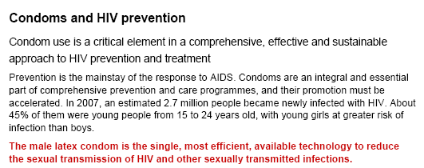
http://data.unaids.org/pub/BaseDocument/2009/20090318_position_paper_condoms_en.pdf
Notes:
Condom use is a critical element in a comprehensive, effective and sustainable approach to HIV prevention and treatment.
Prevention is the mainstay of the response to AIDS. Condoms are an integral and essential part of comprehensive prevention and care programs, and their promotion must be accelerated. In 2007, an estimated 2.7 million people became newly infected with HIV. About 45% of them were young people from 15 to 24 years old, with young girls at greater risk of infection than boys.
The male latex condom is the single, most efficient, available technology to reduce the sexual transmission of HIV and other sexually transmitted infections. The search for new preventive technologies such as HIV vaccines and microbicides continues to make progress, but condoms will remain the key preventive tool for many, many years to come. Condoms are a key component of combination prevention strategies individuals can choose at different times in their lives to reduce their risks of sexual exposure to HIV. These include delay of sexual initiation, abstinence, being safer by being faithful to one’s partner when both partners are uninfected and consistently faithful, reducing the number of sexual partners, correct and consistent use of condoms1, and male circumcision.
Conclusive evidence from extensive research among heterosexual couples in which one partner is infected with HIV shows that correct and consistent condom use significantly reduces the risk of HIV transmission from both men to women, and also from women to men2. Laboratory studies show that male latex condoms are impermeable to infectious agents contained in genital secretions3. To ensure safety and efficacy, condoms must be manufactured to the highest international standards. They must be procured according to the quality assurance procedures established by the WHO, UNFPA and UNAIDS and they should be stored away from direct heat sources. Prevention programs need to ensure that high-quality condoms are accessible to those who need them, when they need them, and that people have the knowledge and skills to use them correctly.
Condoms must be readily available universally, either free or at low cost, and promoted in ways that help overcome social and personal obstacles to their use.
Condom use is more likely when people can access them at no cost or at greatly subsidized prices. Effective condom promotion targets not only the general population, but also people at higher risk of HIV exposure, especially women, young people, sex workers and their clients, injecting drug users and men who have sex with men. UNFPA estimates that the current supply of condoms in low- and middle-income countries falls well short of the number required (the condom ‘gap’)4. Despite the gap, international funding for condom procurement has not increased in recent especially those that depend on external assistance for condom procurement, promotion and distribution.
Collective actions at all levels are needed to support efforts of countries, Young girls and women are regularly and repeatedly denied information about, and access to, condoms. Often they do not have the power to negotiate the use of condoms. In many social contexts, men are resistant to the use of condoms. This needs to be recognized in designing condom promotion programs. Female condoms can provide women with more control in protecting themselves. However, women will remain highly vulnerable to HIV exposure, until men and women share equal decision-making powers in their interpersonal relationships.
1 UNAIDS. 2004 Report on the global AIDS epidemic, page, 72.
2 Holmes K, Levine R, Weaver M. Effectiveness of condoms in preventing sexually transmitted infections. Bulletin of the World Health Organization. Geneva. June 2004.
3 WHO/UNAIDS. Information note on Effectiveness of Condoms in Preventing Sexually Transmitted Infections including HIV. Geneva. August 2001.
4 UNFPA. 2007 report on donor support for contraceptives and condoms for STI/HIV prevention 2007.
5 Singh S, Darroch J.E, Bankole A. A,B, and C in Uganda: The Roles of Abstinence, Monogamy and Condom Use in HIV Decline. The Alan Guttmacher Institute. Washington DC. 2003.
6 Gremy I, Beltzer N. HIV risk and condom use in the adult heterosexual population in France between 1992 and 2001: return to the starting point? AIDS 2004;18:805–9.

Slide 19
Risk Factor: Social/Institutional
Lack of Transportation
Lack of Insurance/$ to Pay
Concerns About Confidentiality
Adolescents Not Being Screened and Treated
Lack of Sex Ed Regarding Risk and Symptoms
Stigma
Notes:
There also exist many social and institutional risk factors that contribute to adolescents’ disproportionate risk for STIs, including:
Lack of sex education regarding how to protect oneself from sexually transmitted infections, including condom use;
Lack of insurance or ability to pay for services;
Lack of transportation to clinics or doctors offices;
Concerns about confidentiality which may inhibit young people from seeking care;
Stigma regarding STI testing and diagnosis.

Slide 20
STI Protective Factors
Peer support for contraception and condoms
Communication with parents about sex
Connection to family
Connection to school and future success
Connection to community organizations
Notes:
http://www.thenationalcampaign.org/resources/pdf/pubs/SexualRisk.pdf

Slide 21

Case: Erica
  Erica is a 16-year-old female who presents with dysuria.
  What is your initial differential diagnosis?
  What additional information do you need?

Slide 22
Sexual History:
The Five Ps
Partners
  Gender(s), Number (three months, lifetime)
Prevention of pregnancy
  Contraception, EC
Protection from STIs
  Condom use
Practices
  Types of sex: anal, vaginal, oral
Past history of STIs
www.stdhivtraining.net
Notes:
For a more complete picture of your patient’s health and to determine the cause of Erica’s symptoms, a sexual history is necessary. A sexual history needs to be taken during a patient’s initial visit, during routine preventive exams, and when you see signs of STIs (as in Erica’s case). The dialogue lends itself to the opportunity for risk-reduction counseling and sharing information about behaviors that may place your patient at risk of contracting STIs.
A sexual history allows you to identify those individuals at risk for syphilis and other STIs, including HIV, and to identify appropriate anatomical sites for certain STI tests.
Some patients may not be comfortable talking about their sexual history, sex partners, or sexual practices. Try to put patients at ease and let them know that taking a sexual history is an important part of a regular medical exam or physical history.
The five Ps stand for: Partners, Prevention of pregnancy, Protection from STIs, Practices, and Past history of STIs.
These are the areas that you should openly discuss with your patients. You probably will need to ask additional questions that are appropriate to each patient’s special situation or circumstances.

Slide 23
Erica: Sexual History Results
Several episodes of unprotected sex
in the last few weeks with one male partner (her only lifetime)
Not on hormonal contraception but
uses condoms most of the time
Engages in oral (giving and receiving) and vaginal sex
No known history of STIs

Slide 24
History of Present Illness
Onset and duration of symptoms
Description of symptoms
Associated symptoms
  Nausea
  Vomiting
  Fever
  Chills
  Back pain
  Sores, lumps, bumps
Notes:
At this point, the provider must obtain additional information about Erica’s condition. This includes the onset and duration of the symptoms (When did you start experiencing these symptoms? How long does the burning usually last?), a description of the symptoms (Does it burn on the inside or the outside? Have you noticed any discharge? Is there itching and irritation?), and associated symptoms (nausea, vomiting, fevers, chills, lower back pain, sores).

Slide 25
Erica: History of Present Illness Results
Erica tells you she has burning with urination and a “yellowish” discharge. She reports itchiness.
She denies abdominal pain and fever and reports no bumps or lesions.
What is the differential diagnosis?

Slide 26
Differential Diagnosis
Dysuria
Urinary Tract
Infection
Genital Tract Infection
Skin Related Abnormalities/ mucosal perineal
Cervicitis
Vaginitis
Herpes
Trauma

Slide 27

Case: Erica
Do you need to perform a pelvic exam?

Slide 28
Pelvic Exam?
Yes… Why?
  Erica is symptomatic and sexually active.
  A pelvic exam in this case is a diagnostic exam not an asymptomatic screening.
  If Erica had been asymptomatic, would you perform a speculum exam?

Slide 29
Initiating Cervical Cytology: Updated Guidelines (2012)
American College of Obstetrics & Gynecology (ACOG):
  Begin screening at 21 years
  Screening recommended every
  3 years for women 21–29 years
ACOG Practice Bulletin No. 109: Cervical cytology screening. ACOG Committee on Practice Bulletins--Gynecology.
Notes:
ACOG now recommends that women begin screening at 21 years of age. Women ages 21–30 should be screened every three years instead of every 2 years, Screening using either the conventional Pap or the liquid-based method is acceptable. Women younger than 30, however, should not be screened with co-testing.
Sexually active adolescents under 21 should be counseled and tested for sexually transmitted infections, with additional counseling regarding safer sex and contraception. These measures may be carried out without a Pap test.
What is new about these guidelines?
This is the first time that USPSTF has recommended the combined use of cervical cytology and high-risk human papillomavirus (HPV) DNA testing (“co-testing”). The previous USPSTF guidelines had indicated that evidence was insufficient to make a recommendation regarding the use of co-testing. USPSTF now recommends that women age 30–65 years should be screened by either cytology every 3 years or co-testing every 5 years.
In contrast, ACS/ASCCP/ASCP finds that co-testing every 5 years is preferred to cytology alone but that cytology alone every 3 years is an acceptable strategy. In choosing to make co-testing the preferred strategy, ACS/ASCCP/ASCP focused on evidence from multiple randomized trials showing that co-testing has improved performance compared with cytology alone. Specifically, co-testing has increased sensitivity for detecting cervical intraepithelial neoplasia grade 3 or greater (CIN3+), and women who have undergone co-testing have a lower risk of CIN3+ and invasive cancer after the first screening round. Because of this improved performance, co-testing can be used for screening at less frequent intervals than cytology alone. In addition, co-testing offers greater risk reduction than cytology alone for adenocarcinoma of the cervix and its precursors.
Moving the baseline cervical screening to age 21 is a conservative approach to avoid unnecessary treatment of adolescents which can have economic, emotional, and future childbearing implications. ACOG previously recommended that cervical screening begin three years after first sexual intercourse or by age 21, whichever occurred first. Although the rate of HPV infection is high among sexually active adolescents, invasive cervical cancer is very rare in women under age 21. The immune system clears the HPV infection within one to two years among most adolescent women. Because the adolescent cervix is immature, there is a higher incidence of HPV-related precancerous lesions (called dysplasia). However, the large majority of cervical dysplasias in adolescents resolve on their own without treatment.
Routine cervical cytology testing should be discontinued in women (regardless of age) who have had a total hysterectomy (removal of the cervix along with the uterus) for noncancerous reasons, as long as they have no history of high-grade CIN.
Women who have been vaccinated should continue to be screened.
Source: ACOG Practice Bulletin No. 109: Cervical cytology screening. ACOG Committee on Practice Bulletins--Gynecology. Obstet Gynecol. 2009;114:1409-1420.
https://www.acog.org/About_ACOG/Announcements/New_Cervical_Cancer_Screening_Recommendations
http://www.acog.org/About_ACOG/News_Room/News_Releases/2012/Ob-Gyns_Recommend_Women_Wait_3_to_5_Years_Between_Pap_Tests

Slide 30
Female Genital Exam
External Exam
Speculum Exam
Bimanual Exam

Slide 31
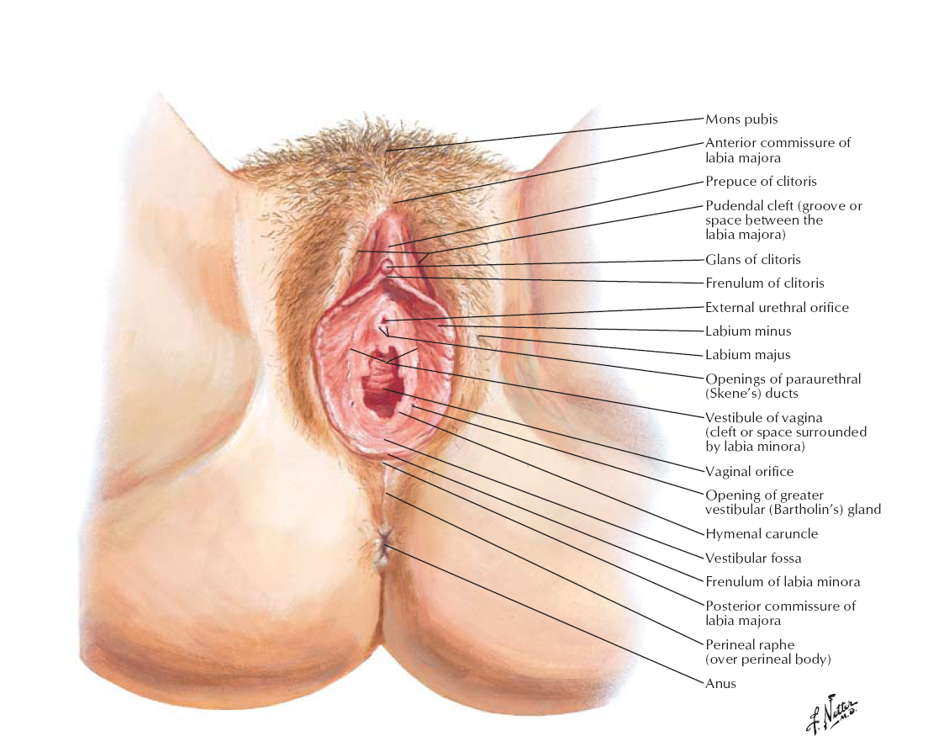
External Exam
Pubic Hair: Lice, crabs, scabies
External Genitalia:
Lesions, rash
Urethra: Discharge
Lymph Nodes: Swelling
Notes:
During the external exam, providers will inspect:
The pubic hair for lice, crabs, scabies, and any other abnormalities;
The external genitalia for lesions, rashes, and any other abnormalities;
The urethra for discharge;
The lymph nodes for swelling.

Slide 32
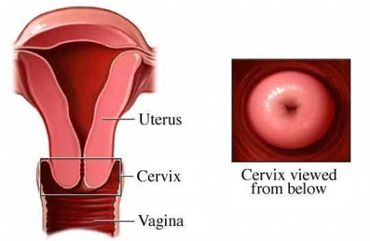
Speculum Exam
Inspect
Determine
Origination of discharge—os or vault? Use swab test to determine
Vagina and cervix for discharge, cervical friability, strawberry cervix, foreign bodies
1) Put swab in os to collect specimen
2) Hold it up against white—if it is yellow = bacteria
Notes:
What are you looking for during the speculum exam? You want to know if the discharge is originating in the vault or the os. If it is originating in the vault, Erica most likely has:
Vaginitis: While inspecting the discharge, take note of color, amount, odor (whiff test) amine release.
or
Trich: Strawberry cervix
If the discharge is originating from the os, Erica most likely has:
Cervicitis: Take note of color, amount, cervical friability
Swab test: Put the swab in the os to collect specimen; hold it out and up against white background—if it is yellow more indicative of a bacteria

Slide 33
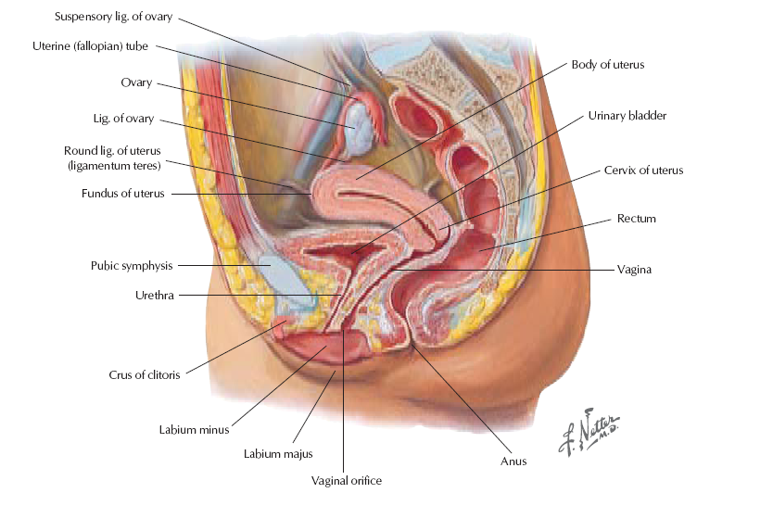
Bimanual Exam
Assess
-Cervical motion tenderness
-Adnexal tenderness
-Uterine size or tenderness
-Mass uterine
Notes:
During the a bimanual examination, the provider will assess the uterus and ovaries of the patient. The provider will insert one or two gloved fingers into the vagina and locate the cervix with the tip of her finger. With her other hand, she will press firmly on the abdomen, right above the pubic bone. During this procedure, the provider is evaluating the size, shape, and consistency of the cervix, uterus, and ovaries. This can often feel like pressure to the woman. Any pain should be discussed with the provider.

Slide 34
Differential Diagnosis
You observe discharge in the vault but not in the os.
You suspect vaginitis.
What are the causes of vaginitis?

Slide 35
Differential Diagnosis
Dysuria
Genital Tract Infection
Trichomonas
Bacterial Vaginitis
Vaginitis
Candida Vaginitis
Notes:
Vaginitis is infectious or noninfectious inflammation of the vaginal mucosa, sometimes with inflammation of the vulva. Symptoms include vaginal discharge, irritation, pruritus, and erythema.
Vaginitis is one of the most common gynecologic disorders. Some of its causes affect the vulva alone (vulvitis) or in addition (vulvovaginitis).
Three causes of vaginitis include: trichomoniasis, bacterial vaginitis, candida vaginitis.

Slide 36
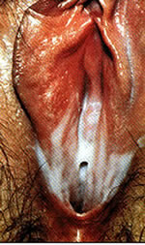
Trichomonas
Caused by infection with a protozoan parasite (Trichomonas vaginalis)
Most common curable STI
  More women are infected than men
Prevalence
  ~3.7 million people
  Only 30% develop any symptoms
Notes:
Trichomoniasis is an STI caused by a protozoan, usually found in the vagina and urethral tissues. Although this condition is most often treated in women, men can also be infected (and often have no symptoms).
Sources:
http://www.cdc.gov/std/trichomonas/STDFact-Trichomoniasis.htm
http://www.cdc.gov/std/trichomonas/stats.htm (different numbers based on a study with just women published in 2007)
Sutton M, Sternberg M, Koumans EH, McQuillan G, Berman S, Markowitz L. The prevalence of Trichomonas vaginalis infection among reproductive-age women in the United States, 2001-2004. Clin Infect Dis. 2007 Nov 15;45(10):1319-26
Weinstock H, Berman S, Cates W Jr. Sexually transmitted diseases among american youth: incidence and prevalence estimates, 2000. Perspect Sex Reprod Health 2004;36:6–10.

Slide 37
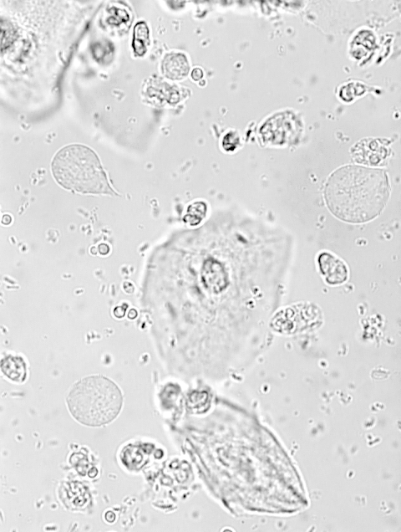
Trichomonads
Trichomonas: bigger than PMNs
PMNs: dense nucleus; Trich: many small vacules
Trich: dead once viewed with microscopy—flagella rarely seen
PMN
Yeast buds
Trichomonas*
Trichomonas*
Squamous epithelial cells
PMN

Slide 38
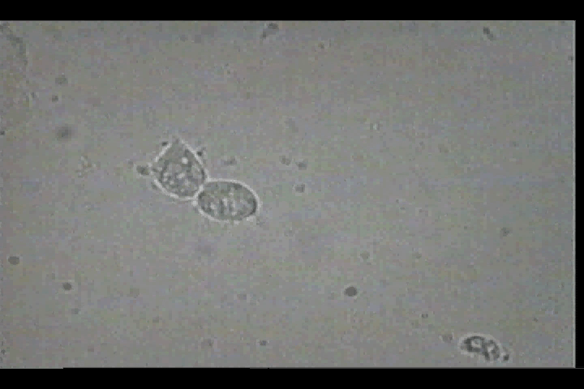
Trichomonads in Real-Time
Video: Cincinnati STD/HIV Prevention Training Center

Slide 39
Trichomonas Infection: Symptoms
Females: ~70% are asymptomatic
Foul-smelling, frothy discharge
Greenish-yellow discharge
Vaginal itching, burning, redness
Dyspareunia
Dysuria
Soreness of the genitals
Males:
Most are asymptomatic & often missed
Itching/irritation inside the penis
burning after urination or ejaculation
discharge from the penis
Notes:
Women with trichomoniasis may notice itching, burning, redness or soreness of the genitals, discomfort with urination, or a thin discharge with an unusual smell that can be clear, white, yellowish, or greenish.
Men with trichomoniasis may feel itching or irritation inside the penis, burning after urination or ejaculation, or some discharge from the penis.
Source: http://www.cdc.gov/std/trichomonas/STDFact-Trichomoniasis.htm
Symptoms of trichomoniasis typically occur after an incubation period of 5–28 days. In women, T vaginalis is isolated from the vagina, cervix, urethra, bladder, and Bartholin and Skene glands. In men, the organism is found in the anterior urethra, external genitalia, prostate, epididymis, and semen.
The findings of trichomoniasis in men: physical examination are generally unremarkable unless the infection is complicated. It may be associated with local inflammatory states, including balanitis and balanoposthitis. Physical findings of epididymitis and prostatitis may also occur.
Source:
Centers for Disease Control and Prevention. Parasitic Disease Control. Trichomonas Infection Fact Sheet.

Slide 40
Trichomonas Infection
Sequelae:
  Pregnancy Complications
    Preterm delivery; low birth weight
  Can increase HIV risk
Vaginitis
Urethritis
Notes:
Source:
Centers for Disease Control and Prevention. Parasitic Disease Control. Trichomonas Infection Fact Sheet. http://www.cdc.gov/Ncidod/dpd/parasites/trichomonas/factsht_trichomonas.htm#what

Slide 41
Differential Diagnosis
Dysuria
Genital Tract Infection
Trichomonas
Bacterial Vaginosis
Vaginitis
Candida Vaginitis

Slide 42
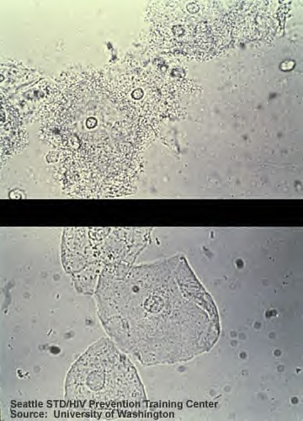
Bacterial Vaginosis
Most common vaginal infection in women of childbearing age
  Fewer than normal hydrogen peroxide-producing lactobacilli & greater prevalence of other types of bacteria in the vagina
Vaginal saline prep: normal (below); clue cells (above)
Notes:
Bacterial vaginosis (BV) is the name of a condition in women where the normal balance of bacteria in the vagina is disrupted and replaced by an overgrowth of certain bacteria.
A disturbance of vaginal microflora, is a common cause of vaginal symptoms and is associated with an increased risk of acquisition of sexually transmitted infections, HIV, and with adverse pregnancy outcomes.
Bacterial vaginosis is the most common cause of vaginal symptoms among women, but it is not clear what role sexual activity plays in the development of BV. Bacterial vaginosis (BV) is the most common vaginal infection in women of childbearing age. In the United States, BV is common in pregnant women. http://www.cdc.gov/std/bv/stats.htm
Not much is known about how women get BV. There are many unanswered questions about the role that harmful bacteria play in causing BV. Any woman can get BV. However, some activities or behaviors can upset the normal balance of bacteria in the vagina and put women at increased risk including:
•Having a new sexual partner or multiple partners,
•Douching
Women do not get BV from toilet seats, bedding, swimming pools, or from touching objects around them. Women who have never had sexual intercourse may also be affected.
The detection of clue cells is the most useful single procedure for the diagnosis of BV. Presence of more than 20% clue cells in vaginal discharge is included in Amsel's criteria for the diagnosis of BV. This image shows normal cells versus 20% clue cells.
42

Slide 43

Bacterial Vaginosis
Symptoms
  Odorous discharge
  Itching , burning, pain
Prevalence
  21.2 million (29.2%) among ages 14-49
Sequelae
  Pregnancy complications; Pelvic Inflammatory Disease (PID)
  Susceptibility to other STDs (HIV, HSV, CT/GC)
Notes:
The prevalence in the United States is estimated to be 21.2 million (29.2%) among women ages 14–49, based on a nationally representative sample of women who participated in NHANES 2001–2004; only 15.7% of the women with BV reported vaginal symptoms. The following are other findings from this study. [i]
Most women found to have BV (84%) reported no symptoms.
Women who have not had vaginal, oral, or anal sex can still be affected by BV (18.8%), as can pregnant women (25%), and women who have ever been pregnant (31.7%).
Prevalence of BV increases based on lifetime number of sexual partners.
Non white women have higher rates (African-American 51%, Mexican Americans 32%) than white women (23%). [i]
Earlier research indicates that BV prevalence varies by clinical setting, from 17%–19% in family planning clinics to 24%–47% in sexually transmitted disease clinics. [ii],[iii],[iv]
Sources:
[i] Koumans EH, Sternberg, M, Bruce C, McQuillan G, Kendrick J, Sutton M, Markowitz Lauri. The Prevalence of Bacterial Vaginosis in the United States, 2001–2004; Associations With Symptoms, Sexual Behaviors, and Reproductive Health. Sexually Transmitted Diseases. 34(11):864–869, November 2007.
[ii] Sobel JD. Vaginitis. N Engl J Med 1997; 337:1896–1903
[iii] Amsel R, Totten PA, Spiegel CA, et al. Nonspecific vaginitis. Diagnostic criteria and microbial and epidemiologic associations. Am J Med 1983; 74:14–22.
[iv] Cherpes TL, Meyn LA, Krohn MA, et al. Association between acquisition of herpes simplex virus type 2 in women and bacterial vaginosis. Clin Infect Dis 2003; 37:319–325.
43

Slide 44
Differential Diagnosis
Dysuria
Genital Tract Infection
Trichomonas
Bacterial Vaginosis
Vaginitis
Candida Vaginitis

Slide 45
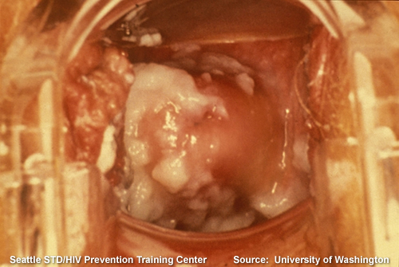
Vaginal Candidiasis: “yeast infection”

Slide 46
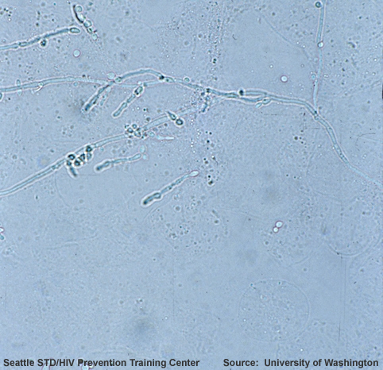
Vaginal Candidiasis
What is it?
  Overgrowth of the yeast called Candida
Description: yeast seen in 10% KOH wet mount
Notes:
Candida albicans is a widespread organism found throughout the world. It exists in small amounts in the vagina, the mouth, the digestive tract, and on the skin without causing disease or symptoms (approximately 25% of women without disease symptoms have this organism present).
Symptoms appear when the number of Candida albicans becomes larger in relation to the other microorganisms that normally inhabit the vagina. Candida albicans grows when the vagina has certain favorable conditions or when it is difficult for other microorganisms to survive. This causes the imbalance that leads to a yeast infection.
Source: http://www.cdc.gov/fungal/Candidiasis/genital/definition.html
46

Slide 47
Candidiasis Symptoms
Females
Experience genital itching or burning, "cottage cheese-like“ discharge
Males
Itchy penile rash
Notes:
Sources:
http://www.cdc.gov/fungal/Candidiasis/genital/symptoms.html

Slide 48
Vaginal Candidiasis
Nearly 75% of women experience at least one “yeast infection” in their lifetime
  Men rarely get genital candidiasis
Transmission
  Most cases caused by person’s own candida organisms
  Less commonly passed through sexual intercourse
Notes:
Source:
Sobel J. Pathogens and treatment of recurrent vulvovaginal candiasis. Clinical Infectious Disease 1992;14:5148–5153.
Nearly 75% of all adult women have had at least one "yeast infection" in their lifetime. On rare occasions, men can also get genital candidiasis. VVC occurs more frequently and more severely in people with weakened immune systems. Other conditions that may put a woman at risk for genital candidiasis include:
Pregnancy
Diabetes
Long-term use of broad-spectrum antibiotics
Use of corticosteroid medications
48

Slide 49
Erica’s Cervix
During the speculum exam you observe Erica’s cervix.
You suspect trichomonas.
How do you definitively diagnose the causes of Erica’s vaginitis.
Image: CDC

Slide 50
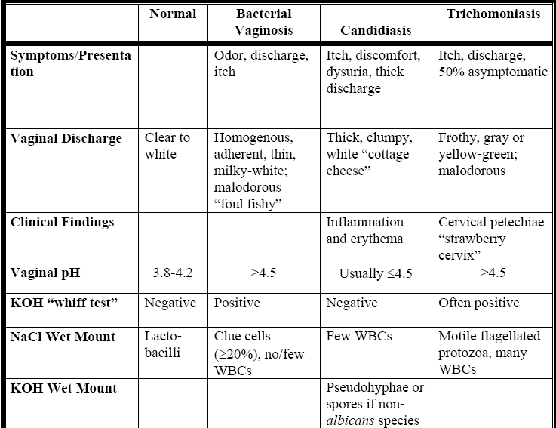
Evaluating Vaginitis
Source: CA STD Training Center
Notes:
*Note that this table includes only three of the more common causes of vaginitis.
Many women with vulvovaginal complaints have other conditions, including
irritant or chemical vulvovaginitis, desquamative interstitial vaginitis, and
lichen planus or lichen simplex chronicus. Genital herpes should also be
considered in the differential when women complain of recurrent pruritic
lesions or vulvar fissures.
Source: https://www.stdhivtraining.org/clinical_resources.html
https://www.stdhivtraining.org/resource.php?id=55&ret=clinical_resources
National Network of STD/HIV Prevention Training Centers
Vaginitis
August 2007
Page 20

Slide 51

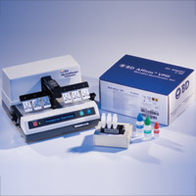
Trichomonas Diagnosis
Sensitivity:
85–90%
Antigen Detection
Sensitivity: 83%
Specificity: 97%
DNA Probe
Wet Mount
Specificity: 100%
Sensitivity: 60-80%
Specificity: >97%
Culture
Specificity: 100%
Sensitivity:
60–70%
Available test: OSOM Rapid Test
Available Test: Affirm™ VP III
No good test for males so often untested
Notes:
51
Diagnosis of vaginal trich is usually performed by microscopy of vaginal secretions but this method has a sensitivity of only ~60–70% and requires immediate evaluation of wet prep slide for optimal results.
The other FDA cleared tests for Trichomonas in women are
OSOM Trichomonas Rapid Test (Genzyme Diagnostics)
immunochromatogenic assay that uses “lateral flow test stick format” to detect Trichomonas antigens directly from vaginal swabs
Performed on vaginal secretions, sensitivity of >83%, specificity of >97%
Point of care diagnostics, FDA cleared
Available in 10minutes
Affirm VP III.
nucleic probe test that evaluates for T. vaginalis, G. vaginalis and C.albicans
Performed on vaginal secretions, sensitivity of >83%, specificity of >97%
Point of care diagnostics, FDA cleared
Available in 45minutes
Although these tests tend to be more sensitive than vaginal wet prep, false positives might occur especially in low prevalence populations.
Amplicor
FDA cleared PCR assay for detection of gonorrhea and chlamydial infections has been modified for T. vaginalis in vaginal or endocervical squabs and in urine from women and men
Sensitivity ranges from 88-97%
Specificity: 98-99%
Culture is the most sensitive and specific commercially available method.
Both the Pap and wet mount are less sensitive than culture (36% to 60% sensitive), although specificity is high (97% for the Pap smear; 100% for wet mount).
Sources: Centers for Disease Control and Prevention. Sexually Transmitted Diseases Treatment Guidelines, 2010. MMWR 2010;59(12):1-116.
Lara-Torre E, Pinkerton JS. Accuracy of detection of trichomonas vaginalis organisms on a liquid-based papanicolaou smear. Am J Obstet Gynecol. 2003;188:354–356.

Slide 52
Candida Diagnosis
Wet Mount
Sensitivity: 35–45%
Specificity: 97–99%
DNA Probe
Sensitivity: 80%
Specificity: 98%
Notes:
Affirm VP III.
nucleic probe test that evaluates for T. vaginalis, G. vaginalis and C.albicans
Performed on vaginal secretions, sensitivity of >83%, specificity of >97%
Point of care diagnostics, FDA cleared
Available in 45minutes
Source: Centers for Disease Control and Prevention. Sexually Transmitted Diseases Treatment Guidelines, 2010. MMWR 2010;59(12):1-116.
A 2007 study was performed to determine the accuracy of rapid vaginal yeast detection assay compared with yeast cultures for the diagnosis of vulvovaginal candidiasis. This was a prospective study that involved 104 subjects—34 asymptomatic women and 70 symptomatic women with vaginitis. Vaginal swabs were obtained from all subjects for wet mount, yeast culture, and the rapid yeast detection test. Overall, the prevalence rate was 39.4%, based on positive yeast cultures. The rapid yeast test performed by the physician was positive in 30 of 41 subjects with positive cultures and 13 of 63 subjects with negative cultures.
The rapid yeast test had 73.1% sensitivity and 82.0% negative predictive value compared with the wet mount, which had 43.9% sensitivity and 70.9% negative predictive value. In symptomatic patients, the test had 77.4% sensitivity and 81% negative predictive value compared with wet mount, which had 51.6% sensitivity. Patient-performed test results were identical to the tests that were performed by the physicians. The cost of the rapid yeast test kit is estimated to be <$10, compared with a mean of $65 for the yeast culture.[i]
A 2004 study was conducted to compare the Affirm VPIII Microbial Identification Test for detection and identification of Candida species, Gardnerella vaginalis and Trichomonas vaginalis to clinical and microscopic criteria commonly used to diagnose vaginitis. The Affirm assay was significantly more likely to identify Gardnerella and Candida than wet mount. 190 (45%) were positive for Gardnerella by Affirm compared to 58 (14%) by wet mount; 45 (11%) were positive for Candida by Affirm compared to 31 (7%) by wet mount; and 30 (7%) were positive for Trichomonas by Affirm compared to 23 (5%) by wet mount. Symptomatic women were significantly more likely to be positive by Affirm only (23% vs. 10%), wet mount only (3% vs. 2%) or Affirm and wet mount (15% vs. 1%). [ii]
[i] Brown HL, Fuller DD, Jasper LT, Davis TE, Wright JD. Clinical evaluation of affirm VPIII in the detection and identification of Trichomonas vaginalis, Gardnerella vaginalis, and Candida species in vaginitis/vaginosis.
Infect Dis Obstet Gynecol. 2004;12(1):17-21.
[ii] Chatwani A, Mehta R, Hassan S, et al. Rapid testing for vaginal yeast detection: a prospective study. Rapid testing for vaginal yeast detection: a prospective study. American Journal of Obstetrics and Gynecology 2007;196:309.

Slide 53
Bacterial Vaginitis Diagnosis
Amsel’s Criteria
Requires the presence of at least three of the following
four criteria:
Whiff test positive for fishy or musty odor when alkaline KOH solution added to smear.
Clue cells (bacteria attached to the borders of epithelial cells,
>20 % of epithelial cells)
Vaginal pH > 4.5
A homogenous noninflammatory discharge
Notes:
Source:
Amsel R, Totten PA, Spiegel CA, Chen KC, Eschenbach D, Holmes KK. Nonspecific vaginitis. Diagnostic criteria and microbial and epidemiologic associations. Am J Med. 1983 Jan;74(1):14–22.
Diagnostic criteria for BV (As per CDC 2010 STD Treatment Guidelines
Affirm VP III (Becton Dickenson, San Jose, California)
-Nucleic acid probe test that evaluates for T. vaginalis, G. vaginalis, and C. albicans.
-Performed on vaginal secretions
-Sensitivity: >83%
-Specificity: >97%
-Point of care diagnostics
-Available in approximately 45minutes
-FDA cleared
- Pip Activity TestCard, Quidel, San Diego, California
-Prolineaminopeptidase test card
-Detects elevated pH and trimethylamine
-Low sensitivity and specificity
-Not recommended
-OSOM BVBlue Test (Genzyme Diagnostics, Cambridge, Massachusetts)
-Detects elevated vaginal fluid sialidase activity, an enzyme produced by bacterial pathogens associated with BV including Gardnerella, Bacteroides, Prevotella and Mobilincus.
-Rapid test results available in 10minutes
Source: Centers for Disease Control and Prevention. Sexually Transmitted Diseases Treatment Guidelines, 2010. MMWR 2010;59(12):1-116.
53

Slide 54

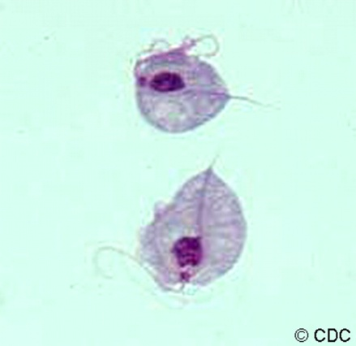

Treatment
  Erica’s final diagnosis is vaginitis related to trichomonas.
  How do you treat her?

Slide 55
Trichomonas: Treatment
Recommended regimen
Metronidazole 2 gm PO x 1
Tinidazole
2 gm PO x 1
Alternative treatment
Metronidazole 500 mg PO BID x 7 days
Treatment failure
Retreat with Metronidazole 500 mg PO BID x 7 days
If repeat failure, treat w/ Tinidazole or Metronidazole 2 gm PO x 5 days
Never use topicals
Notes:
55
Patients should be advised to avoid consuming alcohol during treatment with metronidazole or tinidazole. Abstinence from alcohol use should continue for 24 hours after completion of metronidazole or 72 hours after completion of tinidazole.
The nitroimidazoles comprise the only class of drugs useful for the oral or parenteral therapy of trichomoniasis. Of these drugs, metronidazole and tinidazole are available in the United States and are cleared by the FDA for the treatment of trichomoniasis. In randomized clinical trials, the recommended metronidazole regimens have resulted in cure rates of approximately 90%–95%, and the recommended tinidazole regimen has resulted in cure rates of approximately 86%–100%. The appropriate treatment of sex partners might increase these reported rates. Randomized controlled trials comparing single 2 g doses of metronidazole and tinidazole suggest that tinidazole is equivalent to, or superior to, metronidazole in achieving parasitologic cure and resolution of symptoms (170). Treatment of patients and sex partners results in relief of symptoms, microbiologic cure, and reduction of transmission.
Metronidazole gel is considerably less efficacious for the treatment of trichomoniasis (<50%) than oral preparations of metronidazole. Topically applied antimicrobials (e.g., metronidazole gel) are unlikely to achieve therapeutic levels in the urethra or perivaginal glands; therefore, use of the gel is not recommended. Several other topically applied antimicrobials occasionally have been used for treatment of trichomoniasis; however, these preparations probably do not have greater efficacy than metronidazole gel.
For women with multiple recurrences after completion of a recommended regimen, metronidazole gel twice weekly for 4-6 months has been shown to reduce recurrences, although this benefit might not persist when suppressive therapy is discontinued. Limited data suggest that oral nitroimidazole followed by intravaginal boric acid and suppressive metronidazole gel
Source: Centers for Disease Control and Prevention. Sexually Transmitted Diseases Treatment Guidelines, 2010. MMWR 2010;59(12):58-61.
Centers for Disease Control and Prevention. Sexually transmitted diseases treatment guidelines, 2006. MMWR Recomm Rep 2006 Aug 4; 55:1–94.

Slide 56
Trichomonas: Partner Management
Sex partners of patients with T. vaginalis should be treated.
Patients should be instructed to avoid sex until they and their sex partners are cured.

Slide 57
How would you treat if Erica was diagnosed with BV?
Recommended regimen
Metronidazole 500 mg PO x BID x 7 days
Alternative treatment
Clindamycin 300 mg PO BID x 7 days
Metronidazole gel, 0.75%, 1 full applicator (5 g) PV OD x 5 days
Clindamycin cream, 2%, 1 full applicator (5 g) PV QHS x 7 days
Clindamycin ovules 100 mg PV QHS x 3 days
Tinidazole 2g PO OD x 2 days
Tinidazole 1g PO OD x 5 days
Notes:
The results of two randomized controlled trials have indicated that treatment of BV with metronidazole substantially reduced postabortion PID. Three trials that evaluated the use of anaerobic antimicrobial coverage (i.e., metronidazole) for routine operative prophylaxis before abortion and seven trials that evaluated this additional coverage for women undergoing hysterectomy demonstrated a substantial reduction in postoperative infectious complications. Because of the increased risk for postoperative infectious complications associated with BV, some specialists suggest that before performing surgical abortion or hysterectomy, providers should screen for and treat women with BV in addition to providing routine prophylaxis. However, more information is needed before recommending treatment of asymptomatic BV before other invasive procedures.
Patients should be advised to avoid consuming alcohol during treatment with metronidazole and for 24 hours thereafter. Clindamycin cream is oil-based and might weaken latex condoms and diaphragms for five days after use. Refer to clindamycin product labeling for additional information. Topical clindamycin preparations should not be used in the second half of pregnancy.
The recommended metronidazole regimens are equally efficacious. One randomized trial evaluated the clinical equivalency of intra-vaginal metronidazole gel 0.75% once daily versus twice daily and demonstrated similar cure rates one month after therapy.
Source:
Centers for Disease Control and Prevention. Sexually Transmitted Diseases Treatment Guidelines, 2010. MMWR 2010;59(12):58-61.

Slide 58
BV Diagnosis: Partner Management
Clinical trials indicate that a woman’s response to therapy and likelihood of relapse or recurrence are not affected by treatment of her sex partner(s).
Routine treatment of sex partners is not recommended.

Slide 59
How would you treat if Erica was diagnosed with Candida?
Over-The-Counter Intravaginal Agents
Butoconazole 2% cream 5g PV x 3days
Prescription Intravaginal Agents
Butoconazole 2% cream (single dose bioadhesive product), 5g, PV x 1 day
Clotrimazole 1% cream 5g PV x 7-14days
Clotrimazole 2% cream 5g PV x 3 days
Miconazole 2% 5g PV x 7days
Miconazole 4% cream 5g PV x 3 days
Miconazole 100mg vaginal suppository, one suppository for 7 days
Miconazole 200mg vaginal suppository, one suppository for 3 days
Miconazole 1200mg vaginal suppository, one suppository for 1 days
Tioconazole 6.5% ointment 5g PV in a single application
Nystatin 100,000- unit vaginal tablet, one tablet for 14 days
Terconazole 0.4% 5g PV x 7 days
Terconazole 0.8% cream 5g PV x 3days
Terconazole 80mg vaginal suppository, one suppository for 3 days
Notes:
Centers for Disease Control and Prevention. Sexually Transmitted Diseases Treatment Guidelines, 2010. MMWR 2010;59(12):1-116

Slide 60
Treatment for Candida
Oral Agents
Fluconazole 150 mg oral tablet, one tablet in single dose
Notes:
Centers for Disease Control and Prevention. Sexually Transmitted Diseases Treatment Guidelines, 2010. MMWR 2010;59(12):1-116

Slide 61
Candida: Partner Management
Not usually acquired through sexual intercourse
Treatment of sex partners not recommended—may be considered in women who have recurrent infection
Minority of male sex partners might have balanitis—may benefit from treatment with topical antifungal agents
Notes:
Management of Sex Partners
VVC is not usually acquired through sexual intercourse; no data support the treatment of sex partners. A minority of male sex partners might have balanitis, which is characterized by erythematous areas on the glans of the penis in conjunction with pruritus or irritation. These men benefit from treatment with topical antifungal agents to relieve symptoms.
Source: Centers for Disease Control and Prevention. Sexually Transmitted Diseases Treatment Guidelines, 2010. MMWR 2010;59(12):1-116

Slide 62

Additional Concerns
Because she is a sexually active 16 year old, she is also at risk for cervicitis.
What are the most common identifiable causes of cervicitis?
  Chlamydia
  Gonorrhea

Slide 63
Chlamydia
Curable bacterial STI
Most common reportable communicable disease
Highest reported rates among adolescent females
Usually asymptomatic
Notes:
Chlamydia continues to be the most commonly reported nationally notifiable disease with 1,422,976 cases reported in 2012. For the first time since 1995, chlamydia case rates among females did not increase. For the first time since 2000, Chlamydia case rates decreased among both males and females aged 15–19 years. However, both test positivity and the number of reported cases of C. trachomatis infections remain high among most age groups, racial/ethnic groups, geographic areas, and both sexes. Racial differences also persist; reported case rates and prevalence estimates among blacks continue to be substantially higher than among other racial/ethnic groups.
A large number of cases are not reported because most people with chlamydia are asymptomatic and do not seek testing.
Chlamydia is most common among young people. Chlamydia prevalence among sexually-active young persons aged 14-24 years is nearly three times the prevalence among persons aged 25-39 years.⁴ It is estimated that 1 in 15 sexually active females aged 14-19 years has chlamydia.⁵
Source: http://www.cdc.gov/std/stats12/chlamydia.htm
Source: http://www.cdc.gov/std/chlamydia/STDFact-chlamydia-detailed.htm

Slide 64
Chlamydia—Rates by Sex, United States, 1992–2012
2011-Fig 1. SR
Notes:
In 2012, a total of 1,422,976 chlamydial infections were reported to CDC in 50 states and the District of Columbia (Table 1). This case count corresponds to a rate of 456.7 cases per 100,000 population, only a 0.7% increase compared with the rate of 453.4 in 2011. During 1992–2012, the rate of reported chlamydial infection increased from 182.3 to 456.7 cases per 100,000 population (Figure 1, Table 1).
**NOTE: As of January 2000, all 50 states and the District of Columbia have regulations that require the reporting of chlamydia cases.
Chlamydia by Sex
During 1995–2011, chlamydia rates among females increased each year (Figure 1). In 2012, the overall rate of reported chlamydial infection among women in all 50 states and the District of Columbia (643.3 cases per 100,000 females) was similiar to the reported case rate in 2011 (643.4 cases per 100,000 females). This is the first time since nationwide reporting began in 1995 that chlamydia case rates among females did not increase.
The overall case rate among males increased 3.2% during 2011–2012 (254.4 to 262.6 cases per 100,000 males). As in previous years, the reported case rate among females was about two times the case rate among men in 2012, likely reflecting a larger number of women screened for this infection (Figure 1, Tables 4 and 5). The lower rates among men also suggest that many of the sex partners of women with chlamydia are not receiving a diagnosis of chlamydia or being reported as having chlamydia.
However, with the advent of highly sensitive nucleic acid amplification tests (NAATs) that can be performed on urine, chlamydial infection is increasingly being diagnosed in symptomatic and asymptomatic men. During 2008–2012, the reported chlamydial infection rate among men increased 25.5% (from 209.3 to 262.6 cases per 100,000 males) compared with a 11.0% increase among women during the same period (from 579.4 to 643.3 cases per 100,000 females).
During 2002–2011, chlamydia rates increased in all regions (Figure 2). In 2011, rates were highest in the South (505.3 per 100,000 population), followed by the Midwest (445.7), the West (424.9), and the Northeast (415.8) (Table 3).
Source: http://www.cdc.gov/std/stats12/chlamydia.htm
Centers for Disease Control and Prevention. Sexually transmitted diseases treatment guidelines, 2010; No.59(RR-12):1-110. Erratum in: MMWR Recomm Rep. 2011;60(1):18.

Slide 65
Chlamydia—Rates by Age and Sex, United States, 2012
2011-Fig 5. SR
Notes:
Source: http://www.cdc.gov/std/stats12/chlamydia.htm
Chlamydia by Age
Among women, the highest age-specific rates of reported chlamydia in 2012 were among those aged 15–19 years (3,291.5 cases per 100,000 females) and 20–24 years (3,695.5 cases per 100,000 females) (Figure 5, Table 10). Within these age ranges, reported rates were highest among women aged 18 years (4,666.3 cases per 100,000 females), aged 19 years (4,921.1 cases per 100,000 females), and aged 20 years (4,647.5 cases per 100,000 females) (Table 12). After increasing steadily from 2000 to 2011, during 2011–2012, rates among women aged 15–19 years decreased 5.6% (3,485.2 to 3,291.5 cases per 100,000 females). Rates increased slightly (1.8%) among women aged 20–24 years (3,630.0 to 3,695.5 cases per 100,000 females) during 2011–2012.
Age-specific rates among men, although substantially lower than the rates among women, were highest in those aged 20–24 years (1,350.4 cases per 100,000 males) (Figure 5, Table 10). Similar to trends in women, after increasing for the last decade, during 2011–2012 reported case rates among men aged 15–19 years decreased 5.1% (816.3 to 774.8 cases per 100,000 males). During 2011–2012, reported cases among men aged 20–24 years increased slightly (1,307.8 to 1350.4 cases per 100,000 males).

Slide 66
Chlamydia—Rates by Race/Ethnicity, United States, 2008-2012
2011-Fig O. SR
Notes:
**AI/AN=American Indians/Alaska Natives;
**A/PI=Asians/Pacific Islanders
Among the 48 jurisdictions (47 states and the District of Columbia) that submitted data in the new race and ethnicity categories in 2012 according to the revised OMB standards, chlamydia rates were highest among black men and women (Figure L, Table 11B). The rate of chlamydia among blacks was almost seven times the rate among whites (1,229.4 and 179.6 cases per 100,000 population, respectively). The rate among American Indians/Alaska Natives (728.2 cases per 100,000) was 4.1 times the rate among whites. The rate among Hispanics (380.3 cases per 100,000) was 2.1 times the rate among whites. The rate among Native Hawaiians/Other Pacific Islanders (590.4 cases per 100,000) was 3.3 times the rate among whites. The rate among Asians was lower than the rate among whites (112.9 cases and 179.6 cases per 100,000, respectively).
Among the 39 jurisdictions (38 states and the District of Columbia) that submitted data in the new race and ethnicity categories from 2008–2012 according to the OMB standards, rates among blacks increased 3.7% (from 1,186.5 to 1,230.6 cases per 100,000). Among whites, rates increased 38.5% (from 134.4 to 186.2 cases per 100,000) (Figure 6).
Source: http://www.cdc.gov/std/stats12/chlamydia.htm

Slide 67
Chlamydia Symptoms
Females:
Up to ~80-90% asymptomatic
Heavy or prolonged menses
Spotting
Dysmenorrhea
Dyspareunia
Vaginal discharge
Penile discharge
Dysuria
Males: Up to 90% asymptomatic
Notes:
About 80%–90% of chlamydial infections¹⁰ and up to 80% of gonococcal infections¹¹ in women are asymptomatic.
Source: Stamm WE. Chlamydia trachomatis infections in the adult. In: Holmes KK, Sparling PF, Stamm WE, Piot P, Wasserheit JN, Corey L, et al, (editors). Sex Transm Dis. 4th ed. New York: McGraw-Hill; 2008:575-93.
Estimates of the proportion of chlamydia-infected people who develop symptoms vary by setting and study methodology; two published studies that incorporated modeling techniques to address limitations of point prevalence surveys estimated that only about 10% of men and 5-30% of women with laboratory-confirmed chlamydial infection develop symptoms.^{21,22}
http://www.cdc.gov/std/chlamydia/STDFact-chlamydia-detailed.htm
Based on this information, up to 90% of males are asymptomatic and up to 70- 95% of females are asymptomatic….

Slide 68
Sequelae Untreated Chlamydia: Females
Symptomatic PID occurs in 10-15% of women with untreated Chlamydia
Increased risk HIV transmission
Notes:
Women infected with C. trachomatis or N. gonorrhoeae can develop PID, which, in turn, can lead to reproductive system morbidity such as ectopic pregnancy and tubal factor infertility.
Among women with PID, tubal scarring can cause infertility in 20% of women, ectopic pregnancy in 9%, and chronic pelvic pain in 18%.⁹
Source: http://www.cdc.gov/std/stats11/womenandinf.htm
In women, untreated chlamydia can spread into the uterus or fallopian tubes and cause pelvic inflammatory disease (PID). Symptomatic PID occurs in about 10 to 15 percent of women with untreated chlamydia.^{30,31} However, chlamydia can also cause subclinical inflammation of the upper genital tract (“subclinical PID”). Both acute and subclinical PID can cause permanent damage to the fallopian tubes, uterus, and surrounding tissues.
30. Haggerty CL, Gottlieb SL, Taylor BD, Low N, Xu F, Ness RB. Risk of sequelae after Chlamydia trachomatis genital infection in women. The Journal of infectious diseases 2010;201 Suppl 2:S134-55.
31. Oakeshott P, Kerry S, Aghaizu A, et al. Randomised controlled trial of screening for Chlamydia trachomatis to prevent pelvic inflammatory disease: the POPI (prevention of pelvic infection) trial. BMJ (Clinical research ed) 2010;340:c1642.
The vague symptoms associated with chlamydial and gonococcal PID cause 85% of women to delay seeking medical care, thereby increasing the risk of infertility and ectopic pregnancy. [i] [ii]
Untreated chlamydia may increase a person’s chances of acquiring or transmitting HIV – the virus that causes AIDS.³⁶
36. Fleming DT, Wasserheit JN. From epidemiological synergy to public health policy and practice: the contribution of other sexually transmitted diseases to sexual transmission of HIV infection. Sexually transmitted infections 1999;75:3-17.
http://www.cdc.gov/std/chlamydia/STDFact-chlamydia-detailed.htm
Source: Westrom L, Joesoef R, Reynolds G, Hagdu A, Thompson SE. Pelvic inflammatory disease and fertility: a cohort study of 1,844 women with laparoscopically verified disease and 657 control women with normal laparoscopy. Sex Transm Dis. 1992;9:185-92.
About 80%–90% of chlamydial infections¹⁰ and up to 80% of gonococcal infections¹¹ in women are asymptomatic. These infections are detected primarily through screening. The symptoms associated with PID are vague so 85% of women with PID delay seeking medical care, thereby increasing the risk for infertility and ectopic pregnancy.¹² Data from a randomized controlled trial of chlamydia screening in a managed care setting suggest that such screening programs can reduce the incidence of PID by as much as 60%.¹³
Source: Hillis SD, Joesoef R, Marchbanks PA, Wasserheit JN, Cates W Jr, Westrom L. Delayed care of pelvic inflammatory disease as a risk factor for impaired fertility. Am J Obstet Gynecol. 1993;168:1503-9.
Source:
[i] Source: Center for Disease Control and Prevention. STD Surveillance, 2011: Women and Infants. http://www.cdc.gov/std/stats/womenandinf.htm
[ii] Hills SD Wasserheit JN. Screening for Chlamydia – A Key to The Prevention of Pelvic Inflammatory Disease. New England Journal of Medicine. 1996;334(21):1399–1401.
[iii] Fleming DT, Wasserheit IN. From Epidemiological synergy to public health policy and practice: the contribution of other sexually transmitted diseases to sexual transmission of HIV infection. Sex Transm Inf 1999;75:3–17

Slide 69
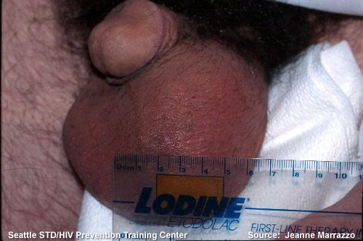
Sequelae Untreated Chlamydia:
Males
Epididymitis
Reactive Arthritis
HIV transmission
Proctitis
Notes:
Men who are symptomatic typically have urethritis, with a mucoid or watery urethral discharge and dysuria. A minority of infected men develop epididymitis (with or without symptomatic urethritis), presenting with unilateral testicular pain, tenderness, and swelling.²⁴
24. Berger RE, Alexander ER, Monda GD, Ansell J, McCormick G, Holmes KK. Chlamydia trachomatis as a cause of acute "idiopathic" epididymitis. The New England journal of medicine 1978;298:301-4.
Reactive arthritis can occur in men and women following symptomatic or asymptomatic chlamydial infection, sometimes as part of a triad of symptoms (with urethritis and conjunctivitis) formerly referred to as Reiter’s Syndrome.³⁵
Epididymitis is infection or less frequently, inflammation of the epididymis. In men younger than about 39 years of age, the causes are usually the bacterial organisms Chlamydia trachomatis and Neisseria gonorrhea (responsible for nearly 50%–60% of cases). In general, individuals have discomfort and pain in the area of the testicle(s) or groin; some may develop fever, penile discharge and blood in the urine.
Reiter's syndrome is a triad of symptoms that include conjunctivitis, polyarthritis, and genital inflammation. The disease is associated with HLA-B27. Approximately 50%–65% of patients have an acute C. trachomatis infection at the onset of arthritis and greater than 80% have serological evidence for C. trachomatis infection. Other infections (shigellosis or Yersinia enterocolitica) have also been associated with Reiter's syndrome.
Proctitis is defined as inflammation of the anus and lining of the rectum. Symptoms can vary greatly and can include pain during bowel movement, bleeding, discharge, and anal discomfort.
Source: http://www.cdc.gov/std/chlamydia/stdfact-chlamydia.htm

Slide 70
Chlamydia Screening: Sexually Active Females
Sexually active females 25 and under: Screened annually
Repeat testing 3–4 months after treatment due to high rate of re-infection
AAP and CDC Recommendations
Notes:
CDC recommends yearly chlamydia screening of all sexually active women age 25 or younger and older women with risk factors for chlamydial infections (e.g., women who have a new or more than one sex partner).⁴⁰ Pregnant women should be screened during their first prenatal care visit.
Data from a randomized controlled trial of Chlamydia screening in a managed care setting suggest that screening programs can lead to a reduction in the incidence of PID by as much as 60%.[i]
Chlamydia screening and reporting are likely to expand further in response to the recently implemented Health Plan Employer Data and Information Set (HEDIS) measure for Chlamydia screening of sexually active women 15–25 years of age who receive medical care through managed care organizations.
Test of cure is not recommended for all non-pregnant patients because the NAAT tests can remain positive for up to three weeks. Test of cure (at three weeks post completion of therapy) is recommended in all pregnant patients.
Sources:
[i] Scholes D, Stergachis A, Heidrich FE, Andrilla H, Holmes KK, Stamm WE. Prevention of pelvic inflammatory disease by screening for cervical chlamydial infection. N Engl J Med 1996;34(21): 1362–66.
40. Workowski KA, Berman S, Centers for Disease C, Prevention. Sexually transmitted diseases treatment guidelines, 2010. MMWR Recommendations and reports : Morbidity and mortality weekly report Recommendations and reports / Centers for Disease Control 2010;59:1-110.
http://www.cdc.gov/std/chlamydia/STDFact-chlamydia-detailed.htm

Slide 71
Chlamydia Screening: Males
Routine Screening NOT recommended for Men
Correctional facilities
STD clinics
Selective screening in high-prevalence populations should be considered
Adolescent-serving clinics
MSM
Multiple partners
AAFP, CDC, USPSTF, AAP Recommendations
Notes:
Routinely screening adolescents who are asymptomatic for certain STDs (e.g., syphilis, trichomoniasis,
BV, HSV, HPV, HAV, and HBV) is not recommended. However, young men who have sex with men and
pregnant adolescent females might require more thorough evaluation.
Source: http://www2.aap.org/sections/adolescenthealth/pdfs/STD%20Article%20Feb%202011.pdf
Routine screening is not recommended for men. However, the screening of sexually active young men should be considered in clinical settings with a high prevalence of chlamydia (e.g., adolescent clinics, correctional facilities, and STD clinics) when resources permit and do not hinder screening efforts in women.⁴⁰
40. Workowski KA, Berman S, Centers for Disease C, Prevention. Sexually transmitted diseases treatment guidelines, 2010. MMWR Recommendations and reports : Morbidity and mortality weekly report Recommendations and reports / Centers for Disease Control 2010;59:1-110.

Slide 72
Chlamydia Summary
Reported # of cases higher among women
Higher rates among15-19 and 20-24 year old females
  could be due to screening recommendations
Racial disparities persist
  Reported rates/prevalence higher among blacks compared to other racial/ethnic groups
Notes:
Source: http://www.cdc.gov/std/stats12/chlamydia.htm

Slide 73
Additional Concerns
Because Erica is a sexually active 16 year old, she is also at risk for cervicitis.
What are the most common causes of cervicitis?
  Chlamydia
  Gonorrhea

Slide 74
Gonorrhea
Curable bacterial STI
Second most commonly reported disease
Found in the cervix, uterus, fallopian tubes, and the urethra
Can also be found in the mouth, throat, eyes, and anus
Notes:
Gonorrhea is a curable sexually transmitted infection (STI) caused by bacteria called Neisseria gonorrhoeae. These bacteria can infect the genital tract, mouth, and rectum of both men and women. It is the second most commonly reported disease in the United States.
In women, the opening to the uterus—the cervix—is the first place of infection. The disease can spread into the uterus and fallopian tubes, resulting in pelvic inflammatory disease (PID). PID affects more than one million women in this country every year and can cause ectopic pregnancy and infertility in as many as 10% of infected women.
Source: National Institute of Allergy and Infectious Diseases. Gonorrhea: Fact Sheet. National Institute of Allergy and Infectious Diseases, Washington DC: 2004. Accessed July 10, 2006 at: http://www.niaid.nih.gov/factsheets/stdgon.htm
http://www.cdc.gov/std/gonorrhea/STDFact-gonorrhea.htm

Slide 75
UPDATE:
Gonorrhea Case Definition
JANUARY 2014
Physician diagnosis no longer establishes a case of gonorrhea
Cases must have laboratory evidence of gonococcal infection, as defined by the surveillance case definitions.
Not anticipated to have any impact upon program activity.
Notes:
Gonorrhea (effective January 1, 2014)
Clinical description
A sexually transmitted infection commonly manifested by urethritis, cervicitis, proctitis, salpingitis,
or pharyngitis. Infection may be asymptomatic.
Laboratory Criteria for Diagnosis
• Observation of gram-negative intracellular diplococci in a urethral smear obtained from a male or
an endocervical smear obtained from a female, or
• Isolation of typical gram-negative, oxidase-positive diplococci by culture (presumptive Neisseria
gonorrhoeae) from a clinical specimen, or
• Demonstration of N. gonorrhoeae in a clinical specimen by detection of antigen or nucleic acid
Case Classification
Probable: demonstration of gram-negative intracellular diplococci in a urethral smear obtained
from a male or an endocervical smear obtained from a female
Confirmed: a person with laboratory isolation of typical gram-negative, oxidase-positive diplococci
by culture (presumptive Neisseria gonorrhoeae) from a clinical specimen, or demonstration of N.
gonorrhoeae in a clinical specimen by detection of antigen or detection of nucleic acid via nucleic
acid amplification (e.g., PCR) or hybridization with a nucleic acid probe
Sources: http://www.cdc.gov/std/stats/CaseDefinitions-2014.pdf
Source: http://www.cdc.gov/std/stats/CaseDef-ProgramImpact-2014.pdf

Slide 76
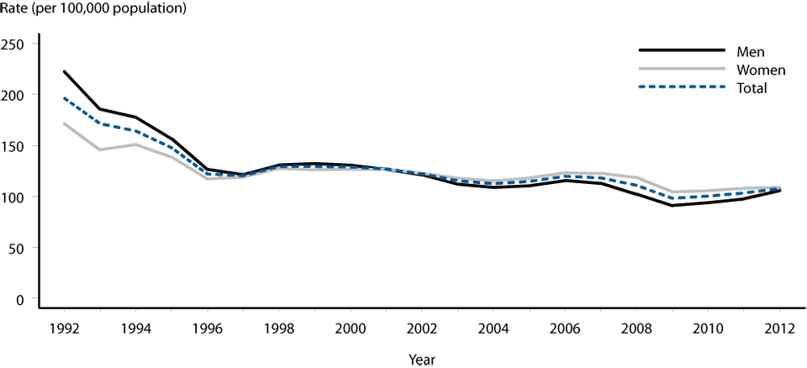
Gonorrhea—Rates by Sex, United States, 1992–2012
2011-Fig 17. SR
Notes:
Gonorrhea rates among women have been slightly higher than those among men since 2001 (Figure 12). During 2011–2012, the gonorrhea rate among women increased 0.6%, to 108.7 cases per 100,000
population, and the rate among men increased 8.3%, to 105.8 per 100,000 population (Tables 15 and 16).
The magnitude of the increase among men compared to women is suggestive of either increased transmission or increased case ascertainment (e.g., through increased extra-genital screening) among men who have sex with men (MSM).
However, most jurisdictions do not routinely report sex of sex partners or site of infection for gonorrhea cases, so trends in gonorrhea rates among MSM cannot be assessed.
Source: http://www.cdc.gov/std/stats12/Surv2012.pdf

Slide 77
Gonorrhea—Rates by Age and Sex, United States, 2012
Notes:
In 2012, gonorrhea rates were highest among adolescents and young adults.
In 2012, the highest rates were observed among women aged 20–24 years (578.5) and 15–19 years (521.2). Among men, the rate was highest among those aged 20–24 years (462.8) (Figure 16, Table 21).
During 2011–2012, gonorrhea rates increased among most age groups within this age range: the gonorrhea rate increased 3.1% among those aged 20–24 years, 9.8% among those aged 25–29 years, 15.7% among
those aged 30–34 years, 14.7% among those aged 35–39 years, and 13.0% among those aged 40–44 years (Table 21).
The gonorrhea rate decreased 7.5% among those aged 15–19 years.
Source: http://www.cdc.gov/std/stats12/Surv2012.pdf
Source: http://www.cdc.gov/std/stats12/slides.htm

Slide 78
Gonorrhea—Rates by Race/Ethnicity and Sex, U.S., 2011
63% all reported GC cases occurred among blacks
GC rate among blacks 15 times rate among whites
http://www.cdc.gov/std/stats11/minorities.htm
Notes:
In 2012, among the 48 jurisdictions (47 states and the District of Columbia) that submitted data in the new race and ethnic categories according to the revised Office of Management and Budget (OMB) standards,
gonorrhea rates remained highest among blacks (462.0 cases per 100,000 population) (Table 22B).
The rate among blacks was 14.9 times the rate among whites (31.0 per 100,000 population). The gonorrhea rate among American Indians/Alaska Natives (124.9) was 4.0 times that of whites, the rate among Native
Hawaiians/Other Pacific Islanders (87.8) was 2.8 times that of whites, the rate among Hispanics (60.4) was 1.9 times that of whites, and the rate among Asians (16.9) was 0.5 times that of whites (Table 22B).
During 2008–2012, among the 39 jurisdictions (38 states and the District of Columbia) that submitted data in the new race and ethnic categories for all five years during that period, gonorrhea rates increased
among American Indians/Alaska Natives (61.8%), Native Hawaiians/Pacific Islanders (33.5%), whites
(22.9%), and Asians (14.5%). During this same time period, the gonorrhea rate decreased among blacks 15.5%) (Figure 19).
In 2012, 63% of reported gonorrhea cases with known race/ethnicity occurred among blacks (excluding cases with missing information on race or ethnicity, and cases whose reported race or ethnicity was other) (Table 22A). The rate of gonorrhea among blacks in 2012 was 462.0 cases per 100,000 population, which was 14.9 times the rate among whites (31.0 per 100,000) (Table 22B). This disparity has decreased slightly in recent years (Figure M). This disparity was larger for black men (16.2 times) than for black women (13.8 times) (Figure N, Table 22B).
Source: http://www.cdc.gov/std/stats12/minorities.htm
Source: http://www.cdc.gov/std/stats12/slides.htm
Source: http://www.cdc.gov/std/stats12/Surv2012.pdf

Slide 79
Transmission
Efficiently transmitted by
  Male to female via semen
  Vagina to male urethra
  Rectal intercourse
  Fellatio (pharyngeal infection)
  Perinatal transmission (mother to infant)
Gonorrhea associated with increased transmission of and susceptibility to HIV infection
Notes:
Source: Gale Burstein slides

Slide 80
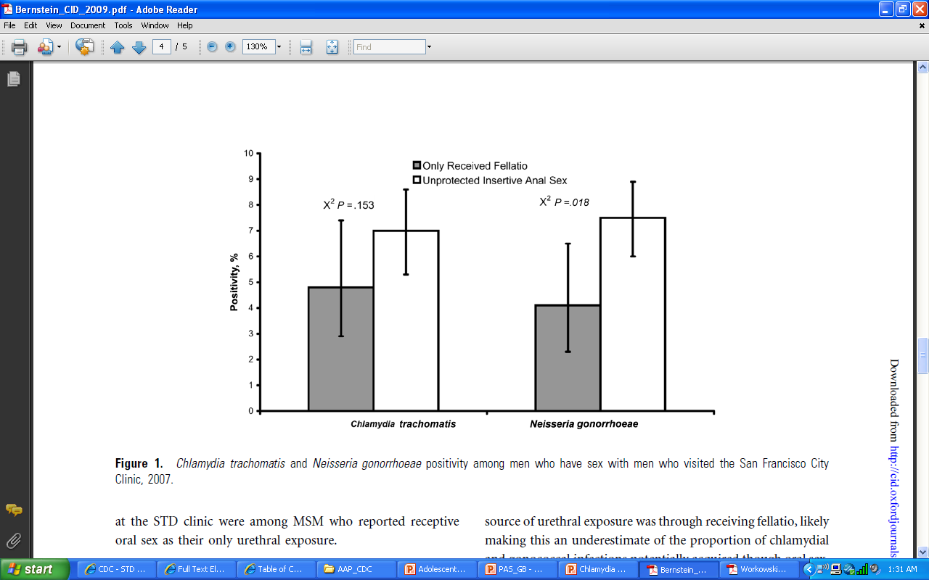
Bernstein KT, et al. CID 2009; 49:1793–7

Slide 81
Gonorrhea Symptoms
Females:
~50% are asymptomatic
Yellow or bloody vaginal discharge
Burning/Painful urination
Bleeding with vaginal intercourse
Males: Up to 50% asymptomatic
White, yellow/green pus from the penis with pain
Burning during urination
Swollen/painful testicles
Notes:
http://www.niaid.nih.gov/topics/gonorrhea/understanding/Pages/symptoms.aspx

Slide 82
Clinical Manifestations
Males
Females

Slide 83
Male Genital Infection
Urethritis – Inflammation of urethra
Epididymitis – Inflammation of the epididymis

Slide 84
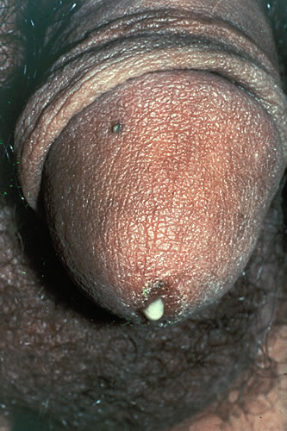
Gonococcal Urethritis: Purulent Discharge
Source: Seattle STD/HIV Prevention Training Center at the University of Washington:
Connie Celum and Walter Stamm

Slide 85

Swollen or Tender Testicle (Epididymitis)
Source: Seattle STD/HIV Prevention Training Center at the University of Washington

Slide 86
Female Genital Infection
Most infections asymptomatic
Cervicitis – inflammation of the cervix
Urethritis – inflammation of the urethra

Slide 87
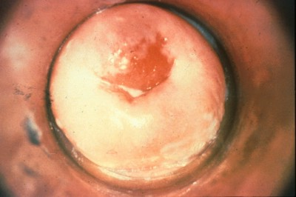
Gonococcal Cervicitis
Source: CDC/NCHSTP/Division of STD Prevention, STD Clinical Slides

Slide 88
Sequelae of Untreated Gonorrhea
PID
Infertility
Ectopic Pregnancy
HIV
Cramps and Pain, vomiting, fever
Can lead to
Rare
Prostate Complications
Epididymis
HIV
Left Untreated
Notes:
10%–20% of women with gonorrhea develop ascending infection that causes acute salpingitis with or without endometritis, also known as PID. Presentations may range from no symptoms to severe abdominal pain with a high fever. PID can negatively affect fertility, causing infertility in 15% of patients; 50% of patients who have three or more episodes of PID develop infertility.
The Centers for Disease Control and Prevention (CDC) recommends that physicians maintain a low threshold for diagnosing PID because of significant negative sequelae associated with this infection. The CDC currently recommends empiric treatment of PID in women with uterine and adnexal tenderness or cervical motion tenderness if they are at risk of sexually transmitted infections and no other causes can be identified.
In men, gonorrhea can cause epididymitis, though sequelae are rare.
Rarely, untreated gonorrhea can spread through the blood to the joints. This can cause an inflammation of the joints.
There is also an increased risk of HIV with infection.
Sources:
National Institute of Allergy and Infectious Diseases. Gonorrhea: Fact Sheet. National Institute of Allergy and Infectious Diseases, Washington DC: 2004. Accessed July 10, 2006 at: http://www.niaid.nih.gov/factsheets/stdgon.htm
Miller K. Diagnosis and Treatment of Neisseria gonorrhoeae Infections. Am Fam Physician. 2006; 73.

Slide 89
Gonorrhea Screening: Females
Annual screening for sexually active females at high risk including:
Under age 25 yrs
History of STI
Multiple or new sexual partners
Inconsistent condom use
Areas of high prevalence
AAFP, CDC, USPSTF, AAP Recommendations
Notes:
Source:
Centers for Disease Control and Prevention. Sexually Transmitted Diseases Treatment Guidelines, 2010. MMWR 2010;59(12):1-116
http://www.cdc.gov/std/treatment/2010/gonococcal-infections.htm
http://www.uspreventiveservicestaskforce.org/uspstf/uspsgono.htm
Screen all sexually active ♀ if at ↑ risk for infection
i.e., young (<25 yrs), previous gonorrhea or other STIs, new or multiple sexual partners, inconsistent condom use, sex work, drug use
Risk factors for pregnant ♀ = non-pregnant ♀
African Americans and MSM have higher prevalence of infection than the general population in many communities and settings
Insufficient evidence to recommend for or against routine gonorrhea screening ♂ at ↑ risk
No routine gonorrhea screening ♀ and ♂ at ↓ risk

Slide 90
USPSTF GC Risk Factors
♀ & ♂ < 25 yrs are highest risk for GC
Population-based factors:
  residence in urban communities and communities with ↑ poverty rates
  GC prevalence varies widely among communities & patient populations
    African Americans and MSM have higher prevalence of infection
Notes:
Local public health provide guidance to clinicians to help identify populations at ↑ risk in their communities.
Individual risk depends on local epidemiology of disease.
Clinicians may consider other population-based risk factors, i.e., residence in urban communities and communities with ↑ poverty rates
In communities w/ ↑ GC prevalence, broader screening of sexually active young people may be warranted, especially in settings serving individuals who are ↑ risk.
Low community GC prevalence may justify more targeted screening

Slide 91
♂ Routine gonorrhea screening
AAP (draft) | MSM (Q₃₋₆ mo if ↑ risk); Contact in past 60 days; Consider screening on basis of individual and population based risk factors (persons of color, ↑ community prevalence)
AAFP | Insufficient evidence to recommend for or against routine GC screening for in ♂ at ↑increased risk for infection
CDC | MSM, contact in past 60 days
USPSTF* | Insufficient evidence to recommend for or against routine GC screening for in ♂ at ↑increased risk for infection
*Update in Progress
Notes:
A recent study has shown that residential segregation of black populations contributes to the large racial disparity for youth by creating distinct social networks that perpetuate the persistence of their endemically gonorrhea high rates.46 Rates for American Indian/Alaskan native and Hispanic populations are between the rates for non-Hispanic black and non-Hispanic white populations.
The 2010 CDC STD testing and treatment guidelines list GC recommendations for MSM that include annual urethral, rectal (if engages in receptive oral sex in the past year). More frequent GC screening is recommended for MSM with high risk behaviors.
-Tests for urethral infection in men who have had insertive intercourse during the preceding year
-Test for rectal infections in men who have had receptive anal intercourse during the preceding year.
-Most frequent STD screening (3-6month intervals) indicated for MSM who have had multiple or anonymous partners and sex in conjunction with illicit drug use or whose sex partners participates in these activities.
Source:
Centers for Disease Control and Prevention. Sexually Transmitted Diseases Treatment Guidelines, 2010. MMWR 2010;59(12):1-116
http://www.cdc.gov/std/treatment/2010/gonococcal-infections.htm

Slide 92

Case: Evaluating Cervicitis
How do you evaluate Erica for cervicitis?

Slide 93
Chlamydia/Gonorrhea NAAT Screening
Preferred Genitourinary Specimens
♀: Self-collected Vaginal swab is preferred
  Urine samples acceptable
    ↓ performance compared to genital swabs
♂: Urine is the preferred specimen
  Urethral swab samples ↓ sensitive than urine
www.aphl.org/aphlprograms/infectious/std/Documents/CTGCLabGuidelinesMeetingReport.pdf
Notes:
While there is a great deal of choice in terms of sample type, the preferred specimens for gonorrhea screening for females is a self-collected vaginal swab, if possible. Urine is still a good specimen, but vaginal swabs perform a little better. For males, the preferred specimen is urine.

Slide 94
MSM Recommended HIV/STI Screening
Urethral N. gonorrhoeae and C. trachomatis in men who have insertive intercourse;
  urine NAAT is preferred;
Rectal N. gonorrhoeae and C. trachomatis in men who have receptive anal intercourse
  NAAT of rectal swab is preferred
Pharyngeal N. gonorrhoeae in men who have receptive oral intercourse
  NAAT of oral swab is preferred
  pharyngeal C. trachomatis asymptomatic screening not recommended
www.cdc.gov/std/treatment/2010/specialpops.htm#msm

Slide 95
Nucleic Acid
Amplified Tests (NAAT)
Markedly amplifies target nucleic acids
Increases sensitivity to >90% for cervical and urethral swabs
All can be used on first 10–15 cc of urine specimens from men and women (Must be > 2 hours after last void)
Self-collected vaginal swabs offer another sensitive specimen
Notes:
NAATs are recommended for detection of reproductive tract infections caused by C. trachomatis and N. gonorrhoeae infections in men and women with and without symptoms.
Urine is the preferred specimen type for testing males using NAATs.
FDA cleared for testing urine, cervical and urethral specimens.
Vaginal swabs are equal or superior to endocervical swabs or urine when processed with NAATs for the detection of C. trachomatis and N. gonorrhoeae in women. Vaginal swabs are therefore the preferred sample type for screening
NAATs have superior performance to culture for the detection of rectal and pharyngeal infections caused by C. trachomatis and N. gonorrhoeae. However, these specimen types have not been cleared by the FDA for use with NAATs and laboratories must establish performance specifications to satisfy CMS regulations for CLIA compliance prior to reporting results for patient management.
Some labs have bet requires for gonorrhea and chlamydia NAATs on rectal swab specimens and gonorrhea on oral swabs.
Pharyngeal specimens being assessed for N. gonorrhoeae should be tested using a NAAT that has been shown to be minimally affected by commensal Neisseria spp. Pharyngeal swab specimens have not been cleared by the FDA for use with NAATs and laboratories must establish performance specifications to satisfy CMS regulations for CLIA compliance prior to reporting results for patient management.
Routine repeat testing of NAAT positive screening specimens is not recommended.
Pooling specimens for testing with NAATs is an acceptable method to reduce costs without compromising performance.
Source: Laboratory Diagnostic Testing for Chlamydia trachomatis and Neisseria gonorrhoeae . Expert Consultation Meeting Summary Report
January 13–15, 2009. Atlanta, GA
Centers for Disease Control and Prevention. Sexually Transmitted Diseases Treatment Guidelines, 2010. MMWR 2010;59(12):1-116
http://www.cdc.gov/std/treatment/2010/gonococcal-infections.htm

Slide 96
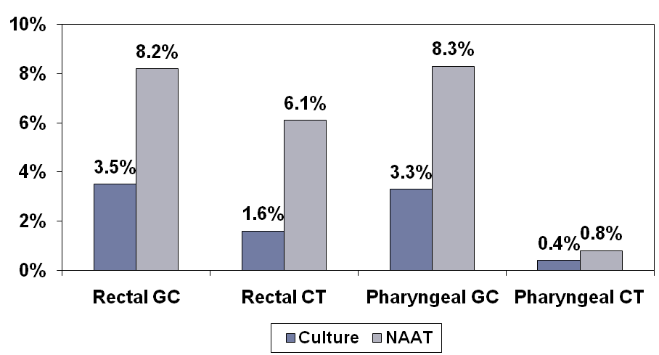
NAAT vs Culture
Schachter J,et al. Sex Transm Dis. 2008;35:637-42.
Notes:
This slide show how much more sensitive the NAATs are compared to culture for rectal and oral gonorrhea and chlamydia testing. In this study, all men seen at a SF men’s clinic were tested with both culture in dark blue and NAAT in gray on rectal and oral specimens. You can see that there was much more disease identified with the NAAT tests compared to culture.

Slide 97
Chlamydia Diagnosis
Culture
NAAT
EIA
DFA
DNA Probe
Sensitivity: 70%
Specificity: 85%–95%
Sensitivity: 85%–90%
Specificity: >98%
Sensitivity: 50%–65%
Specificity: >95%
Sensitivity: 65%–70%
Specificity: 95%
Sensitivity: 65%–70%
Specificity: 95%
Preferred
Notes:
Nucleic acid amplification technology first became available in 1993. Commercially available test kits include the Roche Amplicor, which is based on polymerase chain reaction technology; the Gen-Probe APTIMA based on transcription mediated amplification; and the Becton-Dickinson BD ProbeTec based on strand displacement amplification. Sensitivities of all these tests are approximately 85%–95% and specificities are greater than 98%. Sensitivity for female urine specimens is slightly lower compared to endocervical swab specimens. NAAT assays may suffer from some problems with inhibitors of amplification found in clinical specimens, which slightly reduce test sensitivity. Most NAATs can be performed on male and female urine specimens in addition to urethral and endocervical specimens and, for some, offer the advantage of simultaneous detection of Neisseria gonorrhoeae from one specimen. In addition, specimen adequacy is less of an issue, so costly quality assurance programs needed to evaluate the adequacy of specimens collected for non-amplified methods are not necessary for NAATs.
Culture of urethral or endocervical specimens has long been the gold standard for diagnosis and is used for medico-legal purposes because of its high, near perfect specificity; however, compared to NAAT its sensitivity is approximately 60%–80% depending on the laboratory expertise, adequacy of specimen collection and transport conditions. For screening purposes it is impractical for reasons of cost, low sensitivity, complexity, limited availability and long turnaround time.
Gram stain of cervical discharge in females and in asymptomatic males is not recommended because of very low sensitivity of this method.
Sources:
California Chlamydia Action Coalition: Screening Test Information for Medical Directors. http://www.ucsf.edu/castd/toolbox/07v2-ScreenTestForDirectors.pdf
Centers for Disease Control and Prevention. Screening Tests To Detect Chlamydia trachomatis and Neisseria gonorrhoeae Infections--2002. MMWR 2002; 51 (No. RR-15):1–38.
Crotchfelt KA, Pare B, Gaydos C, Quinn TC. Detection of Chlamydia trachomatis by the Gen-Probe AMPLIFIED Chlamydia trachomatis assay (AMP-CT) in urine specimens from men and women and endocervical specimens from women. J Clin Microbiol 1998; 36:391–94.

Slide 98
Gonorrhea Diagnosis
Culture
NAAT
Typical Gram Stain
DNA
Probe
Sensitivity: 90%
Specificity: 99%
Sensitivity: 85%–90%
Specificity: >98%
Sensitivity: 80%
Specificity: 98%
Sensitivity: 35%–45%
Specificity: 99%
Preferred
90% sensitive in symptomatic male; only 50% sensitive in females and in asymptomatic males.
Notes:
Ideally, all gonorrhea cases should be diagnosed by culture to facilitate antimicrobial susceptibility testing.
However, nucleic acid amplification tests (NAATs), are highly sensitive and specific, and have provided the ability to use alternative sample types for the diagnosis of gonorrhea.
Self-collected genital specimens, such as urine or even vaginal swabs, can now be accurately used to diagnose gonorrhea infections.
In many cases, use of these sample types can decrease the necessity for a clinician to perform a pelvic examination on women or to collect a urethral swab from men, thus extending the diagnostic capability for detecting these infections to non-clinic screening venues.
As most Chlamydia infections and many gonorrhea infections are asymptomatic, the use of NAATs for self-collected samples greatly increases the types and numbers of patients that can be screened outside of clinic settings.
Self-sampling also allows clinicians to easily screen patients in the clinic for STIs who are not presenting for pelvic or urogenital examinations. The application of NAATs to self-collected specimens has the potential to augment public health programs designed to control the epidemic of STIs in the community.
Source: Gavdos C. Nucleic acid amplification tests for gonorrhea and Chlamydia: practice and applications. Infect Dis Clin North Am. 2005 Jun;19(2):367–86
Centers for Disease Control and Prevention. Sexually transmitted diseases treatment guidelines, 2006. MMWR Recomm Rep 2006 Aug 4; 55:1–94.

Slide 99
Performance of NAATs for Diagnosis of Rectal N. gonorrhoeae Infection
Rectal Infection
 | C. trachomatis | N. Gonorrhoeae
 | % Sensitivity/Specificity | % Sensitivity/Specificity
ProbeTec (SDA) | 100/90 | 100/96
Amplicor (PCR) | 96/92 | 96/96
Aptima Combo2 (TMA) | 100/89 | 100/96
Culture | 46/99 | 72/100
Bachmann, L et al. J. Clin Microbiol. 2010;48(5);1827-1832.
Notes:
For rectal gonorrhea and chlamydia testing, NAAT tests are much more sensitive compared to cell culture on the bottom row. Providers who use culture for rectal testing will miss half of chlamydia and about a third of gonorrhea infections.
Not FDA approved but many labs have CLIA approval to perform these tests

Slide 100
Performance of NAATs for Diagnosis of Pharyngeal N. gonorrhoeae Infection
Pharyngeal Gonococcal Infections (N=961)
 | % Sensitivity | % Specificity
ProbeTec (SDA) | 97% | 94%
Amplicor (PCR) | 91% | 72%
Aptima Combo2 (TMA) | 100% | 96%
Culture | 65% | 99%
Bachmann, et al. J Clin Micro. 2009;47:902-907.
Notes:
For pharyngeal gonorrhea testing, NAAT tests are also much more sensitive compared to gonorrhea culture on the bottom row. Providers who use culture for gonorrhea pharyngeal testing will also miss about 1 third of the infections.
Not FDA approved but many labs have CLIA approval to perform these tests

Slide 101

Erica: Case Continued
You collect a specimen and order a NAAT test for both gonorrhea and chlamydia.
You administer a pregnancy test which is negative.
What else would you do?

Slide 102
Erica: Case Continued
Administer EC and write advanced prescription
HIV test
HPV vaccine
Notes:
http://www.cdc.gov/hepatitis/Populations/PDFs/RiskPopulationTable.pdf

Slide 103
Erica: Case Continued
Because your exam was consistent for trichomonas and not cervicitis, you do not presumptively treat for gonorrhea and chlamydia.
In a week, labs confirm positive gonorrhea and negative chlamydia.

Slide 104
Neisseria gonorrhoeae
Antimicrobial Resistance
Antimicrobial resistance
  Undermines treatment success
  Heightens risk of complications
  Facilitates transmission
NG has demonstrated ability to progressively develop antimicrobial resistance
Sulfonamides
Penicillins
Tetracyclines
Fluoroquinolones
Resistance

Slide 105
Emerging Threat of Cephalosporin-Resistant N. gonorrhoeae
Cefixime treatment failures in Asia and Europe
Identification of cefixime and ceftriaxone-resistant isolates in Japan (2009), France (2011), and Spain (2011)
Increasing MICs in Asia, Australia, Europe and US

Slide 106
Treatment for Uncomplicated Gonococcal Infections of the Cervix, Urethra, and Rectum
Recommended
Ceftriaxone | 250 mg | IM | Once
PLUS
Azithromycin | 1 g | Orally | Once
OR
Doxycycline | 100 mg | Orally | Twice a day for 7 days
Quinolones are no longer recommended in the United States for the treatment of gonorrhea and associated conditions, such as PID
www.cdc.gov/mmwr/preview/mmwrhtml/mm6131a3.htm?s_cid=mm6131a3_w
Notes:
CDC now recommends treatment with TWO antibiotics rather than one. So the current recommendation for treatment of uncomplicated gonorrhea in the cervix, urethra and rectum is ceftriaxone 250 mg (up from 125 mg) AND either azithromycin 1 gram or doxycycline 100 mg twice daily for 7 days. The azithro or doxy is not to treat an undiagnosed chlamydia infection, but CDC now recommends two antibiotics for enhanced synergy and decreased likelihood of a strain resistant to this antibiotic combination.

Slide 107
Treatment for Uncomplicated Gonococcal Infections of the Cervix, Urethra, and Rectum
Alternative 1: If Ceftriaxone is not available
Cefixime | 400 mg | Orally | Once
PLUS
Azithromycin | 1 g | Orally | Once
OR
Doxycycline | 100 mg | Orally | Twice a day for 7 days
PLUS
Test of cure in 1 week
www.cdc.gov/mmwr/preview/mmwrhtml/mm6131a3.htm?s_cid=mm6131a3_w
Notes:
Some offices do not provide IM infections or cannot bring patients back for treatment in a timely manor. In those cases, an alternative regimen can be used with just oral antibiotics that consists of cefixime orally PLUS either azithromycin or doxycycline, but to ensure a cure, providers should perform a test of cure 1 week after treatment is complete. The test of cure should preferable be a culture so that antibiotic susceptibility testing can be done. But if culture is not available, providers can use a NAAT. Although for chlamydia, it can take 3 weeks for the DNA or RNA to clear, for gonorrhea, studies show that the DNA or RNA clears by 5 days after treatment. So, a NAAT can be performed in a week.

Slide 108
Gonorrhea Treatment Options for pharynx
Ceftriaxone 250mg in a single intramuscular Dose
Azithromycin 1g orally in a single dose. OR doxycycline 100mg daily for 7 days
PLUS
As of 2007, quinolones are no longer recommended in the US for treatment of gonorrhea and associated conditions.
Notes:
Treatment for the uncomplicated gonorrhea infection of the pharynx
Centers for Disease Control and Prevention. Sexually Transmitted Diseases Treatment Guidelines, 2010. MMWR 2010;59(12):1-116
http://www.cdc.gov/std/treatment/2010/gonococcal-infections.htm

Slide 109
Treatment for Uncomplicated Gonococcal Infections of Cervix, Urethra, Rectum, and Pharynx
Alternative 2: If patient is cephalosporin-allergic
Azithromycin | 2 g | Orally | Once
PLUS
Test of cure in 1 week
www.cdc.gov/mmwr/preview/mmwrhtml/mm6131a3.htm?s_cid=mm6131a3_w

Slide 110
Dual Therapy for Gonorrhea Treatment
CDC recommends dual therapy for gonoccocal infections at all anatomic sites.
Patients infected with N. gonorrhoeae frequently are coinfected with C. trachomatis; this finding has led to the recommendation that patients treated for gonococcal infection also be treated routinely with a regimen that is effective against uncomplicated genital C. trachomatis
Notes:
Patients infected with N. gonorrhoeae frequently are coinfected with C. trachomatis; this finding has led to the recommendation that patients treated for gonococcal infection also be treated routinely with a regimen that is effective against uncomplicated genital C. trachomatis infection (294).
Because most gonococci in the United States are susceptible to doxycycline and azithromycin, routine cotreatment might also hinder the development of antimicrobial-resistant N. gonorrhoeae.
Limited data suggest that dual treatment with azithromycin might enhance treatment efficacy for pharyngeal infection when using oral cephalosporins (295,296).
Centers for Disease Control and Prevention. Sexually Transmitted Diseases Treatment Guidelines, 2010. MMWR 2010;59(12):1-116
http://www.cdc.gov/std/treatment/2010/gonococcal-infections.htm

Slide 111
GC Follow up testing
Test of cure is not recommended if recommended regimen is administered
Test of cure is recommended if
  alternative regimen is administered
  Sx persist after Tx and not from reinfection (Rx failure)
Test of cure by N. gonorrhoeae culture
  Test isolated GC for antimicrobial susceptibility
  If no Cx access, use NAAT
    most GC NAATs negative within a week of GC Rx
Repeat testing in 3 months regardless of Rx
www.cdc.gov/mmwr/preview/mmwrhtml/mm6131a3.htm?s_cid=mm6131a3_w

Slide 112
Clinical Management of Treatment Failures
Obtain specimens for culture/AST from all exposed anatomic sites (pharyngeal, rectal, urogenital)
Re-treat
  If initially treated with cefixime, re-treat with ceftriaxone 250 mg IM + azithromycin 2 g orally
  If initially treated with ceftriaxone, consult with State or County Department of Health
Report to State or County Department of Health
Obtain test of cure (preferably with culture) after re-treatment
Ensure partners are treated!!!!!

Slide 113
Positive Gonorrhea: When to Treat for Chlamydia
If she had tested positive for chlamydia and gonorrhea
If she had been tested for chlamydia with a test other than a NAAT and the chlamydia test was negative
Notes:
Preemptively treat for chlamydia when NAAT is not available because the sensitivity for non-amplified tests are too low.

Slide 114
Chlamydia Treatment
Per 2010 CDC Treatment Guidelines
Recommended Regimens
Azithromycin 1 g PO single dose
Alternative Regimens
Erythromycin base 500mg PO QID x 7 days
Doxycycline 100mg PO BID x 7 days
Erythromycin ethylsuccinate 800mg PO QID x 7 days
Levofloxacin 500mg PO OD x 7 days
Ofloxacin 300mg PO BID x 7days
When available, single-dose treatment preferable for adolescents
Notes:
When available, on-site single dose treatments should be used for teens. Directly observed.
Source: Centers for Disease Control and Prevention. Sexually Transmitted Diseases Treatment Guidelines, 2010. MMWR 2010;59(12):1-116

Slide 115
Erica: Case Continued
What else do you need to do with this patient?
High C. trachomatis and N. gonorrhoeae reinfection rates
Retest males and females for Chlamydia and/or gonorrhea at 3months after treatment or whenever persons next present for medical care.
  Regardless if patients believe sex partners are treated.
Depending on your state, consider writing a prescription for Expedited Partner Therapy (EPT).
Notes:
PPT Presentation by Dr. Burstein “Changes in the 2010 STD Treatment Guidelines”

Slide 116
STI Partner Management Strategies
Provider Referral
Partners contacted by index patient's provider or by a disease intervention specialist
Patient Referral
Index patient assumes primary responsibility to notify and refer his/her partners at risk
Patient Delivered Therapy
Providers (1) give patient medication intended for the partners (2) prescribe extra doses of meds in the index patient’s name (3) write partners’ prescriptions for medication
Notes:
Partners collect medication at public health center or other venues
Public health workers deliver medications to partners in non-clinical settings.

Slide 117
Expedited Partner Therapy (EPT)
EPT: Delivery of medications or prescriptions by persons infected with an STD to their sex partners without clinical assessment of the partners.
EPT is permissible in 35 states and 1 city (Baltimore, MD).
Heterosexual sex partners should be:
  Evaluated, tested and treated if
    Had sexual contact with patient during or > 60 days of symptom onset/ diagnosis of Chlamydia or Gonorrhea
Notes:
Source: http://www.cdc.gov/sTd/ept/legal/default.htm
An alternative approach to assuring treatment of partners is expedited partner therapy (EPT). EPT is the delivery of medications or prescriptions by persons infected with an STD to their sex partners without clinical assessment of the partners. Clinicians (e.g., physicians, nurse practitioners, physician assistants, pharmacists, public health workers) provide patients with sufficient medications directly or via prescription for the patients and their partners. After evaluating multiple studies involving EPT, CDC concluded that EPT is a “useful option” to further partner treatment, particularly for male partners of women with chlamydia or gonorrhea . In August 2006, CDC recommended the practice of EPT for certain populations and specific conditions and CDC continues to recommend it in Sexually Transmitted Diseases Treatment Guidelines, 2010.
Patients should be instructed to refer their sex partners for evaluation, testing, and treatment. The following recommendations on exposure intervals are based on limited evaluation. Sex partners should be evaluated, tested, and treated if they had sexual contact with the patient during the 60 days preceding onset of symptoms in the patient or diagnosis of chlamydia. The most recent sex partner should be evaluated and treated, even if the time of the last sexual contact was >60 days before symptom onset or diagnosis.
EPT is not routinely recommended for MSM because of a high risk for coexisting infections, especially undiagnosed HIV infection, in their partners.
If concerns exist that sex partners will not seek evaluation and treatment, or if other management strategies are impractical or unsuccessful, then delivery of antibiotic therapy (either a prescription or medication) by heterosexual male or female patients to their partners might be an option. Limited studies to date have demonstrated a trend toward a decrease in rates of persistent or recurrent chlamydia with this approach compared with standard partner referral. Male patients must inform female partners of their infection and be given accompanying written materials about the importance of seeking evaluation for PID (especially if symptomatic).
Patients should be instructed to abstain from sexual intercourse until they and their sex partners have completed treatment. Abstinence should be continued until seven days after a single-dose regimen or after completion of a seven-day regimen. Timely treatment of sexual partners is essential for decreasing the risk for reinfecting the index patient.
Centers for Disease Control and Prevention. Expedited partner therapy in the management of sexually transmitted diseases. Atlanta, GA: US Department of Health and Human Services, 2006.
http://www.cdc.gov/std/treatment/EPTFinalReport2006.pdf

Slide 118
CDC 2010 STD Treatment Guidelines
Providers consider including EPT as part of their regular STI care
EPT is “useful option” to further partner treatment
Especially for male partners of chlamydia- or gonorrhea-infected females
CDC 2010 STD Treatment Guidelines recommend EPT as option for partner treatment among heterosexual persons with chlamydia or gonorrhea
    EPT “Dear Colleague” letter available at: http://www.cdc.gov/std/ept/DCL-EPT-toolkit-1-31-2011.pdf
Notes:
Centers for Disease Control and Prevention. Expedited partner therapy in the management of sexually transmitted diseases. Atlanta, GA: US Department of Health and Human Services, 2006.
http://www.cdc.gov/std/treatment/EPTFinalReport2006.pdf

Slide 119
EPT Effect on Repeat Chlamydia Infections
Randomized controlled trial evaluating partner management strategies to prevent repeat CT
sample of 1,454 ♀ diagnosed with CT
Trend for ↓ CT infection at follow-up among ♀ in EPT arm. Infection rates in both groups were high at follow-up:
12% CT infections among ♀ in EPT arm
15% CT infections among ♀ in patient referral arm
Odds Ratio: 0.80 (95% CI = 0.62 – 1.05; P=.102)
compared patient delivered vs. patient referral
Schillinger, et al. Sex Transm Dis 2003;30(1):49–56.
Notes:
119
About Schillinger RCT:
-Multi-center, multi-venue, randomized clinical trial
-728 women with CT randomized to PDPT; 726 to patient referral
-Rate of reinfection 20% lower in PDPT group (12% vs 15%, p= .102)
Source: Centers for Disease Control and Prevention. Expedited partner therapy in the management of sexually transmitted diseases. Atlanta, GA: US Department of Health and Human Services, 2006.
http://www.cdc.gov/std/treatment/EPTFinalReport2006.pdf

Slide 120
Effect of EPT to Prevent Recurrent/Persistent GC or CT
2005 Study: Women and men with chlamydia and gonorrhea infection randomized to have partners receive:
1) Expedited treatment
- Patients given medication to give to partners or
-Study’s staff members contacted partners and provided meds without exam
2) Standard referral
- Advised to refer their partners for treatment and offered assistance notifying partners
Golden, et al. NEJM 2005;352:676–685.
Notes:
About Golden Study:
- RCT of EPT vs standard partner referral
- 929 patients in EPT arm vs 931patients in standard referral arm
- Male and female index cases
Rate of reinfection lower in EPT groups, not robust effect for CT
Centers for Disease Control and Prevention. Expedited partner therapy in the management of sexually transmitted diseases. Atlanta, GA: US Department of Health and Human Services, 2006.
http://www.cdc.gov/std/treatment/EPTFinalReport2006.pdf

Slide 121
Guidance on the Use of EPT in the Treatment of Gonorrhea
Evaluate and Treat patient’s sex partners from past 60 days with a recommended regimen (ceftriaxone 250 mgIM plus either a single dose of azithromycin 1 g orally or doxycycline 100 mg orally twice daily for 7 days).
EPT for heterosexual partners still permissible
EPT not routinely recommended for MSM
  High risk for coexisting infections: i.e., HIV
Notes:
Source: http://www.cdc.gov/std/ept/GC-Guidance.htm
CDC no longer recommends the routine use of orally-administered cefixime for the treatment of gonorrhea in the United States. Rather, for treatment of uncomplicated urogenital, anorectal, and pharyngeal gonorrhea, CDC recommends that combination therapy be used with a single intramuscular dose of ceftriaxone 250 mg plus either a single dose of azithromycin 1 g orally or doxycycline 100 mg orally twice daily for 7 days.
Since EPT is not possible where treatment involves an injection, the new CDC gonorrhea treatment recommendations have implications for the use of EPT in the treatment of gonorrhea.
1. In light of CDC’s recent changes to its gonorrhea treatment recommendations, can EPT be used for gonorrhea?
Under these new guidelines every effort should be made to ensure that a patient’s sex partners from the past 60 days are evaluated and treated with a recommended regimen (ceftriaxone 250 mgIM plus either a single dose of azithromycin 1 g orally or doxycycline 100 mg orally twice daily for 7 days). However, because that is not always possible, providers can still consider EPT for heterosexual partners of patients diagnosed with gonorrhea who are unlikely to access timely evaluation and treatment. EPT is not routinely recommended for MSM because of a high risk for coexisting infections, especially undiagnosed HIV infection, in their partners.
2. Since CDC no longer recommends exclusively oral treatment for gonorrhea, and since CDC recommends that a patient return for a test-of-cure when oral cefixime is used as an alternative treatment, how does CDC recommend EPT be practiced for gonorrhea?
If a heterosexual partner of a gonorrhea patient cannot be linked to evaluation and treatment in a timely fashion, EPT with cefixime and azithromycin should still be considered, as not treating partners is significantly more harmful than is practicing EPT for gonorrhea. As has always been the case, medication or prescriptions provided as part of EPT should be accompanied by treatment instructions, appropriate warnings about taking medications (if the partner is pregnant or has an allergy to the medication), general gonorrhea health education and counseling, and a statement advising that partners seek personal medical evaluation, particularly women with symptoms of PID.² Now, with the new CDC recommendations, instructions for partners should also include a recommendation that the partner receive a test-of-cure approximately one week after finishing their medication. Given that the partner receiving EPT may have little or no access to health care, information as to where they can receive a test-of-cure or other personal medical evaluations should also be provided.

Slide 122
EPT for Trichomonas
484 female randomized to partner self-referral (PR), partner delivered therapy (PDPT), or health department disease intervention (DIS) locating partners and delivering medications in the field.
Initial cure rates = 95%
PDPT had lower repeat infection rates compared to DIS (6% vs. 15%) or PR/DIS combined (6% vs. 12.5%) at 1 month
  80% of females randomized to PDPT reported delivering medications
    89% believed that partners took the medication.
No serious adverse events reported
Schweibe JR, Desmond RA. Sex Transm. Disease 2010 June;37:392-6

Slide 123
Behaviors Affecting EPT Effectiveness
Patient-delivered specific
Patient did not give Rx to
any/all partners
Partners noncompliant with Rx
Patients did not contact partners
General non-compliance
Patients noncompliant with Rx
Resumed sex < 7 days after case and partner treatment
Sex with new partner(s)
Notes:
Centers for Disease Control and Prevention. Expedited partner therapy in the management of sexually transmitted diseases. Atlanta, GA: US Department of Health and Human Services, 2006.
http://www.cdc.gov/std/treatment/EPTFinalReport2006.pdf

Slide 124
EPT Barriers
General theoretical liability issues
  Rx without an exam
  Medical records for treated partner?
Legal issues with minors
  Consent to care
  Obligation to report sex in minors with older partners
Financial: who pays for partner Rx?
Adverse Drug Effects
Partner may not seek complete STI assessment
  Potential to miss partners’ other STIs, including HIV
  Missed counseling opportunities for partners
Notes:
For the last two bullets, it should be stressed that EPT should not be provided without the exhortations provided through patient referral. It’s not known (or even especially likely) that EPT results in fewer people getting evaluated than the current standard (i.e., patient referral).
Centers for Disease Control and Prevention. Expedited partner therapy in the management of sexually transmitted diseases. Atlanta, GA: US Department of Health and Human Services, 2006.
http://www.cdc.gov/std/treatment/EPTFinalReport2006.pdf

Slide 125
What is next for STI Partner Strategies?
Internet
  Internet to be used to facilitate partner notification
    MSM and in cases where no other identifying information is available
    Many health departments now conduct formal internet partner notification (IPN)
Expedited Partner Therapy Legal/Policy Toolkit
  Assist states interested in adopting EPT supportive laws
  Assist states that have adopted EPT laws with addressing full implementation barriers
  Legal toolkit can be found at: http://www.cdc.gov/std/ept/legal/LegalToolkit.htm

Slide 126
Erica: Case Continued
What else do you need to do with this patient?
HIV testing

Slide 127
CDC HIV Screening Guidelines
Screening recommended for all patients at least once unless patient opts out
All patients seeking treatment for STIs should be screened routinely for HIV
All persons likely at high risk* for HIV should be tested at least annually
Separate written consent for HIV testing and prevention counseling should not be required
MMWR 2006;55(RR14):1–17
Notes:
* High risk includes: injection-drug users and their sex partners, persons who exchange sex for money or drugs, sex partners of HIV-infected persons, and MSM or heterosexual persons who themselves or whose sex partners have had more than one sex partner since their most recent HIV test.
Branson B, Handsfield H, et al. Revised Recommendations for HIV Testing of Adults, Adolescents, and Pregnant Women in Health-Care Settings. MMWR 2006;55(RR14):1–17

Slide 128
HIV/AIDS
Incidence
Symptoms
1/3 of new infections in 2006 in people 13–29
Infections in adolescents not usually symptomatic or diagnosed until 20s or 30s
Some develop flu-like symptoms within a month or two of exposure to HIV
Notes:
http://www.cdc.gov/hiv/surveillance/resources/reports/2010report/pdf/2010_HIV_Surveillance_Report_vol_22.pdf
**Recent incidence estimates from 2006 through 2009 suggested overall stability in new HIV infections, but a 21% increase in HIV incidence for persons aged 13–29 years.
The Centers for Disease Control and Prevention released a new report, Estimated HIV Incidence
among Adults and Adolescents in the United States, 2007-2010
(http://www.cdc.gov/hiv/surveillance/resources/reports/2010supp_vol17no4/index.htm), which
includes new HIV incidence estimates for 2010 and updates previously published estimates for
2007 through 2009. The report estimates that 47,500 people became infected with HIV in the US
in 2010, with certain groups, including African Americans, Latinos and gay and bisexual men of
all races/ethnicities, disproportionately affected. Also, when comparing 2008 and 2010
estimates, the report found a continuing increase in new infections among young gay and
bisexual men, as well as early signs of a decrease in new infections among black women.
In 2006, the incidence of HIV in young people aged 13–29 was 26.8 per 100 000, representing 34% of the total infections. More than half of the infections in this age group were in men who have sex with men (MSM).
From 2007 through 2010, the annual estimated number and rate of diagnoses of HIV infection remained stable in the 46 states.
As shown in the figure, in 2010, an estimated 77% of diagnosed HIV infections among males were attributed to male-to-male sexual contact, and 86% of diagnosed infections among females were attributed to heterosexual contact.
In 2010, the largest percentage of all diagnoses (16%) and the highest rate per 100,000 population (36.9) were those for persons aged 20–24 years.
Sources:
Chesson H, et al. The Estimated Direct Medical Cost of Sexually Transmitted Diseases Among American Youth, 2000. Perspect Sex Repro Health 2004;36;1
Weinstock H, Berman S, Cates Willard. Sexually Transmitted Diseases Among American Youth: Incidence and Prevalence Estimates, 2000. Perspectives on Sexual and Reproductive Health 2004;36:6–10.

Slide 129
HIV
Diagnostic Methods
Most settings: Rapid enzyme linked immunoassay (EIA) followed by Western Blot
Many settings: rapid HIV tests available for screening and confirmation
In high risk populations: pooling sera for NAAT can be cost effective
Notes:
Testing for HIV is usually a two-step process. First, an inexpensive screening test is done. If that test is positive, a second test (Western Blot) is done to confirm the result. Antibody tests are the most common initial screening test used. Most commonly, blood is drawn for an enzyme immunoassay (EIA). The test is usually run in a local laboratory, so results can take one to three days.
With each generation of antibody assay, timing of identification of HIV infections is reduced. Newer fourth generation assays combine antibody and p23 antigen detection, and may simplify identification of chronic and acute HIV infection.
Other tests can detect antibodies in body fluids other than blood, such as saliva, urine, and vaginal secretions. Some of these are designed to be rapid tests that produce results in approximately 20 minutes. These tests have accuracy rates similar to traditional blood tests.
In high-risk populations, pooling sera for nucleic acid amplification testing can be a cost-effective method for diagnosing acute HIV infection. In some public health clinics, pooled RNA testing is now routinely performed on specimens that are negative on EIA tests.
Centers for Disease Control and Prevention. Sexually transmitted diseases treatment guidelines, 2006. MMWR Recomm Rep 2006 Aug 4; 55:1–94.

Slide 130
HIV Testing Technology
Enzyme Immunoassay (EIA) and Western Blot (WB)
  Very sensitive and specific yet neither is perfect
  Positive only after at least two EIAs and one WB
  all positive
  Results available in one to two weeks
Rapid Testing
  Provide definitive negative and preliminary positive result (requires confirmatory tests)
Home Testing
  Patients collect own finger-prick blood sample, mail sample, and call for anonymous results and counseling days later
Notes:
Sources:
Centers for Disease Control and Prevention. Sexually transmitted diseases treatment guidelines, 2006. MMWR Recomm Rep 2006 Aug 4; 55:1–94.

Slide 131
FDA Approved Rapid HIV Tests
Notes:
Source: Mitchell H. ABC of sexually transmitted infections. BMJ 2004;328:1306–1308.

Slide 132
HIV
Positive Diagnosis
Counseled regarding behavioral, psychosocial, and medical implications
Assess need for immediate care or support
Link patients to psychosocial and medical services
Partners (sexual and IDU) should be notified, either by the patient him/herself or by the provider, hospital, or state/local health department
Notes:
Those persons who test positive for HIV should receive prevention counseling before leaving the testing site. Such persons should receive or be referred for a medical evaluation and, if indicated, be provided with behavioral and psychological services as determined by a thorough psychosocial evaluation, which can also be used to identify high-risk behaviors. Providers who refer their HIV-positive patients to other professionals should establish means to ensure that these patients are linked successfully to such services, especially to on-going medical care.
Providers should expect persons to be distressed when first informed of a positive HIV test result. Such persons face multiple major adaptive challenges, including coping with the reactions of others to a stigmatizing illness, developing and adopting strategies for maintaining physical and emotional health, initiating changes in behavior to prevent HIV transmission to others, and reducing the risk for acquiring additional STDs. Many persons will require assistance with making reproductive choices, gaining access to health services, and coping with changes in personal relationships. Therefore, behavioral and psychosocial services are an integral part of health care for HIV-infected persons.
Patients testing positive for HIV have unique needs. Some patients require referral for specific behavioral interventions (e.g., a substance abuse program), mental health disorders (e.g., depression), or emotional distress. Others might require assistance with securing and maintaining employment and housing. Women should be counseled or appropriately referred regarding reproductive choices and contraceptive options, and patients with multiple psychosocial problems might be candidates for comprehensive risk-reduction counseling and services.
The following are specific recommendations for HIV counseling and referral:
Persons who test positive for HIV antibody should be counseled, either on site or through referral, concerning the behavioral, psychosocial, and medical implications of HIV infection.
Health-care providers should be alert for medical or psychosocial conditions that require immediate attention.
Providers should assess the needs of newly diagnosed persons for immediate medical care or support and should link them to services provided by health-care personnel experienced in providing care for HIV-infected persons. Such persons might need medical care or services for substance abuse, mental health disorders, emotional distress, reproductive counseling, risk-reduction counseling, and case management. Providers should follow up to ensure that patients have received the needed services.
Patients should be educated about the importance of follow-up medical care as well as what to expect.
Several successful, innovative interventions for HIV prevention have been developed for diverse at-risk populations, and these can be locally replicated or adapted (11–14,135,136). Involvement of nongovernment organizations and community-based organizations might complement such efforts in the clinical setting.
Source: http://www.cdc.gov/std/treatment/2010/hiv.htm
Sources:
11.CDC, Health Resources and Services Administration, National Institutes of Health, NIV Medicine Association of the Infectious Diseases Society of American, HIV Prevention in Clinical Care Working Group. Recommendations for incorporating human immunodeficiency virus (HIV) prevention into the medical care of persons living with HIV. Clin Infect Dis 2004;38:104–21.
Wingood GM, DiClemente RJ, Mikhail I, et al. A randomized controlled trial to reduce HIV transmission risk behaviors and sexually transmitted diseases among women living with HIV: The WiLLOW Program. J Acquir Immune Defic Syndr 2004;37(Suppl 2):S58–67.
Richardson JL, Milam J, Stoyanoff S, et al. Using patient risk indicators to plan prevention strategies in the clinical care setting. J Acquir Immune Defic Syndr 2004;37(Suppl 2):S88–94.
Fisher JD, Cornman DH, Osborn CY, et al. Clinician-initiated HIV risk reduction intervention for HIV-positive persons: Formative Research, Acceptability, and Fidelity of the Options Project. J Acquir Immune Defic Syndr 2004;37(Suppl 2):S78–87.
Source: CDC. Incorporating HIV prevention into the medical care of persons living with HIV: recommendations of CDC, the Health Resources and Services Administration, the National Institutes of Health, and the HIV Medicine Association of the Infectious Diseases Society of America. MMWR 2003;52(No. RR-12).
CDC. Recommendations for partner services programs for HIV infection, syphilis, gonorrhea, and chlamydial infection. MMWR 2008;57(No. RR-9).

Slide 133

Case: Justin
Justin is a 17-year-old male who presents with a painful sore “down there.” He noticed it five days ago.
Notes:
Picture: Getty Images

Slide 134
Sexual History
During the sexual history, Justin discloses that he has had both male (one lifetime) and female partners (three lifetime).
He is currently in a relationship with a female with whom he has vaginal and oral sex.
He uses condoms “almost all the time.”
He has no known history of STIs.

Slide 135
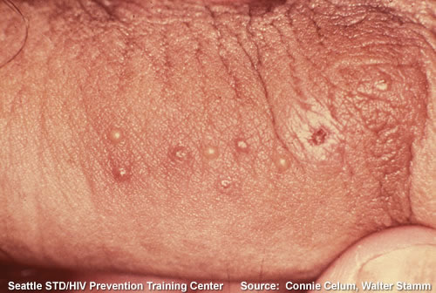
Physical Exam
You do a genital exam and on the shaft of the penis, you observe several lesions.
What is your differential diagnosis?
Notes:
The lesions associated with herpes usually manifest as a cluster of painful sores on a red base.

Slide 136
Differential Diagnosis
Herpes
Genital Sores
Syphilis
Cluster of painful (sometimes) sores
Solitary painless ulcer with indurated border
Chancroid
Trauma
LGV
Painful ulcer with sharp borders
Painless papule, shallow erosion or ulcer

Slide 137
Genital Herpes
Background
Caused by the herpes simplex viruses type 1 (HSV-1) and type 2 (HSV-2)
Majority of genital and perirectal herpetic outbreaks caused by HSV-2
Estimated that one million new cases occur in the U.S. each year
Over 80% new cases undiagnosed

Slide 138
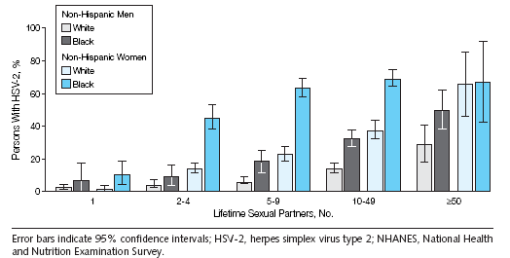
HSV-2 Seroprevalence NHANES Data in 1999–2004
Epidemiology
Source: Xu F et al. JAMA, 2006; 296(8):964–973.

Slide 139
Asymptomatic Viral Shedding
Most HSV-2 is transmitted during asymptomatic shedding
Rates of asymptomatic shedding greater in HSV-2 than HSV-1
Rates of asymptomatic shedding are highest in new infections (<2 years) and gradually decrease over time
Asymptomatic shedding episodes are of shorter duration than shedding during clinical recurrences

Slide 140
Asymptomatic Viral Shedding
Most common sites of asymptomatic shedding are vulva and perianal areas in women and penile skin and perianal area in men
Antiviral suppressive therapy dramatically reduces, but does not eradicate shedding

Slide 141
Genital Herpes: Symptoms
Most cases asymptomatic (up to 90%)
Painful blisters/open sores in genital area
May be preceded by a tingling or burning sensation in the legs, buttocks, or genital region
Sores usually disappear within 2–3 weeks
Virus remains in the body for life causing outbreaks to recur occasionally
Notes:
Most infections of genital herpes are asymptomatic.
Corey L, Wald A. Genital herpes. In: Holmes KK, Sparling PF, Mardh P et al. (eds). Sexually Transmitted Disease, 3rd Edition. New York: McGraw-Hill, 1999, p. 285–312.
Corey L, Wald A, Patel R et al. Once-daily valacyclovir to reduce the risk of transmission of genital herpes. New England Journal of Medicine 2004; 350:11–20.
Fleming DT, McQuillan GM, Johnson RE, Nahmias AJ, Aral SO, Lee FK, St. Louis ME. Herpes Simplex Virus Type 2 in the United States, 1976 to 1994. New England Journal of Medicine 1997; 16:1105–1111.
Weinstock H, Berman S, Cates Willard. Sexually Transmitted Diseases Among American Youth: Incidence and Prevalence Estimates, 2000. Perspectives on Sexual and Reproductive Health 2004;36:6–10.

Slide 142
Genital Herpes
Types of Infection
First clinical episode
  Primary
  Non-primary
Recurrent symptomatic infection
Asymptomatic infection
Notes:
First Clinical Episode
Primary infection
First infection ever with either HSV-1 or HSV-2
No antibody present when symptoms appear
Disease is more severe than recurrent disease
Non-primary infection
Newly acquired HSV-1 or HSV-2 infection in an individual previously seropositive to the other virus
Symptoms usually milder than primary infection
Antibody to new infection may take several weeks to a few months to appear
Recurrent symptomatic infection
Antibody present when symptoms appear
Disease usually mild and short in duration
Asymptomatic infection
Serum antibody is present
No known history of clinical outbreaks

Slide 143
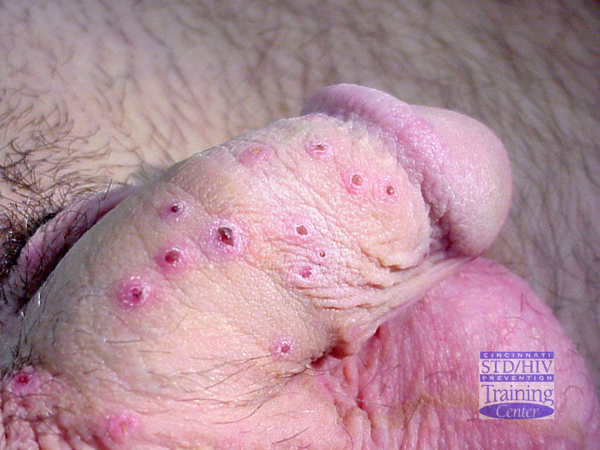
Genital Herpes
Primary Lesions
Source: Cincinnati STD/HIV Prevention Training Center

Slide 144
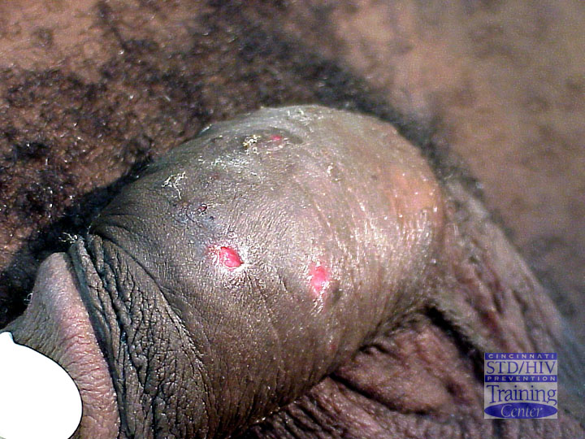
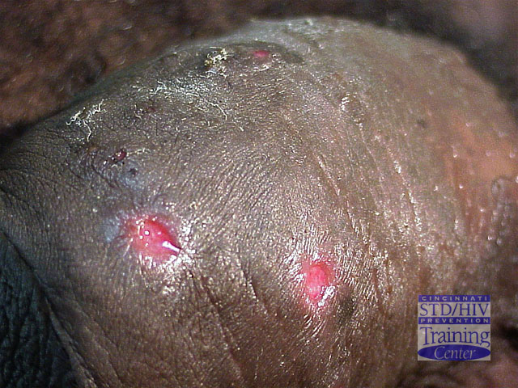
Genital Herpes
Multiple Ulcers
Source: Cincinnati STD/HIV Prevention Training Center

Slide 145
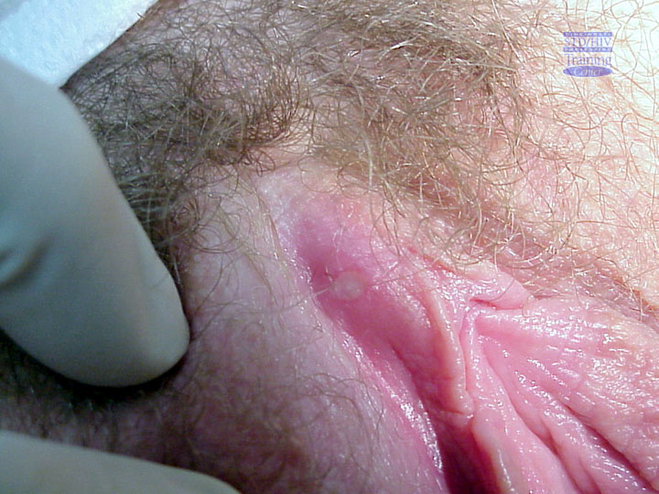
Genital Herpes
Recurrent Ulcer
Source: Cincinnati STD/HIV Prevention Training Center

Slide 146
Infection Type | Lesions/Symptoms | Type Antibody at Presentation
HSV-1 HSV-2
1st Episode Primary Type 1 or 2 | +/Sever, bilateral | – | –
1st Episode Non-primary Type 2 | +/Moderate | + | –
1st Episode Recurrence Type 2 | +/Mild | +/– | +
Symptomatic Recurrence Type 2 | +/Mild, unilateral | +/– | +
Asymptomatic Infection Type 2 | – | +/– | +

Slide 147
Genital Herpes
Sequelae
Aseptic meningitis
  More common in primary infection
  Generally no neurological sequelae
Rare complications include:
  Stomatitis and pharyngitis
  Radicular pain, sacral paresthesias
  Transverse myelitis
  Autonomic dysfunction
Psychological distress

Slide 148
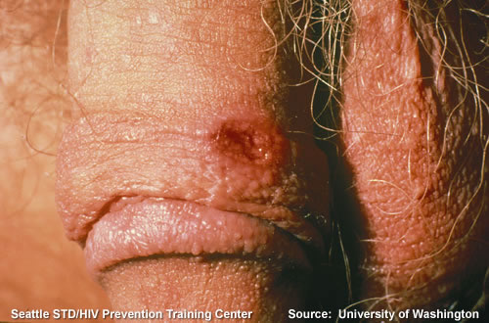
Painless Ulcer
If Jason’s sore had been painless and solitary, what would the differential diagnosis be?

Slide 149
Syphilis
STI caused by the bacterium Treponema pallidum
Includes three stages:
Primary
Secondary
Late and Latent
Notes:
Primary Stage
The primary stage of syphilis is usually marked by the appearance of a single sore (called a chancre), but there may be multiple sores. The time between infection with syphilis and the start of the first symptom can range from 10 to 90 days (average 21 days). The chancre is usually firm, round, small, and painless. It appears at the spot where syphilis entered the body. The chancre lasts three to six weeks, and it heals without treatment. However, if adequate treatment is not administered, the infection progresses to the secondary stage.
Secondary Stage
Skin rash and mucous membrane lesions characterize the secondary stage. This stage typically starts with the development of a rash on one or more areas of the body. The rash usually does not cause itching. Rashes associated with secondary syphilis can appear as the chancre is healing or several weeks after the chancre has healed. The characteristic rash of secondary syphilis may appear as rough, red, or reddish brown spots both on the palms of the hands and the bottoms of the feet. However, rashes with a different appearance may occur on other parts of the body, sometimes resembling rashes caused by other diseases. Sometimes rashes associated with secondary syphilis are so faint that they are not noticed. In addition to rashes, symptoms of secondary syphilis may include fever, swollen lymph glands, sore throat, patchy hair loss, headaches, weight loss, muscle aches, and fatigue. The signs and symptoms of secondary syphilis will resolve with or without treatment, but without treatment, the infection will progress to the latent and late stages of disease.
Late and Latent Stages
The latent (hidden) stage of syphilis begins when secondary symptoms disappear. Without treatment, the infected person will continue to have syphilis even though there are no signs or symptoms; infection remains in the body. In the late stages of syphilis, it may subsequently damage the internal organs, including the brain, nerves, eyes, heart, blood vessels, liver, bones, and joints. This internal damage may not show up until many years later. Signs and symptoms of the late stage of syphilis include difficulty coordinating muscle movements, paralysis, numbness, gradual blindness, and dementia. This damage may be serious enough to be fatal.

Slide 150
UPDATE:
Syphilis Case Definition
JANUARY 2014
Physician diagnosis no longer establishes a case of syphilis — cases must meet the surveillance case definitions. This change should simplify case reporting.
Laboratory methods have been updated (e.g., unavailable tests like DFA and MHA-TP have been omitted, and newer tests like PCR and treponemal EIA, CIA, and TP-PA are mentioned).
Notes:
Source: http://www.cdc.gov/std/stats/CaseDef-ProgramImpact-2014.pdf
"Secondary syphilis" now requires BOTH a reactive treponemal test AND a nontreponemal
titer ≥4. Because common practice is to obtain both treponemal and nontreponemal serologic
tests, this change is not anticipated to affect program activity.
• "Syphilis, latency of unknown duration" has been omitted. These cases should now be
reported as “late latent syphilis”, resulting in a corresponding increase in case counts of late
latent syphilis. That said, programs can still prioritize cases based upon age, titer, etc.
• Latent syphilis (early or late) still requires both reactive treponemal AND nontreponemal
tests. This reminder is not anticipated to have any impact upon program activity.
• A case of latent syphilis with any of the following criteria within the past 12 months is
considered “syphilis, early latent”. These additional criteria might allow more cases to be
classified as early latent syphilis.
o Documented seroconversion or fourfold or greater increase in titer of a
nontreponemal test
o Documented seroconversion on a treponemal test
o A history of symptoms consistent with a diagnosis of primary or secondary syphilis o Sexual exposure to a person with primary, secondary, or early latent syphilis
o Only sexual contact was within the last 12 months (sexual debut)
• “Syphilis, late, with clinical manifestations” can include neurosyphilis. The previous case
definition of late syphilis specifically excluded neurosyphilis. Very small increases in case
counts of late syphilis might be anticipated. (As a reminder: neurosyphilis can occur at any
stage of infection and should not be reported as its own stage, but should be reported by stage
of infection “with neurologic manifestations”.)
• For neurosyphilis, quantitative cutoffs are provided for "elevated" cerebrospinal fluid (CSF)
white blood cell count and protein concentration. These quantitative measures should provide
an objective measure of what is and is not “elevated”, and simplify characterization of
neurologic manifestations of syphilis.
No changes were introduced for congenital syphilis or syphilitic stillbirth.

Slide 151
Syphilis—Reported Cases by Stage of Infection, United States, 1941–2012
2011-Fig 36. SR
Notes:
Source: http://www.cdc.gov/std/stats12/Surv2012.pdf
Source: http://www.cdc.gov/std/stats12/slides.htm
Although the rate of P&S syphilis in the United States declined 89.7% during 1990–2000, the rate increased annually during 2001–2009 before decreasing in 2010 and remaining unchanged during 2011.
During 2012, rates again increased (to 5.0 cases per 100,000 population). Overall increases in rates were observed primarily among men (increasing from 8.1 cases (in 2011) to 9.3 cases (in 2012) per 100,000 population). After persistent declines during 1992–2003, the rate among women increased from 0.8 cases (in 2004) to 1.5 cases (in 2008) per 100,000 population, declining to 0.9 cases per 100,000 population in 2011 and 2012. Syphilis remains a major health problem with increases persisting among men who have sex with men (MSM).
Cases among MSM have been characterized by high rates of HIV co-infection and high-risk sexual behaviors.3–7 The estimated proportion of P&S syphilis cases attributable to MSM increased from 7% in 2000 to 64% in 2004.8,9 In 2005, CDC requested that all state health departments report the sex of sex partners for persons with syphilis.
Of reported male cases with P&S syphilis, sex of sex partner information in 2012 was available for 82%. In 2012, 49 states and the District of Columbia provided information about
sex of sex partners. Among cases of P&S syphilis for whom sex of partner was known, MSM accounted for 75% of P&S syphilis cases.

Slide 152
Primary and Secondary Syphilis—Rates by Age and Sex, United States, 2012
2011-Fig 42. SR
Notes:
Source: http://www.cdc.gov/std/stats12/slides.htm
Source: http://www.cdc.gov/std/stats12/Surv2012.pdf
In 2012, the rate of P&S syphilis was highest among persons aged 20–24 years and 25–29 years (14.8 and 13.7 cases per 100,000 population, respectively)
(Table 35).
Rates were highest among men 20–29 years, increasing
11.0% (from 22.8 to 25.3 cases) among men 20–24
years and 15.6% (from 21.2 to 24.5 cases) among men
25–29 years during 2012 (Figures 35 and 37, Table 35).
This marks the fifth consecutive year that rates of P&S
syphilis among men have been highest among men
aged 20–29 years (Table 35). During this time period
(2008–2012), rates have increased among men aged
20–24 years by 46.2% (from 17.3 to 25.3 cases) and
among men aged 25–29 years by 45.0% (from 16.9 to
24.5 cases). These data indicate a shift since 2006, when
the highest rates were in men aged 35–39 years.
Rates increased among women aged 20–24 years and
45–54 years (from 3.7 to 3.9 and from 0.5 to 0.6 cases
per 100,000 population, respectively). Rates remained
the same or decreased for women of all other age
groups. Rates remained highest among women aged
20–24 years (Figures 35 and 36, Table 35).

Slide 153
Primary and Secondary Syphilis—Rates by Race/Ethnicity, United States, 2008–2012
2011-Fig 45. SR
Notes:
Source: http://www.cdc.gov/std/stats12/slides.htm
Source: http://www.cdc.gov/std/stats12/Surv2012.pdf
In 2012, among the 48 jurisdictions (47 states and
the District of Columbia) that submitted data in the
new race and ethnic categories according to the revised
Office of Management and Budget (OMB) standards,
rates of P&S syphilis remained highest among blacks
(16.4 cases per 100,000 population) (Table 36B). The
rate among blacks was 6.1 times the rate among whites
(2.7 cases per 100,000 population).

Slide 154
Primary and Secondary Syphilis—Reported Cases* by Sex, Sexual Behavior, and Race/Ethnicity,
United States, 2012
2011-Fig 47. SR
Notes:
Source: http://www.cdc.gov/std/stats12/slides.htm
Source: http://www.cdc.gov/std/stats12/Surv2012.pdf
Trend data show that primary and secondary syphilis cases – the most infectious stages of the disease -- are increasing among MSM, who now account for 75 percent of all infections. Syphilis infection can place a person at increased risk for HIV infection. Surveillance data from several major cities throughout the country indicate that an average of 4 in 10 MSM with syphilis are also infected with HIV.
The male-to-female rate ratio for P&S syphilis rates
rose steeply during 2000–2003 (from 1.5 to 5.3), and
again during 2008–2012 (from 5.0 to 10.3), reflecting
higher rates in men than women (Figure 31). In 2012,
this ratio was almost double the ratio of 2003, and
almost seven times the ratio of 2000.
In 2005, CDC began collecting information on the
sex partners of patients with P&S syphilis. In 2012,
this information was available for 82% of male cases.
During 2007–2012, 33 areas reported sex of partner
data for at least 70% of cases each year during this time
period (Figure 30). During 2007–2008 in these areas,
increases in cases occurred among women, men having
sex with women only (MSW), and MSM. During
2008–2012 in these areas, cases among women and
MSW declined 24% (from 1,364 to 1,034 cases) and
15% (from 1,884 to 1,600 cases), respectively, while
cases among MSM increased 46% (from 5,872 to
8,553 cases). During 2011–2012 in these areas, cases
increased very slightly among MSW (4%) and women
(1%), while cases among MSM increased 15% (from
7,422 cases in 2011 to 8,553 cases in 2012)—a larger
increase than in previous years. (In these areas, cases
among MSM increased 6% during 2008–2009 (from
5,872 to 6,243), 10% during 2009–2010 (from 6,243
to 6,870 cases), and 8% during 2010–2011 (from
6,870 to 7,422 cases).) In 2012, among MSW with 30 National Profile: Syphilis STD Surveillance 2012
P&S syphilis, 39.2% had primary syphilis, and 60.8%
had secondary syphilis. Among women with P&S
syphilis, 18.6% had primary syphilis, and 81.4% had
secondary syphilis. Among MSM, 27.2% had primary
syphilis, and 72.8% had secondary syphilis (Figure
39).Among women with P&S syphilis, 18.1% were
white, 65.2% were black, 13.2% were Hispanic, and
2.5% were of other races/ethnicities. Among MSW,
20.4% were white, 55.9% were black, 19.2% were
Hispanic, and 2.8% were of other races/ethnicities.
Among MSM, 37.9% were white, 34.4% were black,
21.1% were Hispanic, and 4.5% were of other races/
ethnicities (Figure 40).

Slide 155
Stages of Syphilis
Stage | Signs/Symptoms
Primary (9–90 days) | Characterized by one or more skin lesions called chancres at the site where the spirochete penetrated (two weeks to three months after initial infection) Large numbers of organisms are present in exudates of lesion and in lymph nodes and infiltration of ulcer with inflammatory cells Highly infectious; diagnosis by dark field microscopy Chancre heals within two months
Secondary (6 weeks– 6 months) | Clinical signs of disseminated disease appear with prominent skin lesions (rash) dispersed over the entire body surface (occurs in 50% of cases) accompanied by flu-like symptoms (sore throat, fever, headache, etc.) and swollen lymph nodes Maculopapular skin lesions that are most prominent on palms of the hands and soles of feet will occur in 80% of patients Lesions called condylomas may occur on skin in moist areas (vagina and anus) Lesions are highly infectious; rash and symptoms will gradually resolve spontaneously and patient enters clinically inactive (latent) stage of disease
Late and Latent (3–20 years) | After a latent period (>2 yrs) following secondary syphilis, the patient may develop granulomatous lesions (gummas) of the skin, bone, and others tissues including the circulatory (cardiovascular syphilis) and nervous (neurological syphilis) system

Slide 156
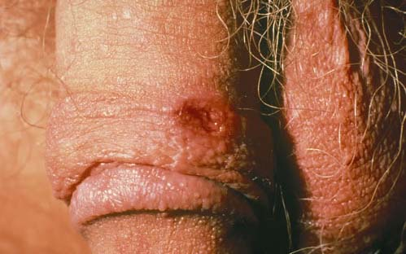
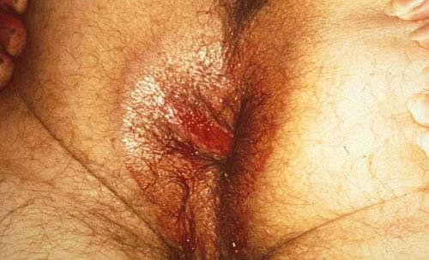
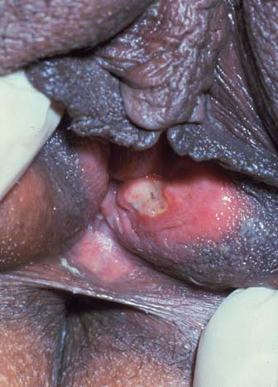
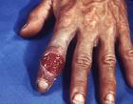

Syphilis: Primary

Slide 157
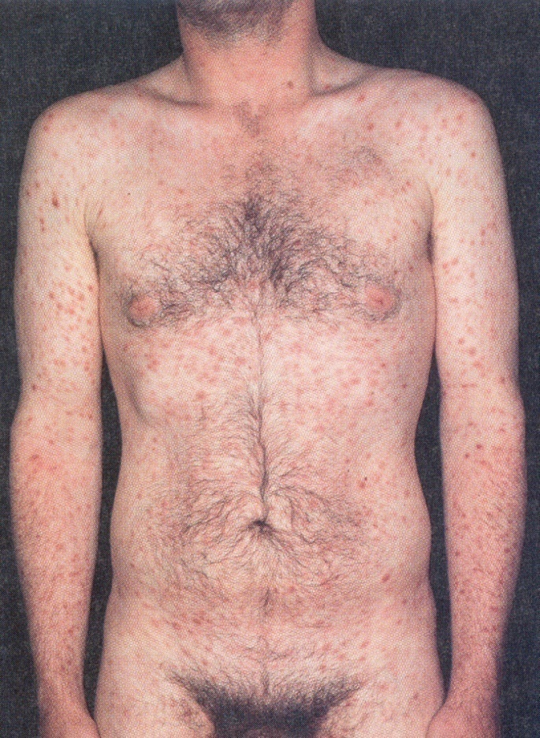
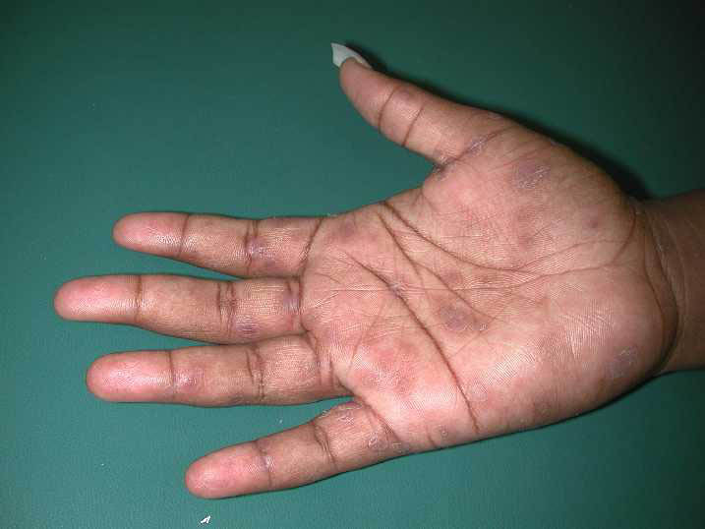
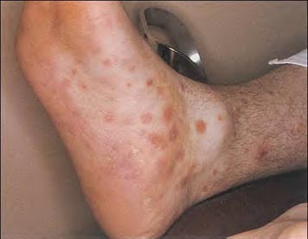
Syphilis: Secondary

Slide 158
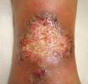
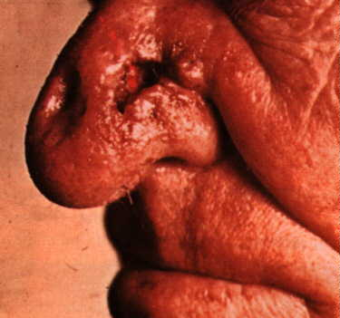
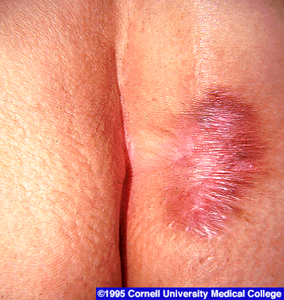
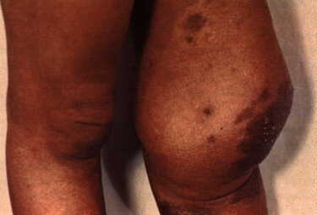
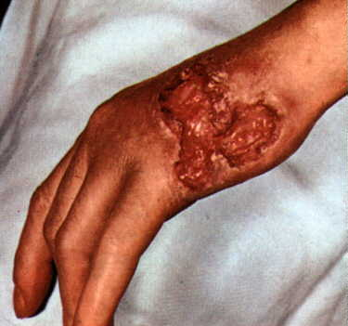
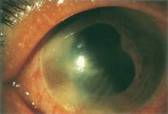
Syphilis Tertiary
Charcot’s joint

Slide 159
Sequelae
Chancre increases the risk of HIV
In recent outbreaks, rates of co-infection ranged from 20%–70%
Notes:
Genital sores and ulcers caused by syphilis make it easier to transmit and acquire HIV infection sexually. There is an estimated two- to five-fold increased risk of acquiring HIV infection when syphilis is present. Ulcerative STDs that cause sores, ulcers, or breaks in the skin or mucous membranes, like syphilis, disrupt barriers that provide protection against infections. The genital ulcers caused by syphilis can increase the infectiousness of and susceptibility to HIV.

Slide 160
Evaluating Genital Ulcers
How do you evaluate the causes of Jason’s genital lesions?

Slide 161
Genital Herpes: Screening
Current CDC guidelines do not recommend universal screening with serology
Past inconclusive work up for genital lesions—negative herpes culture or NAAT
Consider testing if:
Have a partner with genital HSV
MSM
Are HIV infected
Notes:
Source: Sexually transmitted diseases treatment guidelines, 2006. MMWR Recomm Rep 2006 Aug 4; 55:1–94.

Slide 162
Syphilis: Screening
CDC guidelines do not recommend universal screening
Patient is pregnant
Consider testing if:
MSM and engage in high-risk sexual behavior
Other STI diagnosis
Notes:
The United States Preventive Services Task Force (USPSTF) strongly recommends that clinicians screen all pregnant women for syphilis infection. A recommendation.
The USPSTF recommends against routine screening of asymptomatic persons who are not at increased risk for syphilis infection. D recommendation.
Given the low incidence of syphilis infection in the general population and the consequent low yield of such screening, the USPSTF concludes that potential harms of screening (i.e., opportunity cost, false-positive tests, and labeling) in a low-incident population outweigh the benefits.
Populations at increased risk for syphilis infection include men who have sex with men and engage in high-risk sexual behavior, commercial sex workers, persons who exchange sex for drugs, and those in adult correctional facilities. There is no evidence to support an optimal screening frequency in this population. Clinicians should consider the characteristics of the communities they serve in determining appropriate screening strategies.
Persons diagnosed with other STIs may be more likely than others to engage in high-risk behavior, placing them at increased risk for syphilis; however, there is no evidence that supports the routine screening of individuals diagnosed with other STIs for syphilis infection.
Source: United States Preventive Services Task Force. Screening for syphilis infection: recommendation statement. Rockville (MD): Agency for Healthcare Research and Quality (AHRQ); 2004 Jul. 8 p. [18 references]

Slide 163
HSV Diagnosis
Culture
Type Specific Serology
PCR
Sensitivity: 73%
Specificity: 100%
Sensitivity: 80%–98%
Specificity: >96%
Sensitivity: 98%
Specificity: 100%
Culture requires a new lesion and high viral load
Most HSV-1 is not sexually transmitted
Sensitivity decreases as lesion heals
Notes:
163
Viral Culture: Cells at the base of a genital lesion can be collected using a sterile cotton swab, placed in special transport media, and cultured. Cervical secretions can also be cultured. Positive results are usually obtained within two to three days, although a negative diagnosis cannot be made with any certainty for seven days. It should be noted that even though an ulcer is present, the immune system may have killed the herpes virus, resulting in a false-negative diagnosis. A positive culture test is most likely if there are intact vesicles, pustules, or early, moist, tender erosions. The highest quantity of virus is present during the first 48 hours after lesion onset.
Type-specific serology testing can be conducted to determine whether a patient has been infected with HSV-1 or HSV-2. Type-specific HSV tests can be used to confirm the diagnosis of genital herpes in patients who present with a typical manifestation of the disease or are asymptomatic, since the majority of patients with HSV-2 antibodies have genital herpes.
- Type-Specific HSV serologic assays may be useful in the following scenarios:
1) recurrent genital symptoms or atypical symptoms with negative HSV cultures;
2) a clinical diagnosis of genital herpes without laboratory confirmation; or
3) a partner with genital herpes. HSV serologic testing should be considered for persons presenting for an STD evaluation (especially for those persons with multiple sex partners), persons with HIV infection, and MSM at increased risk for HIV acquisition.
PCR techniques are more sensitive and results can be available in less than four hours. In 110 clinical samples from dermal or genital lesions of patients with suspected HSV infection, the sensitivity of PCR was 98% compared with 73% for culture.
Sources:
Centers for Disease Control and Prevention. Sexually Transmitted Diseases Treatment Guidelines, 2010. MMWR 2010;59(12):1-116.
Ramaswamy M, McDonald C, Smith M, et al. Diagnosis of genital herpes by real time PCR in routine clinical practice. Sex Trasm Infect 2004; 80:406–410.

Slide 164
Syphilis Diagnosis
Classical Testing
1st
Non-treponemal
- RPR
- VDRL
2nd Treponemal test
- TPPA
- FTA
Emerging Testing
1st
Treponemal Test
2nd
Non-treponemal test
Notes:
In the United States, testing for syphilis traditionally has consisted of initial screening with an inexpensive nontreponemal test, then retesting reactive specimens with a more specific, and more expensive, treponemal test. When both test results are reactive, they indicate present or past infection. However, some high-volume clinical laboratories have begun using automated treponemal tests, such as automated enzyme immunoassays (EIAs) or immunochemiluminescence tests, and have reversed the testing sequence: first screening with a treponemal test and then retesting reactive results with a nontreponemal test. No formal recommendations exist regarding how such results derived from this new testing sequence should be interpreted, or how patients with such results should be managed. To begin an assessment of how clinical laboratories are addressing this concern, CDC reviewed the testing algorithms used and the test interpretations provided in four laboratories in New York City. Substantial variation was found in the testing strategies used, which might lead to confusion about appropriate patient management. A total of 3664 (3%) of 116 822 specimens had test results (i.e., reactive treponemal test result and nonreactive nontreponemal test result) that would not have been identified by the traditional testing algorithms, which end testing if the nontreponemal test result is nonreactive. If they have not been previously treated, patients with reactive results from treponemal tests and nonreactive results from nontreponemal tests should be treated for late latent syphilis.
164

Slide 165
Justin: Case Continued
Results from the RPR negative and culture are positive for HSV 2
How do you treat?

Slide 166
HSV-2
Treatment for Acute First Episode
Acyclovir 400 mg TID for 7–10 days
Acyclovir 200 mg PO 5x/day for 7–10 days
Famciclovir 250 mg PO TID for
7–10 days
Valacyclovir 1 g PO BID 7-10 days
Simplest regimen preferred with adolescents
Notes:
Acyclovir 400 mg orally twice a day,
OR Famciclovir 250 mg orally twice a day,
OR Valacyclovir 500 mg orally once a day,
OR Valacyclovir 1.0 gram orally once a day.
Source:
Centers for Disease Control and Prevention. Sexually transmitted diseases treatment guidelines, 2006. MMWR Recomm Rep 2006 Aug 4; 55:1–94.

Slide 167
Suppressive Therapy
Treatment with:
  Acyclovir 400 mg orally twice a day or
  Famiciclovir 250 mg orally twice a day or
  Valacyclovir 500 mg orally once a day or
  Valacyclovir 1.0 g orally once a day
Notes:
Suppressive therapy reduces the frequency of genital herpes recurrences by 70%–80% among patients who have frequent recurrences (i.e., ｳ6 recurrences per year).
Source:
Corey L, Wald A, Patel R et al. Once-daily valacyclovir to reduce the risk of transmission of genital herpes. New England Journal of Medicine 2004; 350:11–20.
Centers for Disease Control and Prevention. Sexually transmitted diseases treatment guidelines, 2006. MMWR Recomm Rep 2006 Aug 4; 55:1–94.

Slide 168
Counseling: Treatment
Suppressive therapy available and effective in preventing symptomatic recurrences
Episodic therapy sometimes useful in shortening duration of recurrent episodes
When and how to take antiviral medications
Recognition of prodromal symptoms to know when to begin episodic therapy

Slide 169
Counseling: Transmission and Prevention
    Inform current and future sex partners about genital herpes diagnosis
    Abstain from sexual activity with uninfected partners when lesions or prodrome present
    Correct and consistent use of latex condoms might reduce the risk of HSV transmission
    Valacyclovir suppressive therapy decreases HSV-2 transmission in heterosexual couples in which source partner has recurrent herpes

Slide 170
If Justin Was Positive for Syphilis, How Would You Treat?
Primary, Secondary, and Early Latent
  Benzathine Penicillin G—2.4 million units IM x 1 dose
Notes:
Centers for Disease Control and Prevention. Sexually Transmitted Diseases Treatment Guidelines, 2010. MMWR 2010;59(12):1-116.

Slide 171
Syphilis Treatment: Penicillin Allergy
Previously used treatments:
  Doxycycline 100 mg PO BID x14 days
  Tetracycline 500 mg QID x 14 days
    Limited studies suggest ceftriaxone 1g QD IV or IM x 10-14 days is effective for treating early syphilis but optimal dose and duration has not been defined yet.
Do not use Azithromycin in MSM or pregnant women.
Contact the health department and refer for treatment
Notes:
Compliance better with doxycycline because tetracycline can cause GI problems.
Source:
Centers for Disease Control and Prevention. Sexually Transmitted Diseases Treatment Guidelines, 2010. MMWR 2010;59(12):1-116.

Slide 172
What Other Tests Should You Order?
HIV
Depending on Justin’s disclosed sexual behavior with males:
Urine NAAT for gonorrhea and chlamydia
Urine NAAT for rectal and oral gonorrhea
Notes:
Testing is based on types of sexual behavior engaged in, not sexual orientation or gender of partners. Since we did not disclose Justin’s sexual behaviors with the one male, one cannot specifically state that where we should test for GC and CT.

Slide 173
Updates for MSM Screening: Chlamydia & Gonorrhea
July 2009 MMWR new recommendations
(2010) CDC recommends yearly urethral, rectal and pharyngeal screening for MSMs who, in the last year have participated in:
  Insertive anal intercourse
  Receptive anal intercourse
  Receptive oral intercourse (GC only)
  Screening is recommended regardless of condom use
Notes:
The 2010 STD Treatment Guidelines for men who have sex with men (MSM) suggest:
Routine laboratory screening for common STDs is indicated for all sexually active MSM. The following screening tests should be performed at least annually for sexually active MSM:
a test for urethral infection with N. gonorrhoeae and C. trachomatis in men who have had insertive intercourse† during the preceding year; testing of the urine using nucleic acid amplification testing (NAAT) is the preferred approach;
a test for rectal infection§ with N. gonorrhoeae and C. trachomatis in men who have had receptive anal intercourse* during the preceding year (NAAT of a rectal swab is the preferred approach); and
a test for pharyngeal infection§ with N. gonorrhoeae in men who have had receptive oral intercourse† during the preceding year (NAAT is the preferred approach). Testing for C. trachomatis pharyngeal infection is not recommended.
As a side note, for women, the preferred specimen for GC or CT in the reproductive tract is vaginal swab. Cervical swabs can be used but are not necessary, and therefore a full pelvic exam is not required for these screenings.
Source:
Centers for Disease Control and Prevention. STD Treatment Guidelines 2010. Special Populations: Men Who Have Sex with men. Available at http://www.cdc.gov/std/treatment/2010/specialpops.htm#msm

Slide 174
CDC 2010 Guidelines for MSM
HIV serology, if HIV negative or not tested within the previous year
Syphilis serology
Some specialists consider type-specific serologic tests for HSV-2
Provide Hepatitis A & B immunization (if needed)
Consider testing with a Hepatitis B surface antigen
Notes:
Urethral, rectal tests are indicated for those who have had insertive or receptive anal intercourse during the preceding year.
Pharyngeal test is indicated for those who have acknowledged receptive oral intercourse during the preceding year.
More frequent STD screening (3–6 month intervals) is indicated for MSM who have multiple or anonymous partners, have sex in conjunction with illicit drug use, use methamphetamine, or whose sex partners participate in those activities.
Source: Centers for Disease Control. Sexually Transmitted Diseases Treatment Guidelines, 2010. Accessed at: http://www.cdc.gov/std/treatment/2010/specialpops.htm#msm

Slide 175
Case Wrap Up: Justin
Genital lesions can be painful or painless
  Painful chancroid
  Sometimes painful HSV
  Painless syphilis, LGV
  Patients with genital ulcers should be evaluated with:
    Serologic test for syphilis
    Diagnostic evaluation for HSV

Slide 176

Case: Jenna
Jenna is 15-year-old female who presents with a bump on her vagina.
She has been sexually active for six months and has only had one partner.
What is your differential diagnosis?

Slide 177
Differential Diagnosis
Chancroid
Folliculitis
External Genital Warts
Genital Bump
Molluscum Contagiosum

Slide 178

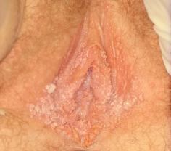
You perform an exam of the external genitalia and find small, firm, painless bumps
No other abnormal findings found during pelvic and speculum exam and discharge is not present

Slide 179
Differential Diagnosis
Condyloma
Lata
Flesh Colored Papular Lesion
Dermatologic Conditions
External Genital Warts
Molluscum Contagiosum
Notes:
External Genital Warts: Flat, papular, pedunculated growths
Molluscum Contagiosum: Discrete, pearly, firm papules, centrally umbilicated with erythematous base
Possible dermatologic conditions include:
Folliculitis
Nevi
Skin tags
Vestibular papullae
Polyp

Slide 180
Human Papillomavirus (HPV)
A member of a group of viruses in the genus Papillomavirus
Of the 100 strains, more than 40 are sexually transmitted and infect the genital area of males and females
Strains are classified as:
  High-risk (oncogenic)
  Low-risk (non-oncogenic)
Notes:
Sources:
Ho GYF, Bierman R, Beardsley L, Chang CJ, Burk RD. Natural history of cervicovaginal papilloma virus infection in young women. New England Journal of Medicine 1998;338:423–8.
Koutsky LA, Kiviat NB. Genital human papillomavirus. In: K. Holmes, P. Sparling, P. Mardh et al (eds). Sexually Transmitted Diseases, 3rd edition. New York: McGraw-Hill, 1999, p. 347–359.
Kiviat NB, Koutsky LA, Paavonen J. Cervical neoplasia and other STD-related genital tract neoplasias. In: K. Holmes, P. Sparling, P. Mardh et al (eds). Sexually Transmitted Diseases, 3rd edition. New York: McGraw-Hill, 1999, p. 811–831.
http://www.cdc.gov/std/HPV/STDFact-HPV.htm#common

Slide 181
Incidence and Prevalence
Highest incident STI in the U.S.
50% of sexually active adults infected during lifetime
Approximate prevalence in adolescents and young adults is 9.2 million
By age 50, at least 80% of females will have acquired genital HPV infection
Notes:
Assessing the extent of genital HPV infection in the U.S. is difficult because HPV does not grow in tissue culture; closely related types cause different diseases; and most infections are asymptomatic.
No surveillance system exists, and no large population-based prevalence surveys have been feasible.
Current knowledge of HPV prevalence is based on measuring the viral DNA in genital epithelial cells.
However, HPV DNA detection is limited by sampling methodology and reflects only current status; HPV DNA becomes undetectable within two years in most women.
Sources:
Weinstock H, Berman S, Cates Willard. Sexually Transmitted Diseases Among American Youth: Incidence and Prevalence Estimates, 2000. Perspectives on Sexual and Reproductive Health 2004;36:6–10.
Koutsky LA, Kiviat NB. Genital human papillomavirus. In: K. Holmes, P. Sparling, P. Mardh et al (eds). Sexually Transmitted Diseases, 3rd edition. New York: McGraw-Hill, 1999, p. 347–359.

Slide 182
Human Papillomavirus—Prevalence of High-risk and Low-risk Types Among Females Aged 14–59 Years, National Health and Nutrition Examination Survey, 2003–2006
Prevalence, %
60
Low-risk HPV*
50
High-risk HPV*
40
30
20
10
0
14–19
20–24
25–29
30–39
40–49
50–59
Age
HPV = human papillomavirus.
NOTE: Error bars indicate 95% confidence intervals. Both high-risk and low-risk HPV types were detected in some females.
Notes:
SOURCE: Hariri S, Unger ER, Sternberg M, Dunne EF, Swan D, Patel S, et al. Prevalence of genital HPV among females in the United States, the National Health and Nutrition Examination Survey, 2003–2006.
J Infect Dis. 2011;204(4):566-73

Slide 183
Genital Warts—Initial Visits to Physicians’ Offices, United States, 1966–2010
Visits (in thousands)
500
400
300
200
100
0
1966
1969
1972
1975
1978
1981
1984
1987
1990
1993
1996
1999
2002
2005
2008
Year
NOTE: The relative standard errors for genital warts estimates of more than 100,000 range from 18% to 30%.
SOURCE: IMS Health, Integrated Promotional Services™. IMS Health Report, 1966–2010.

Slide 184
HPV Clinical Manifestations
Genital warts
Squamous and glandular intraepithelial lesions

Slide 185
Genital Warts
Appearance
Condyloma acuminata:
cauliflower-shaped, flesh colored, pink or hyperpigmented
Smooth papules:
usually dome-shaped and skin colored
Keratotic warts:
thick, horny layer which can resemble common warts
Flat papules:
macular to slightly raised, flesh colored, with smooth surface
Notes:
Condyloma acuminata – May be keratotic on skin but generally non-keratinized when present on mucosal surfaces

Slide 186
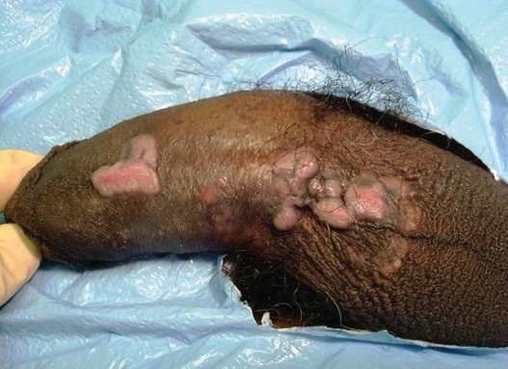
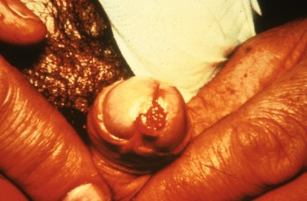
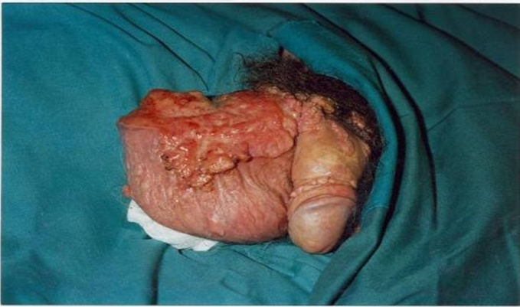
Genital Warts
Sites: Males
Shaft
Frenulum
Corona
Glans
Prepuce
Meatus
Scrotum
Shaft
Meatus
Scrotum
Notes:
Genital warts most commonly occur in areas of coital friction. In males they most commonly occur in the sites listed above.
Cervical and vaginal condylomata are less common than external warts. HPV types causing anogenital warts can occasionally cause lesions on oral, upper respiratory, upper GI, and ocular GI locations.

Slide 187
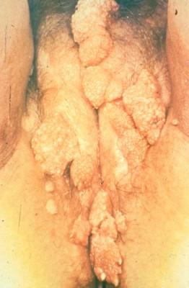
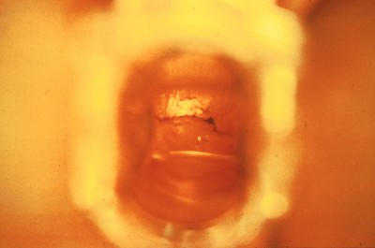
Genital Warts
Sites: Females
Posterior introitus
Labia minora
Labia majora
Perineum
Vagina
Cervix
Anus
Labia
Vaginal wall
Notes:
Cervical and vaginal condylomata are less common than external warts. HPV types causing anogenital warts can occasionally cause lesions on oral, upper respiratory, upper GI, and ocular GI locations.

Slide 188
Genital Warts
Symptoms
Majority are asymptomatic
Most common:
appearance of a wart
Vulvar:
dyspareunia, pruritus, burning
Penile:
occasional itching
Urethral meatal:
hematuria or impairment of urinary stream
Vaginal:
discharge, bleeding
Perianal:
pain, bleeding, itching
Notes:
Sources:
Kiviat NB, Koutsky LA, Paavonen J. Cervical neoplasia and other STD-related genital tract neoplasias. In: K. Holmes, P. Sparling, P. Mardh et al (eds). Sexually Transmitted Diseases, 3rd edition. New York: McGraw-Hill, 1999, p. 811–831.
Ho GYF, Bierman R, Beardsley L, Chang CJ, Burk RD. Natural history of cervicovaginal papilloma virus infection in young women. New England Journal of Medicine 1998;338:423–8.

Slide 189
Squamous and Glandular Intraepithelial Lesions: Appearance
Cervical, vaginal, or anal lesions
  Occur in normal epithelium and mucosal tissue
Vulvar lesions—can present as:
  Verrucous, white lesions
  Bowenoid papulosis, dome shaped or flat papules
  Flesh colored lesions indistinguishable from warts

Slide 190
Squamous and Glandular Intraepithelial Lesions: Sites
Penis
Anus
Females
Males
Cervix
Less commonly
  Vulva
  Vagina
  Anus
Anal lesions: more common with receptive anal sex and HIV positive women

Slide 191
Squamous and Glandular Intraepithelial Lesions: Symptoms
The majority are asymptomatic
Cervical lesions may cause irregular or post-coital bleeding

Slide 192
HPV-Associated Cervical Lesions
Diagnosis
Cytology
Colposcopy
Histopathology
Notes:
Cytology:
Limitations of Pap testing:
Unsatisfactory results (requiring a repeat visit and specimen)
Variable sensitivity
Liquid media-based tests and computer assisted reading may enhance sensitivity but reduce specificity
Histology:
Indications include:
Visible exophytic cervical lesions, certain abnormalities on cytology, and other colposcopic abnormalities
Lesions graded according to the proportion of epithelium involved by disease:
CIN 1: undifferentiated cells in lower 1/3 of epithelium
CIN-2: undifferentiated cells in lower 1/3–2/3 of epithelium
CIN-3/carcinoma in site: undifferentiated cells across full epithelium

Slide 193
HPV-Associated Cervical Lesions
Diagnosis: Cytology
American College of Obstetricians and Gynecologists recommendations:
  Women 21–30: screened every two years
  Women age < 30 with three consecutive negative tests: screened once every three years
  High risk women should be screened more frequently
Notes:
High risk women include:
HIV positive
Immunosuppressed
Exposed to diethylstilbestrol (DES) in utero
Have been treated for cervical intraepithelial neoplasia (CIN) 2, CIN 3, or cervical cancer
Source: ACOG Practice Bulletin No. 109: Cervical cytology screening. ACOG Committee on Practice Bulletins—Gynecology. Obstet Gynecol. 2009;114:1409–1420.

Slide 194
HPV DNA Testing
FDA approved indications
  Triage of women with ASC-US on Pap
  Routine adjunctive screening to Pap test in women > 30 years
Evidence-based indications
  12 month follow-up after negative colposcopy/biopsy for ASC-H, LSIL, or ASC-US with a positive HPV test
  12 month follow-up of CIN1
  6 and 12 month follow-up of initial work-up for AGC
  6 and 12 month follow-up post treatment CIN 2/3

Slide 195
HPV Treatment
Genital warts
  Patient applied
  Provider administered
  Alternative methods
Cervical pre-cancer

Slide 196
Genital Warts: Patient Applied Treatments
Podofilox 0.5% solution/ gel
Apply to visible genital warts twice a day for three days, followed by four days of no therapy
Repeat if necessary
Imiquimod 5% cream
Apply once daily at bedtime, three times a week for up to 16 weeks
Sinecatechins 15% ointment
Apply 3 times daily (0.5cm strand of ointment to each wart) using finger to ensure coverage. Use no longer than 16 wks. Do not wash after use.
OR
Notes:
-Sinecatechins (15%) ointment, known as Veregen™, is a new external genital warts . It is a patient applied therapy treatment option.
-Green tea extract with an active product (catechins)
-Apply three times daily (0.5cm strand of ointment to each wart) using a finger to ensure coverage with a thin layer of ointment until complete clearance of warts up to 16 weeks.
-Do not wash off after use.
-Sexual (i.e. genital, anal or oral) contact should be avoided while the ointment is on the skin.
-Most common side effects are erythema, pruitis/burning, pain, ulceration, edema, induration and vesicular rash.
-Not recommended for HIV-infected persons, immunocompromised persons or persons with clinical genital herpes because of safety and efficacy not established.
-Unknown safety during pregnancy
-Expensive.
Source: Centers for Disease Control and Prevention. Sexually Transmitted Diseases Treatment Guidelines, 2010. MMWR 2010;59(12):1-116.
excision, tangential shave excision, curettage, or electrosurgery

Slide 197
Genital Warts: Costs of Patient Applied Treatments
Drug and Strength | Estimated Cost/Month Supply ($)*
Sinecatechins ointment 15% Veregen™ | Estimated 1 month supply (1-2 15mg tubes) $150-$300
Podofilox 0.5% topical solution | Estimated 1 month supply: $24
Imiquimod 5% topical cream Aldera™ | 1 month supply: $95
Usage dependant on total wart area
Data from April 2008
www.pbm.va.gov

Slide 198
Provider-Administered Treatments
Cryotherapy with liquid nitrogen or cryoprobe
Repeat every 1–2 weeks
Podophyllin resin 10%–25% in compound tincture of benzoin
Trichloroacetic acid (TCA)
Surgical removal either by scissor excision, shave excision, curettage, or electrosurgery
OR
OR
OR
OR
Notes:
Provider-Administered:
Cryotherapy with liquid nitrogen or cryoprobe. Repeat applications every 1–2 weeks.
OR
Podophyllin resin 10%–25% in a compound tincture of benzoin. A small amount should be applied to each wart and allowed to air dry. The treatment can be repeated weekly, if necessary. To avoid the possibility of complications associated with systemic absorption and toxicity, two important guidelines should be followed: (1) application should be limited to <0.5 mL of podophyllin or an area of <10 cm² of warts per session, and (2) no open lesions or wounds should exist in the area to which treatment is administered. Some specialists suggest that the preparation should be thoroughly washed off one to four hours after application to reduce local irritation. The safety of podophyllin during pregnancy has not been established.
OR
Trichloroacetic acid (TCA) or Bichloroacetic acid (BCA) 80%–90%. A small amount should be applied only to the warts and allowed to dry, at which time a white “frosting” develops. If an excess amount of acid is applied, the treated area should be powdered with talc, sodium bicarbonate (i.e., baking soda), or liquid soap preparations to remove unreacted acid. This treatment can be repeated weekly, if necessary.
OR
Surgical removal either by tangential scissor excision, tangential shave excision, curettage, or electrosurgery
Centers for Disease Control and Prevention. Sexually Transmitted Diseases Treatment Guidelines, 2010. MMWR 2010;59(12):1-116.

Slide 199
Alternative Regimens
Intralesional interferon
Laser surgery
Topical cidoforvir
OR
OR
Notes:
Recommended Regimen for Cervical Warts
For women who have exophytic cervical warts, a biopsy evaluation to exclude high-grade SIL must be performed before treatment is initiated. Management of exophytic cervical warts should include consultation with a specialist.
Recommended Regimens for Vaginal Warts
Cryotherapy with liquid nitrogen. The use of a cryoprobe in the vagina is not recommended because of the risk for vaginal perforation and fistula formation.
OR
TCA or BCA 80%–90% applied to warts. A small amount should be applied only to warts and allowed to dry, at which time a white frosting develops. If an excess amount of acid is applied, the treated area should be powdered with talc, sodium bicarbonate, or liquid soap preparations to remove unreacted acid. This treatment can be repeated weekly, if necessary.
Recommended Regimens for Urethral Meatus Warts
Cryotherapy with liquid nitrogen
OR
Podophyllin 10%–25% in compound tincture of benzoin. The treatment area and adjacent normal skin must be dry before contact with podophyllin. This treatment can be repeated weekly, if necessary. The safety of podophyllin during pregnancy has not been established. Data are limited on the use of podofilox and imiquimod for treatment of distal meatal warts.
Recommended Regimens for Anal Warts
Cryotherapy with liquid nitrogen
OR
TCA or BCA 80%–90% applied to warts. A small amount should be applied only to warts and allowed to dry, at which time a white frosting develops. If an excess amount of acid is applied, the treated area should be powdered with talc, sodium bicarbonate, or liquid soap preparations to remove unreacted acid. This treatment can be repeated weekly, if necessary.
OR
Surgical removal
Source: Centers for Disease Control and Prevention. Sexually Transmitted Diseases Treatment Guidelines, 2010. MMWR 2010;59(12):1-116.

Slide 200
Would you give Jenna the HPV vaccine?

Slide 201
HPV Vaccine
Enormous potential for disease prevention
Cost- effective
Protects against multiple strains
Can be given prior to sexual initiation

Slide 202
HPV Vaccines:
FDA Approved
HPV 6,11 cause 90% of genital warts
Gardasil
  Quadrivalent HPV vaccine
    Prevents HPV types 16/18 & 6/11
  FDA approved for females (2006) and males (2009)
Cervarix
  Bivalent HPV vaccine
    Prevents HPV types 16/18
  FDA approved for females (2009)
HPV 16,18 cause 70% of cervical cancer
Notes:
Source: http://www.fda.gov/NewsEvents/Newsroom/PressAnnouncements/2009/ucm187048.htm
Merck (Gardasil): Protects against the…
70% of cervical cancers are caused by HPV strains 16/18
90% of genital warts are caused by HPV strains 6/11
Aluminum Adjuvant, made in yeast
FDA Approved in 2006
GlaxoSmithKine (Cervarix): Protects against the…
70% of cervical cancers caused by HPV strains 16/18
ASO4-Adjuvant (Aluminum + MPL)
Made in insect cells
FDA Approved in 2009

Slide 203
ACIP HPV Vaccine Recommendations for FEMALES
Recommend vaccination for all 11 and 12 yo ♀
  Can begin as young as age 9 yrs
  Either HPV 4 or HPV 2 can be used
Catch-up vaccination recommended for all 13-26yo ♀
Vaccination recommended even if patient
has genital warts or abnormal pap smear
Notes:
ACIP – Advisory Committee on Immunization Practices (ACIP)
CDC. Quadrivalent Human Papillomavirus Vaccine Recommendations of the Advisory Committee on Immunization Practices (ACIP). MMWR March 23, 2007 / 56(RR02);1-24
On October 16, 2009, the Food and Drug Administration (FDA) licensed bivalent human papillomavirus vaccine (HPV2; Cervarix, GlaxoSmithKline) for use in females aged 10 through 25 years. Cervarix is the second human papillomavirus (HPV) vaccine licensed for use in females in the United States. Quadrivalent HPV vaccine (HPV4; Gardasil, Merck & Co, Inc.) was licensed in 2006 for use in females aged 9 through 26 years, and the Advisory Committee on Immunization Practices (ACIP) recommended routine HPV4 vaccination of females aged 11 or 12 years, and catch-up vaccination for females aged 13 through 26 years (1). This report provides updated recommendations for routine and catch-up vaccination of females with either HPV2 or HPV4.
Vaccination is recommended for females aged 13 through 26 years who have not been vaccinated previously or who have not completed the 3-dose series. If a female reaches age 26 years before the vaccination series is complete, remaining doses can be administered after age 26 years. Ideally, vaccine should be administered before potential exposure to HPV through sexual contact.
ACIP recommends vaccination with HPV2 or HPV4 for prevention of cervical cancers and precancers. Both vaccines might provide protection against some other HPV-related cancers in addition to cervical cancer, although there are currently only data sufficient to recommend HPV4 for protection against vulvar and vaginal cancers and precancers. HPV4 is recommended also for prevention of genital warts.
http://www.cdc.gov/mmwr/preview/mmwrhtml/mm5920a4.htm?s_cid=mm5920a4_e

Slide 204
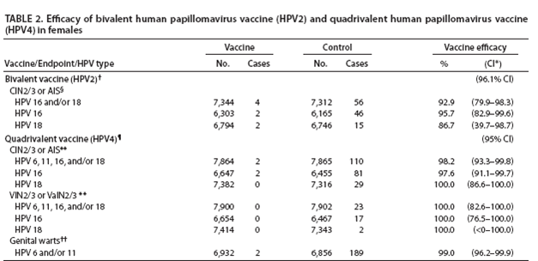
Efficacy of HPV2 and HPV4 Vaccine in Females
CDC. MMWR 2010; Vol. 59 / No. 20
Notes:
http://www.cdc.gov/mmwr/preview/mmwrhtml/mm5920a4.htm
HPV4 Vaccine (Gardasil) has higher efficacy rates than HPV2 Vaccine.
Abbreviations: CIN2/3 = cervical intraepithelial neoplasia grade 2 or 3, AIS = adenocarcinoma in situ, VIN2/3 = vulvar intraepithelial neoplasia grade 2 or 3, VaIN2/3 = vaginal intraepithelial neoplasia grade 2 or 3, HPV = human papillomavirus.
* Confidence interval.
† Phase III trial. According to protocol efficacy analysis included females aged 15 through 25 years who received all 3 vaccine doses, were seronegative at day 1 and HPV DNA negative at day 1 through month 6 for the respective HPV type, and had normal or low grade cytology at day 1, with case counting beginning 1 day after third vaccine dose; mean duration of follow-up post first vaccine dose: 34.9 months.
§ Source: Paavonen J, Naud P, Salmeron J, et al. Efficacy of human papillomavirus (HPV)-16/18 AS04-adjuvanted vaccine against cervical infection and precancer caused by oncogenic HPV types (PATRICIA): final analysis of a double-blind, randomised study in young women. Lancet 2009;374:301--14.
¶ Combined analysis of one phase II and two phase III trials. Per protocol efficacy analysis included females aged 16 through 26 years who received all 3 vaccine doses, were seronegative at day 1 and HPV DNA negative at day 1 through month 7 for the respective HPV type, with case counting beginning 1 month after third vaccine dose; mean duration of follow-up post first vaccine dose: 42 months.
** Source: Kjaer SK, Sigurdsson K, Iversen OE, et al. A pooled analysis of continued prophylactic efficacy of quadrivalent human papillomavirus (Types 6/11/16/18) vaccine against high-grade cervical and external genital lesions. Cancer Prev Res 2009;2:868--78.
†† Source: Food and Drug Administration. Product approval-prescribing information [package insert]. Gardasil [human papillomavirus quadrivalent (types 6, 11, 16, and 18) vaccine, recombinant], Merck & Co, Inc: Food and Drug Administration 2009. Available at http://www.fda.gov/biologicsbloodvaccines/vaccines/approvedproducts/ucm094042.htm. Accessed May 25, 2010.

Slide 205
ACIP HPV Vaccine Recommendations for MALES
Recommend vaccination for all 11 and 12 yo ♂
  Only HPV 4 approved for ♂
Catch-up vaccination recommended for all 13-21yo ♀
Recommended for all MSM and immunocompromised ♂
Permissive recommendation for 22-26 yo ♂ without risk factors
Notes:
Recommendations on the Use of Quadrivalent Human Papillomavirus Vaccine in Males — Advisory Committee on Immunization Practices (ACIP), 2011
Source: http://www.cdc.gov/mmwr/preview/mmwrhtml/mm6050a3.htm
On October 25, 2011, the Advisory Committee on Immunization Practices (ACIP) recommended routine use of quadrivalent human papillomavirus (HPV) vaccine (HPV4; Gardasil, Merck & Co. Inc.) in males aged 11 or 12 years. ACIP also recommended vaccination with HPV4 for males aged 13 through 21 years who have not been vaccinated previously or who have not completed the 3-dose series; males aged 22 through 26 years may be vaccinated. These recommendations replace the October 2009 ACIP guidance that HPV4 may be given to males aged 9 through 26 years (1). For these recommendations, ACIP considered information on vaccine efficacy (including data available since October 2009, on prevention of grade 2 or 3 anal intraepithelial neoplasia [AIN2/3], a precursor of anal cancer), vaccine safety, estimates of disease and cancer resulting from HPV, cost-effectiveness, and programmatic considerations. The evidence for HPV4 vaccination of males was evaluated using Grading of Recommendations, Assessment, Development, and Evaluation (GRADE) methods (2).
http://www.cdc.gov/mmwr/preview/mmwrhtml/mm6050a3.htm
http://www.cdc.gov/vaccines/acip/recs/GRADE/hpv-vac-males.html

Slide 206
Is HPV vaccination cost-effective for boys?
YES
Adding the HPV immunization of 12 yr old ♂ to U.S. female only vaccination programs IS cost-effective, particularly if:
  ♀ HPV4 coverage is low (30% 3-dose coverage at age 12 and 50% 3-dose coverage by age 26)
  all potential HPV vaccine health benefits included in analysis
Increasing ♀ coverage more efficient strategy than ♂ vaccination to lower overall HPV health burden
Chesson HW, et al. Vaccine 2011;29:8443–50.
Notes:
Question: Is adding HPV of 12 yo ♂ to U.S. ♀-only vaccination program cost-effective?
Methods:
CEA
The HPV-associated outcomes:
FDA-indicated: CIN; genital warts; cervical, vaginal, vulvar, & anal CA
nonFDA-indicated: oropharyngeal & penile CA; RRP

Slide 207
Cost-effectiveness of male vaccination*
Cost per QALY gained by vaccinating 12 year-old boys
*Includes transmission effects to females
*Chesson HW, et al Vaccine 2011
Notes:
“Indicated” outcomes include cervical outcomes, vaginal, vulvar, anal cancers, and genital warts. All outcomes include indicated outcomes plus oropharyngeal cancer, penile cancer, and recurrent respiratory papillomatosis. Lower coverage scenario: 30% 3-dose coverage at age 12 and 50% 3-dose coverage by age 26. Higher coverage scenario: 50% 3-dose coverage at age 12 and 70% 3-dose coverage by age 26.

Slide 208
How are we doing with HPV immunization rates?

Slide 209
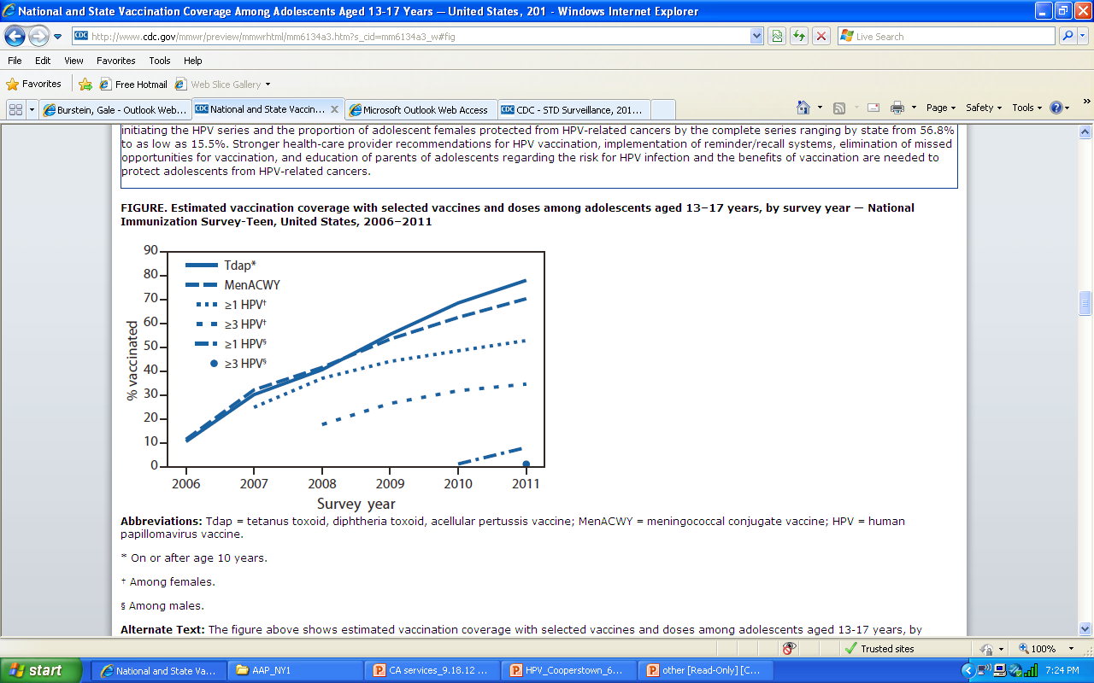
Vaccination Coverage among 13-17 yr olds, Males & Females, 2006-20011
HPV; Females HPV; Males
Notes:
http://www.cdc.gov/mmwr/preview/mmwrhtml/mm6134a3.htm
FIGURE. Estimated vaccination coverage with selected vaccines and doses among adolescents aged 13–17 years, by survey year — National Immunization Survey-Teen, United States, 2006–2011
The figure above shows estimated vaccination coverage with selected vaccines and doses among adolescents aged 13-17 years, by survey year, in the United States during 2006-2011. Adolescent vaccination coverage increased from 2006 to 2011, although the rate of increase differed by vaccine. Males aged 13-17 have the lowest vaccination rates for HPV compared to females, which makes sense considering the HPV vaccination wasn’t approved for males until October 2009.
http://www.cdc.gov/mmwr/preview/mmwrhtml/mm5920a5.htm
Abbreviations: Tdap = tetanus toxoid, diphtheria toxoid, acellular pertussis vaccine; MenACWY = meningococcal conjugate vaccine; HPV = human papillomavirus vaccine.
* On or after age 10 years.
† Among females.
§ Among males.

Slide 210
Why are HPV vaccination rates so low?
Parental delay of HPV vaccination
Fewer & weaker health-care provider recommendations
Providers using risk-based approaches
  Higher HPV initiation rates among blacks and Hispanics vs whites
  ♀ living below poverty line more likely fully protected w/ 3 doses vs ♀ living at or above poverty line

Slide 211
Communicating with Parents
Jenna’s mom is hesitant about the HPV vaccine
How would you address her concerns that the vaccine would increase Jenna’s sexual activity?

Slide 212
Counseling Tips
Remind parents that their behavior, messages and expectations play a key role in their children’s decisions regarding sex and relationships
(NOT the HPV vaccine)
Keep communication lines open
Give positive feedback to parents who
are vaccinating their children
Provide accurate information
Notes:
Source: Michelle Forcier’s advice provided in New York Times editorial on Oct. 19, 2012
http://www.nytimes.com/2012/10/31/opinion/influencing-teenagers-advice-from-a-pediatrician.html

Slide 213
What does the Evidence say?
Recent study published in Pediatrics (October 2012) evaluated sexual activity-related clinical outcomes after adolescent vaccination
HPV Vaccination in the recommended ages (11-12) was not associated with increased sexual activity-related outcome rates.
Pediatrics 2012; 130:798-805.
Notes:
http://pediatrics.aappublications.org/content/early/2012/10/10/peds.2012-1516.abstract
Sexual Activity–Related Outcomes After Human Papillomavirus Vaccination of 11- to 12-Year-Olds
Robert A. Bednarczyk, PhDª,^{b},
Robert Davis, MD, MPHª,
Kevin Ault, MD^{c},
Walter Orenstein, MD^{c},^{d}, and
Saad B. Omer, MBBS, PhD, MPHª,^{b},^{c},^{d}
+ Author Affiliations
ªCenter for Health Research-Southeast, Kaiser Permanente, Atlanta, Georgia; and
^{b}Rollins School of Public Health,
^{c}School of Medicine, and
^{d}Emory Vaccine Center, Emory University, Atlanta, Georgia
Abstract
OBJECTIVE: Previous surveys on hypothesized sexual activity changes after human papillomavirus (HPV) vaccination may be subject to self-response biases. To date, no studies measured clinical markers of sexual activity after HPV vaccination. This study evaluated sexual activity–related clinical outcomes after adolescent vaccination.
METHODS: We conducted a retrospective cohort study utilizing longitudinal electronic data from a large managed care organization. Girls enrolled in the managed care organization, aged 11 through 12 years between July 2006 and December 2007, were classified by adolescent vaccine (HPV; tetanus toxoid, reduced diphtheria toxoid, and acellular pertussis, adsorbed; quadrivalent meningococcal conjugate) receipt. Outcomes (pregnancy/sexually transmitted infection testing or diagnosis; contraceptive counseling) were assessed through December 31, 2010, providing up to 3 years of follow-up. Incidence rate ratios comparing vaccination categories were estimated with multivariate Poisson regression, adjusting for health care–seeking behavior and demographic characteristics.
RESULTS: The cohort included 1398 girls (493 HPV vaccine–exposed; 905 HPV vaccine–unexposed). Risk of the composite outcome (any pregnancy/sexually transmitted infection testing or diagnosis or contraceptive counseling) was not significantly elevated in HPV vaccine–exposed girls relative to HPV vaccine–unexposed girls (adjusted incidence rate ratio: 1.29, 95% confidence interval [CI]: 0.92 to1.80; incidence rate difference: 1.6/100 person-years; 95% CI: −0.03 to 3.24). Incidence rate difference for Chlamydia infection (0.06/100 person-years [95% CI: −0.30 to 0.18]) and pregnancy diagnoses (0.07/100 person-years [95% CI: −0.20 to 0.35]), indicating little clinically meaningful absolute risk differences.
CONCLUSIONS: HPV vaccination in the recommended ages was not associated with increased sexual activity–related outcome rates.
Study Design: Retrospective Cohort Study of 1398 girls
Recent study (year) and objectives
Conclusions

Slide 214
Jenna: Case Synopsis
Differential diagnosis for genital bumps:
  HPV
  Condyloma Lata
  Molluscum contagiosum
  Dermatological Conditions
Majority of HPV infections will clear the system
The HPV vaccine provides tremendous prevention opportunity

Slide 215
STD Prophylaxis- Recommended Regimens
Ceftriaxone 250mg IM in single dose OR
Cefixime 400mg PO in single dose PLUS
Metronidazole 2g PO in single dose
Azithromycin 1g PO in single dose or Doxycycline 100mg PO BID x 7days
Notes:
The following prophylactic regimen is suggested as preventive therapy:
Postexposure hepatitis B vaccination, without HBIG. This vaccine should be administered to sexual assault survivors at the time of the initial examination if they have not been previously vaccinated. Follow-up doses of vaccine should be administered 1–2 and 4–6 months after the first dose.
An empiric antimicrobial regimen for chlamydia, gonorrhea, and trichomonas.
Emergency contraception. (This measure is necessary only when the assault could result in pregnancy in the survivor.)
Source:
Centers for Disease Control and Prevention. Sexually Transmitted Diseases Treatment Guidelines, 2010. MMWR 2010;59(12):1-116.

Slide 216
Persons in Correctional Facilities
Universal screening for Chlamydia and Gonorrhea of adult females up to age 35.
Syphilis screening should be conducted on the basis of local area and institutional syphilis prevalence.
Notes:
Most institutions, especially those for adults, do not routinely screen for STDs. Diagnostic testing of inmates with symptoms indicative of an STD is the more common practice in juvenile detention and jail facilities. However, screening for asymptomatic infections facilitates the identification and treatment of persons with otherwise undetected infections, which not only eliminates complications for the individual, but reduces the prevalence of infection among detainees who are released back into the local community.
Source: Centers for Disease Control and Prevention. Sexually Transmitted Diseases Treatment Guidelines, 2010. MMWR 2010;59(12):1-116.

Slide 217
Women Who Have Sex with Women (WSW)
Sexual identity, behaviors, practice and risk behaviors differ.
  Most self-identified WSW (53%-99%) report having sex with men.
Adolescent WSW and females with both male and female partners might be at increased risk for STDs and HIV.
  Syphilis transmission, likely to occur during oral sex, between female sex partners may occur.
  C. trachomatis among WSW may be more common
  HPV transmission can occur from skin to skin or skin to mucosa contact during sex.
Notes:
Source: Centers for Disease Control and Prevention. Sexually Transmitted Diseases Treatment Guidelines, 2010. MMWR 2010;59(12):1-116.

Slide 218
Women Who Have Sex with Women
Regardless of reported same sex behavior, providers should consider:
  Screening all females for Chlamydia and syphilis as per recommendations
  Offering routine cervical cancer screening and HPV vaccine in accordance with current guidelines.
Notes:
Source: Centers for Disease Control and Prevention. Sexually Transmitted Diseases Treatment Guidelines, 2010. MMWR 2010;59(12):1-116.

Slide 219
Scabies
Recommended Regimens
Alternative Regimen
Lindane (1%) 1oz. Of lotion (or 30g of cream) applied in a thin layer to all areas of the body from neck down and washed off in 8hours.
Permethrin cream (5%) applied to all areas of the body from neck down and washed off after 8-14 hours OR
Ivermectin 200µg/kg orally, repeated in 2 wks
Notes:
Ivermectin (Stromectol)
New first line scabies treatment option
Not recommended for pregnant or lactating patients
Safety in children who weigh <15kg has not been determined
Centers for Disease Control and Prevention. Sexually Transmitted Diseases Treatment Guidelines, 2010. MMWR 2010;59(12):1-116.

Slide 220
Pelvic Inflammatory Disease (PID)
New Alternative Treatment including Azithromycin:
  Azithromycin has demonstrated short-term effectiveness in one randomized trial in combination with ceftriaxone
  Ceftriaxone 250mg IM in single dose PLUS Azithromycin 1g PO once a week for 2 wks
  Should consider adding metronidazole to treat anaerobes and BV.
Regimens that include a quinolone is no longer recommended for PID Treatment due to emergence of quinolone resistant N. gonorrhoeae
Notes:
Source: Centers for Disease Control and Prevention. Sexually Transmitted Diseases Treatment Guidelines, 2010. MMWR 2010;59(12):1-116.

Slide 221
Provider Resources:
Sexually Transmitted Infections
U.S. Centers for Disease Control and Prevention
  Statistics and Surveillance Reports: http://www.cdc.gov/std/stats/default.htm
  Expedited Partner Therapy: http://www.cdc.gov/STD/ept/default.htm
Treatment Guidelines: http://www.cdc.gov/STD/treatment/default.htm
  American Social Health Association:
  http://www.ashastd.org/std-sti/hpv.html
  U.S. Department of Health and Human Services
  http://womenshealth.gov/faq/stdhpv.htm

Slide 222
Provider Resources
www.prh.org—Physicians for Reproductive Health
http://www.nycptc.org/ —New York City STD/HIV Prevention Training Center (PTC)
www.aap.org—The American Academy of Pediatrics
www.acog.org—The American College of Obstetricians and Gynecologists
www.adolescenthealth.org—The Society for Adolescent Health and Medicine
http://www.aclu.org/reproductiverights—The Reproductive Freedom Project of the American Civil Liberties Union
www.advocatesforyouth.org—Advocates for Youth
www.guttmacher.org—Guttmacher Institute
www.cahl.org—Center for Adolescent Health and the Law
http://janefondacenter.emory.edu/—The Jane Fonda Center of Emory University
www.siecus.org—The Sexuality Information and Education Council of the United States
www.arhp.org—The Association of Reproductive Health Professionals
www.rhtp.org—Reproductive Health Technologies Project

Slide 223

Please Complete Your Evaluations Now

