Slide 1
Postpartum Depression
Leah Ederer, MD
Group Health Cooperative
of South Central Wisconsin

Slide 2
Leah Ederer, MD
Graduated University of Pittsburgh School of Medicine 2000
Completed University of Wisconsin Family Medicine Residency 2007
Family Physician at GHC with a busy OB Practice with 100 deliveries a year
Struggled with postpartum depression personally

Slide 3
Disclosures
I have nothing to disclose

Slide 4
Presentation Objectives
Be able to recognize and treat postpartum depression
Understand the relationship between breastfeeding, postpartum depression and family dynamics
Learn ways to incorporate postpartum depression discussion and screening in your practice

Slide 5
Question
You are 2 weeks postpartum and take your baby to the grocery store. While your cart is half full he wakes up and is hungry and crying. What do you do?
A – Ditch your cart full of food
B – Start nursing in store
C – Quickly try to pay for groceries
D – Keep shopping with screaming child

Slide 6
Baby Blues
Mild symptoms of tearfulness, irritability and anxiety
Develop in 40-80% of women within 2-3 days of delivery
Typically peak on the 5th day postpartum
Resolve by 2 weeks
Notes:
Change from diagnosis to spectrum

Slide 7
Postpartum Depression
Moderate to severe symptoms of tearfulness, irritability and anxiety
Develop in about 13% of women within 1 year of delivery
Lasting longer than 2 weeks
Notes:
Change from diagnosis to spectrum

Slide 8
Prevalence and Incidence
Prevalence – 6.5-12.9% in the first year
Similar to non-childbearing women of the same age
Studies did not represent racial and ethnic mix
Incidence – 14.5% in the first 3 months
Gaynes BN, Gavin N, Meltzer-Brody S, et al. Perinatal Depression: Prevalence, Screening Accuracy, and Screening Outcomes. Evidence Report/Technology Assessment, 2005 Feb;(119):1-8.
Notes:
Prevalence refers to the actual number of breast cancer patients in the city that is a ratio you can calculate by dividing cancer patients with the total population of your city. While calculating prevalence, those diagnosed this year are also taken into account. It is the burden of a disease that is new cases plus old cases.
On the other hand, incidence refers to the new cases of breast cancer in a single year that has surfaced in your city. This is again a ratio where you divide the new cases of breast cancer with the total population. Obviously incidence is a ratio that is always smaller than prevalence. While prevalence takes into consideration new cases plus old cases, incidence relates to new cases only

Slide 9
Risk Factors
Past history of depression (prepregnancy, antepartum, or postpartum)
Positive family psychiatric history
History of physical or sexual abuse
Lack of social and financial support
Poor relationship between the patient and her mother
Young age (26%)
Immigrant status
Unplanned pregnancy
Stressful life events (eg, marital conflict) during the 12 months prior to delivery
Unemployment for either the mother (no job to return to) or the head of household
Not breastfeeding
Childcare-related stressors
inconsolable infant crying
Congenital malformation in the infant
Tobacco Use
Pregestational or gestational diabetes
Postpartum blues and unipolar depression: Epidemiology, clinical features, assessment, and diagnosis In: UpToDate, Post, TW (Ed), UpToDate, Waltham, MA, 2014
McCoy SJ, Beal JM, Shipman SB et al. Risk factors for postpartum depression: a retrospective investigation at 4-weeks postnatal and a review of the literature. J Am Osteopath Assoc. 2006 Apr;106(4):193-8.

Slide 10
Risk Factors
Past history of depression
Discontinuation of antidepressants at conception resulted in 68% relapse
26% relapsed if remained on antidepressants during pregnancy
Mode of delivery is not associated with depression
Cohen LS, Altchuler LL, Harlow BL et al. Relapse of major depression during pregnancy in women who maintained of discontinued antidepressants treatment. JAMA 2006; 295:499-507

Slide 11
Symptoms
Depression
Pregnancy/Postpartum
Poor sleep/fatigue
Appetite changes
Decreased energy
Decreased libido
“How do you feel about the pregnancy/baby?”
“Are you having trouble sleeping even when your are exhausted and your baby is sleeping?”
Poor sleep/fatigue
Appetite changes
Decreased energy
Decreased libido

Slide 12
Barriers to care
Embarrassed to acknowledge feelings other than happiness even with friends
Fear they will be labeled “crazy” or that their children will be taken away.

Slide 13
Question
You are 2 weeks postpartum and take your baby to the grocery store. While your cart is half full he wakes up and is hungry and crying. What do you do?
A – Ditch your cart full of food
B – Start nursing in store
C – Quickly try to pay for groceries
D – Keep shopping with screaming child

Slide 14
Beware the blue hair

Slide 15
Adverse outcomes and impact on Family Dynamics
Impaired bonding
Impaired infant and child development
Child behavior problems
Marital discord

Slide 16
Intellectual outcomes
Intervention
IQ level
Venlafaxine
SSRI
Untreated maternal depression
Nondepressed mothers
105
105
108
112
Based on Wechsler Preschool and Primary Scale of intelligence – Third Edition
Nulman I, Koren G, Rovet J et al. Neurodevelopment of children following prenatal exposure to venlafaxine, selective serotonin reuptake inhibitors, or untreated maternal depression. Am J Psychiatry. 2012 Nov;169(11):1165-74.
Notes:
All over higher than general population likely because women self selected to contact Motherisk; 240 total participants

Slide 17
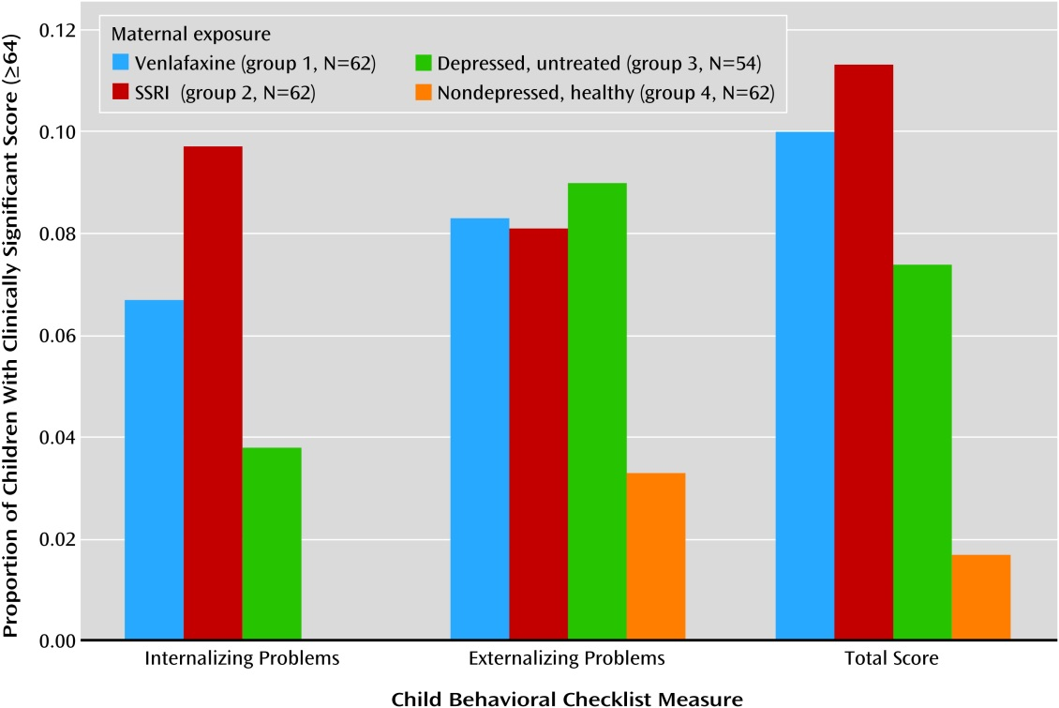
Child Behavior problems
Internalizing problems
Separation anxiety and phobias
Externalizing problems
ADHD, oppositional defiant disorder and conduct disorder
Nulman I, Koren G, Rovet J et al. Neurodevelopment of children following prenatal exposure to venlafaxine, selective serotonin reuptake inhibitors, or untreated maternal depression. Am J Psychiatry. 2012 Nov;169(11):1165-74.

Slide 18
Conclusions
Failed to find an effect of antidepressant medication on child’s intellectual of behavior outcomes
Child exposure to maternal depression is significant predictor of child behavior problems and risk for long-term child psychopathology
14 children had poor neonatal adaptation signs
these did not differ in intelligence
Therefore transient neonatal signs did not have long-lasting impact on aptitude
Nulman I, Koren G, Rovet J et al. Neurodevelopment of children following prenatal exposure to venlafaxine, selective serotonin reuptake inhibitors, or untreated maternal depression. Am J Psychiatry. 2012 Nov;169(11):1165-74.

Slide 19
Neonatal Adaptation Syndrome
Insomnia or somnolence
Agitation , tremors, jitteriness, shivering and/ or altered tone
Restlessness, irritability &constant crying
Poor feeding, vomiting or diarrhea
Poor temperature control, hypoglycemia
Tachypnea, respiratory distress, nasal congestion or cyanosis
Seizures

Slide 20
Other impacts
Emotional Regulation
Poor social competence in school years
Increased risk of depression during adolescence
Cognitive Development
Impaired infant ability to learn
Delayed developmental milestones
Impaired language
Physical Development
Underweight in infancy
Overweight in childhood
Stein A, Pearson R, Goodman S, et al. Effects of perinatal mental disorders on the fetus and child. The Lancet. 2014 Nov; (384) 1800-1819

Slide 21
Mechanism of Impact
Prenatal Impact
Increased risk for premature delivery
Depression-associated stress and anxiety are thought to disrupt fetal neurodevelopment due to inhibition of neurogenesis resulting in decreased gray mater.
Postpartum Impact
Less interactive and supportive environment
Decreased maternal responsiveness
Nulman I, Koren G, Rovet J et al. Neurodevelopment of children following prenatal exposure to venlafaxine, selective serotonin reuptake inhibitors, or untreated maternal depression. Am J Psychiatry. 2012 Nov;169(11):1165-74.
Notes:
Attachment – when a young child uses a caregiver as a secure base from which to explore and, when necessary, as a haven of safety and source for comfort

Slide 22
Postpartum treatment
If previously had done well on another antidepressant medication and no contraindications restart previous treatment
ABM Clinical Protocol #18 Use of Antidepressants in Nursing Mothers Breastfeeding Medicine (2008) Volume 3, Number 1, 44-52.

Slide 23
Postpartum treatment
First-line for mild to moderate depression is psychotherapy
No side-effects
Safe with breastfeeding
May provide lasting changes in coping skills
Amelioration of depressive symptoms alone has not been shown to improve mother-child interaction
Associated with fewer toddler behavioral problems at 18 months than assigned to routine care
ABM Clinical Protocol #18 Use of Antidepressants in Nursing Mothers Breastfeeding Medicine (2008) Volume 3, Number 1, 44-52.
Stein A, Pearson R, Goodman S, et al. Effects of perinatal mental disorders on the fetus and child. The Lancet. 2014 Nov; (384) 1800-1819

Slide 24
Postpartum treatment
First-line for severe depression is medication
All pass into breastmilk but not all were found in infant serum
Recommended less than 10% of maternal level
Aim for medications with shorter half-lives , greater protein binding and/or no active metabolites
If resistant to initial treatment switch antidepressant rather than augmentation
ABM Clinical Protocol #18 Use of Antidepressants in Nursing Mothers Breastfeeding Medicine (2008) Volume 3, Number 1, 44-52.

Slide 25
Specific Antidepressants (SSRI/SNRI)
Drug
Infant Serum Level
Paroxetine
Sertraline
Citalopram
Fluoxetine
Venlafaxine
2 %
7 %
17 %
22 %
20-107%
Weissman AM, Levy BT, Hartz AJ, Et Al. Pooled analysis of antidepressant levels in lactating mothers, breastmilk and nursing infants. Am J Psychiatry 2004; 161:1066-1078

Slide 26
Specific Antidepressants (other)
Drug
Infant Serum Level
Lorazepam
Nortriptyline*
No active metabolites
10 %
* Despite being effective and inexpensive not widely used secondary to significant uncomfortable side effects.

Slide 27
Postpartum treatment
Omega-3 Fatty Acid
do not appear to prevent postnatal depression if taken during pregnancy according to 6 m0 RCT
St. John’s Wort
One study showed increase in colic, drowsiness and lethargy but overall poor study.
ABM Clinical Protocol #18 Use of Antidepressants in Nursing Mothers Breastfeeding Medicine (2008) Volume 3, Number 1, 44-52.

Slide 28
Breastfeeding and PPD
Several studies have demonstrated an association between longer breastfeeding durations and a lower prevalence of PPD; however, other studies have indicated that breastfeeding mothers are not protected from PPD.
Thus, it has been difficult to ascertain whether breastfeeding reduces the risk of PPD or if, instead, successful breastfeeding is more prevalent among mothers at lower risk for PPD
Borra C, Iacovou M, Sevilla A. New Evidence on Breastfeeding and Postpartum Depression: The Importance of Understanding Women’s Intentions. Maternal Child Health J. 2014 Aug 21.

Slide 29
Breastfeeding and PPD
The estimated effect of breastfeeding on PPD differed according to whether women had planned to breastfeed their babies, and by whether they had shown signs of depression during pregnancy.
For mothers who were not depressed during pregnancy, the lowest risk of PPD was found among women who had planned to breastfeed, and who had actually breastfed their babies, while the highest risk was found among women who had planned to breastfeed and had not gone on to breastfeed.
Expectation vs. Reality
Borra C, Iacovou M, Sevilla A. New Evidence on Breastfeeding and Postpartum Depression: The Importance of Understanding Women’s Intentions. Maternal Child Health J. 2014 Aug 21.
Notes:
an unplanned C-section, complications at delivery, a baby who has medical issues, breastfeeding difficulties; all of these can be destabilizing and may be triggers for depression in many women, especially those who do not have adequate supports.

Slide 30
Breastfeeding and PPD
Breastfeeding is related to a reduction in anxiety and depression
Anxiolytic affects of oxytocin
Prepartum anxiety is related to breastfeeding cessation
Worried baby isn’t getting enough
Bottle feeding has worse implications than mixed breastfeeding
On-site lactation services
Ystrom E. Breastfeeding cessation and symptoms of anxiety and depression: a longitudinal cohort study. BMC Pregnancy and Childbirth 2012, 12:36

Slide 31
Incorporating screening and education
33-34 week gestation
2 week well child check
6 week postpartum check
Group Prenatal visits

Slide 32
33-34 weeks gestation
Discussion
Difference between baby blues vs. postpartum depression
Suggest being proactive
Feel comfortable coming to me with concerns
Handout with information and prevention techniques
offer on-site Primary Care Behavior Health consult

Slide 33
Question
You are 2 weeks postpartum and take your baby and toddler to the grocery store. While your cart is half full the baby wakes up and is hungry and crying. What do you do?
A – Ditch your cart full of food
B – Start nursing in store trying to keep the toddler occupied so they don’t pull off everything on shelves
C – Quickly try to pay for groceries
D – Keep shopping with 2 screaming children
E – Order food on-line and take the kids to the park

Slide 34
After hospital and 2 weeks WCC
“How are things going?”
“How is has your mood been?”
Confirm with partner if present
Colic Management

Slide 35
6 week postpartum visit
Edinburgh given by rooming staff
“How are things going?”
“How do you think you mood has been?”
Score Edinburgh with them
>10 concern for severe PPD
Offer medication
5-9 possible mild to moderate PPD
Offer PCBH and follow up

Slide 36
http://www2.aap.org/sections/scan/practicingsafety/Toolkit_Resources/Module2/EPDS.pdf

Slide 37
Screening
RCT compared Edinburgh Postnatal Depression Scale with routine clinical evaluation at 6 weeks postpartum.
Found postpartum depression was detected more with screening tool (35 percent vs. 6 percent)
Evins GG, Theofrastous JP, Galvin SL. Postpartum depression: a comparison of screening and routing clinical evaluation. Am J Obstetrics and Gynecology 2000; 182:1080

Slide 38
Screening
Can improve symptoms
RCT of 462 mothers at 2 month postpartum using Edinburgh.
All mother who showed signs of depression in both groups were treated the same with psychotherapy
EPDS >10 @ 6mo was 13% vs 22%
Leung SS, Leung C, Lam TH, et al. Outcome of a postnatal depression screening programme using the Edinburgh Postnatal Depression Scale: a randomized controlled trial. J Public Health (Oxf) 2001; 33:292

Slide 39
Group Prenatal and Well Child Care
Less preterm labor, increased birth weights and less postpartum depression
Camaraderie and relationships with others in group
Increased education - 83% felt they were comfortable

Slide 40
Perinatal Mental Health Training Modules
Offered by Wisconsin Department of Health Services, Maternal Child Health Program
What: A series of web-based modules providing information and guidance on identification of depression and other perinatal mental health concerns, screening with Edinburgh Postnatal Depression Scale (EPDS), and in-home and community-based interventions to support perinatal mental health.
Why: In light of national and state mandates to screen in the perinatal period, the goal of these modules is to help you feel confident and competent in addressing perinatal mental health issues in the families you serve.

Slide 41
Perinatal Mental Health Training Modules
Offered by Wisconsin Department of Health Services, Maternal Child Health Program
https://www.dhs.wisconsin.gov/mch/pncc.htm

Slide 42
References
J. L. Cox, J.M. Holden, R. Sagovsky, EDINBURGH POSTNATAL DEPRESSION SCALE (EPDS) British Journal of Psychiatry (1987), 150, 782-786.
ABM Clinical Protocol #18 Use of Antidepressants in Nursing Mothers Breastfeeding Medicine (2008) Volume 3, Number 1, 44-52.
Gaynes BN, Gavin N, Meltzer-Brody S, et al. Perinatal Depression: Prevalence, Screening Accuracy, and Screening Outcomes. Evidence Report/Technology Assessment, 2005 Feb;(119):1-8.
McCoy SJ, Beal JM, Shipman SB et al. Risk factors for postpartum depression: a retrospective investigation at 4-weeks postnatal and a review of the literature. J Am Osteopath Assoc. 2006 Apr;106(4):193-8.
www.uptodate.com
Evins GG, Theofrastous JP, Galvin SL. Postpartum depression: a comparison of screening and routing clinical evaluation. Am J Obstetrics and Gynelocology 2000; 182:1080
Weissman AM, Levy BT, Hartz AJ, Et Al. Pooled analysis of antidepressant levels in lactating mothers, breastmilk and nursing infants. Am J Psychiatry 2004; 161:1066-1078
Leung SS, Leung C, Lam TH, et al. Outcome of a postnatal depression screening programme using the Edinburgh Postnatal Depression Scale: a randomized controlled trial. J Public Health (Oxf) 2001; 33:292
Borra C, Iacovou M, Sevilla A. New Evidence on Breastfeeding and Postpartum Depression: The Importance of Understanding Women’s Intentions. Matern Child Health J. 2014 Aug 21.
Ystrom E. Breastfeeding cessation and symptoms of anxiety and depression: a longitudinal cohort study. BMC Pregnancy and Childbirth 2012, 12:36
Stein A, Pearson R, Goodman S, et al. Effects of perinatal mental disorders on the fetus and child. The Lancet. 2014 Nov; (384) 1800-1819
https://www.dhs.wisconsin.gov/mch/pncc.htm

