Slide 1
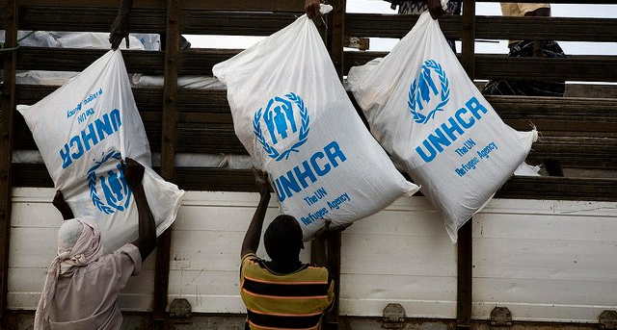
Refugee 101
Natasa Torbica – Refugee Programs Coordinator

Slide 2
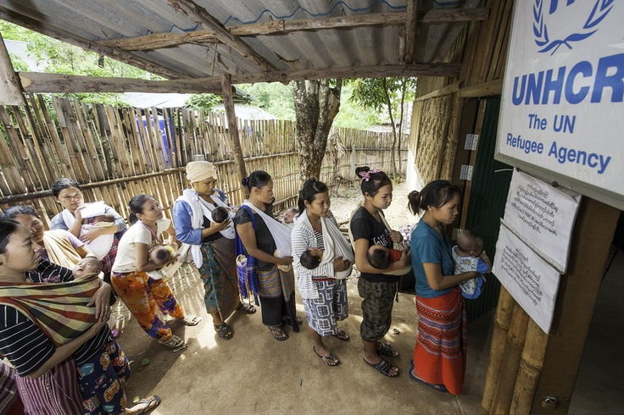
A refugee is a person who is outside of his or her country and is unable or unwilling to return because of persecution or a well-founded fear of persecution.
^{dcf.wisconsin.gov}

Slide 3
Basis of Persecution
Race
Religion
Nationality
Social Group
Political Opinion
^{dcf.wisconsin.gov}

Slide 4
Refugee Definition in the U.S.
Under United States law, a refugee is someone who:
Is of special humanitarian concern to the United States
Is located outside of the United States ( prior to admission)
Demonstrates that they were persecuted or fear persecution due to race, religion, nationality, political opinion, or membership in a particular social group
Is not firmly resettled in another country
Is admissible to the United States
Admitted as a refugee pursuant to section 207 of the Immigration and Nationality Act
^{dcf.wisconsin.gov}

Slide 5
Refugee or Asylee?
Asylees
Refugees
Are already in the U.S.
Apply for asylum and have to proof well founded reason for seeking asylum
Have often wait several years for immigration court to decide on their case
Receive no benefits and are not authorized to work until asylum is granted
Live outside of the U.S.
Have been awarded “refugee” status by the U.N.
Apply for resettlement to the U.S.
Arrive via an authorized “VOLAG” with authorization to work and eligible for benefits
^{dcf.wisconsin.gov}

Slide 6
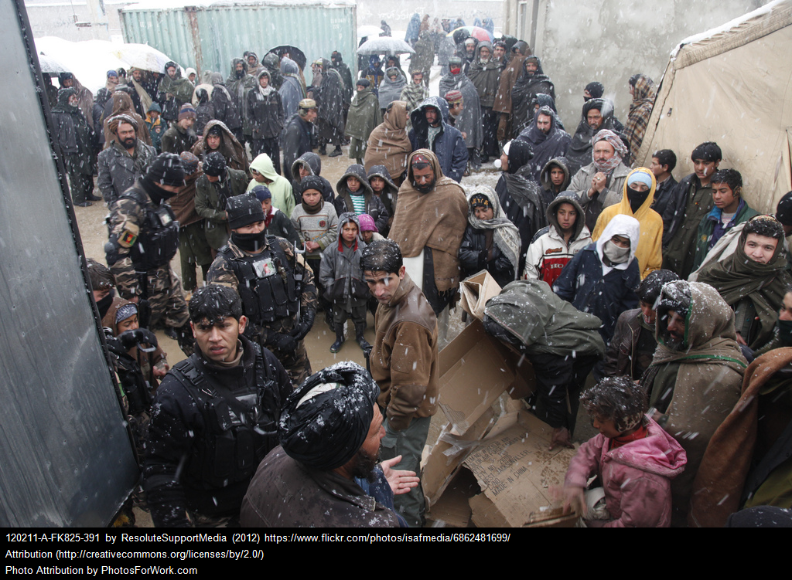
How big is this problem?
Global Refugee Numbers

Slide 7
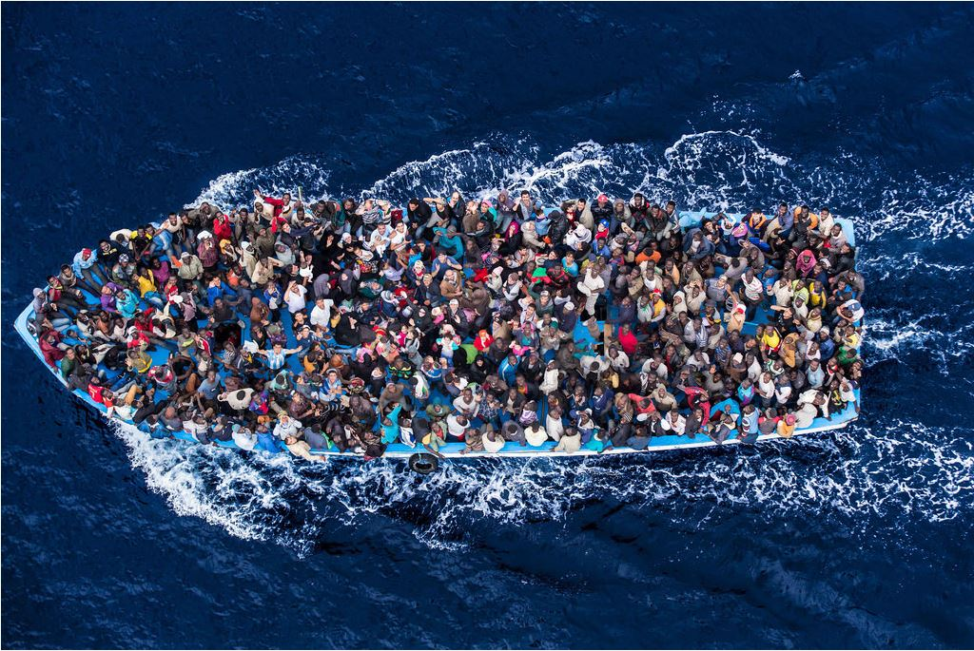
How big the refugee problem is?
^{How big the problem is}

Slide 8
How many people are displaced today?
65.3 million
If these 65.3 million persons were a nation, they would make up the 21st largest in the world.
Source: United Nations High Commissioner for Refugees (UNHCR) 2015

Slide 9
How many refugees are there today?
Global Refugee Numbers
65.3 million
21.3 m refugees
16.1 m under UNHCR’s mandate
5.2 m Palestinian refugees
registered by UNRWA*
40.8 m IDPs
3.2 m asylum-seekers
*UNRWA = United Nations Relief and Works Agency for Palestine Refugees in the Near East
Source: United Nations High Commissioner for Refugees (UNHCR) 2015

Slide 10
How many refugees are there today?
Global Refugee Numbers
In 2015 an average of 34,560 people were forced to leave their homes due to conflicts and persecution PER DAY.
This number has grown rapidly in recent years...
2014 =
42,500
2013 =
32,200
2012 =
23,400
2011 =
14,200
2010 =
10,900
Source: United Nations High Commissioner for Refugees (UNHCR) 2015

Slide 11
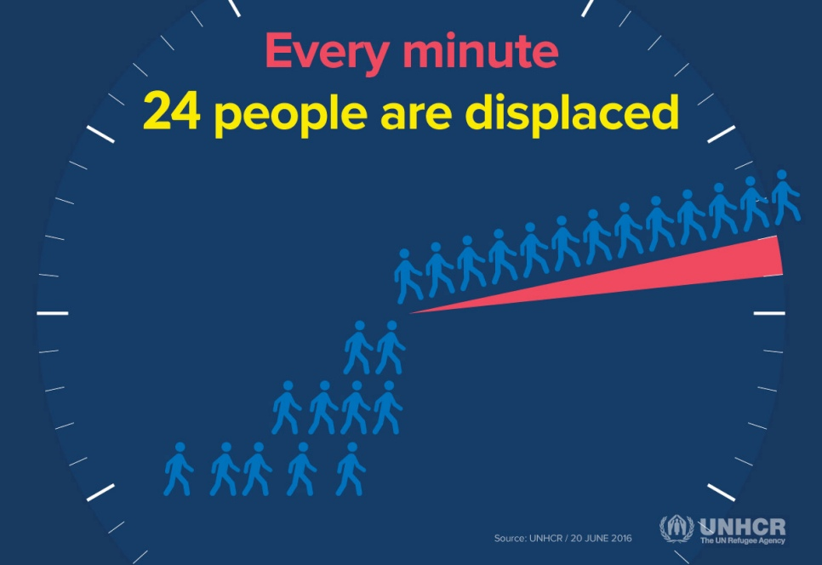
How big the refugee problem is?
Global Refugee Numbers
Source: United Nations High Commissioner for Refugees (UNHCR) 2015

Slide 12
What options do refugees have?
Refugee Resettlement
Voluntary repatriation to the home country when it is safe
Permanent resettlement in the neighboring country
Resettlement in a third country, such as the U.S.

Slide 13
Where can refugees be resettled?
Argentina
Australia
Austria
Belgium
Brazil
Canada
Chile
Czech Rep.
Denmark
Finland
France
Germany
Hungary
Iceland
Ireland
Japan
Liechtenstein
Luxembourg
Netherlands
New Zealand
Nicaragua
Norway
Paraguay
Philippines
Portugal
Romania
Spain
Sweden
Switzerland
United Kingdom
United States
Uruguay
Source: United Nations High Commissioner for Refugees (UNHCR) 2015

Slide 14
How resettlement to the U.S. works?
Resettlement Process in the U.S.

Slide 15
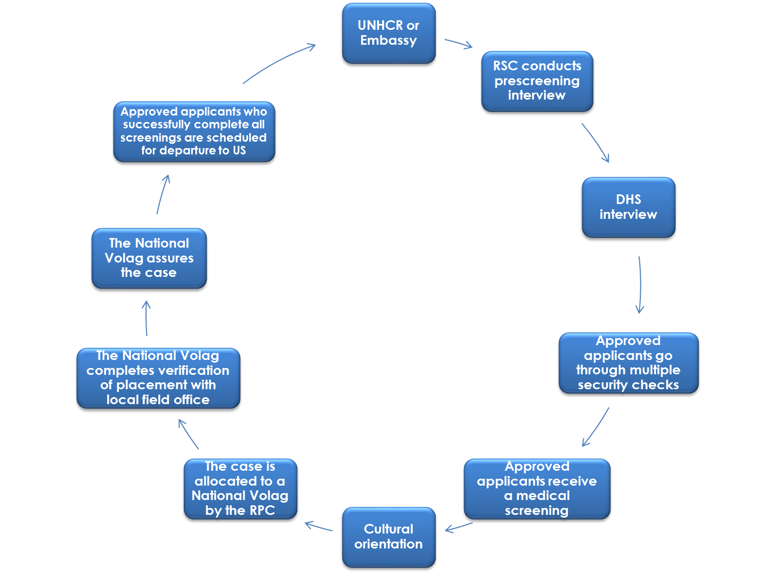
What does the process look like?

Slide 16
Who controls resettlement in the U.S.?
Resettlement Process in the U.S.
Each October, the President, as advised by the Secretary of State and in consultation with Congress, determines the authorized target number of refugee admissions.
The target for FFY 2017 is 50,000 refugees and 7,000 Special Immigrant Visa (SIV) recipients.
The U.S. Department of State’s Bureau of Population, Refugees and Migration (PRM) manages the U.S. Refugee Resettlement Program through contracts with:
- Nine Resettlement Support Centers (RSCs) overseas, and
- Nine National Resettlement Agencies in the United States.
RSCs are funded by PRM and are responsible for the accurate processing of refugees referred to the U.S. Refugee Admissions Program (USRAP) and approved for resettlement to the U.S. by U.S. Citizenship and Immigration Services (USCIS), part of the Department of Homeland Security (DHS)
Source: United Nations High Commissioner for Refugees (UNHCR) 2015

Slide 17
Where are the Resettlement Support Centers?
Source: United Nations High Commissioner for Refugees (UNHCR) 2015

Slide 18
How is process initiated?
Resettlement Process in the U.S.
Designated
NGO
Referral
Resettlement
Support
Center

Slide 19
How are people vetted before entry?
Any person who enters the U.S. with refugee status has had background and health checks by the following agencies:
United Nations High Commission for Refugees (Background and Health)
US National Counterterrorism Center / Intelligence Community (Background)
FBI (Background)
State Department (Background)
Department of Homeland Security (Background and Health)
US Citizenship and Immigration Services (Background and Health)
Department of Human Services (Background and Health)
US Customs and Border Protection (Background)
TSA

Slide 20
How is background check conducted?
Resettlement
Support
Center
Begin Initial Security Screening
Pass Initial Security Screening
U.S. Citizenship
and Immigration
Services

Slide 21
How does someone get admitted to the U.S.?
Resettlement Process in the U.S.
Begin Additional Security Screening
Pass Additional Security and Medical Screenings
U.S. Citizenship
and Immigration
Services

Slide 22
Does anyone help people once they arrive?
Resettlement Agencies
Every person/family is assigned to one of nine national resettlement agencies, also known as Voluntary Agencies (Volags) and their affiliates on the local level.
Nationwide these nine Volags have a network of nearly 350 local offices.
These agencies are non-governmental organizations that contract with PRM and agree to provide core services to newly arrived refugees.

Slide 23
Does anyone help people once they arrive?
World Relief Fox Valley

Slide 24
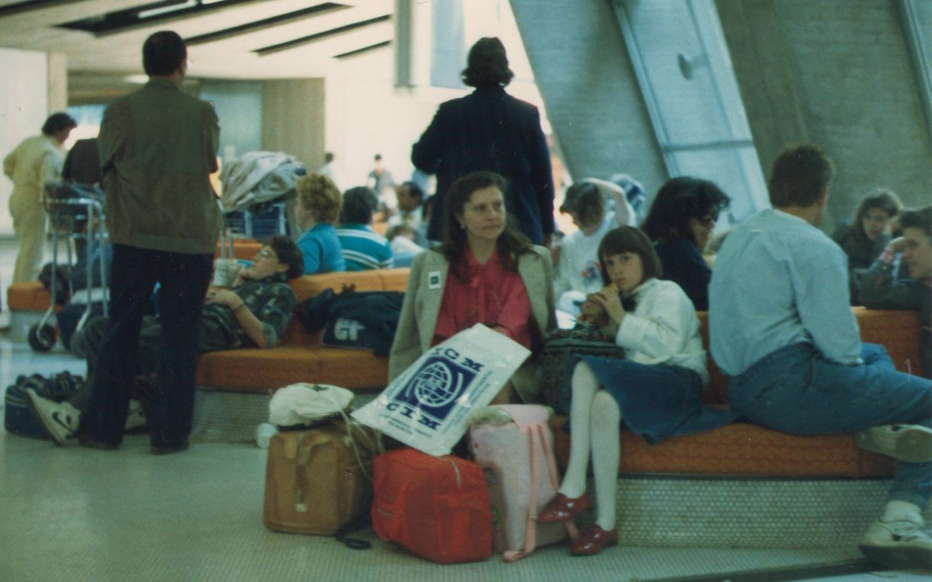
What happens to people once they arrive?

Slide 25
What kinds of services are available?
Housing
Benefits Enrollment
Employment
Community Integration
Citizenship
Cultural Orientation
Banking
Health Screening & PCP
Transportation
Shopping
Schooling

Slide 26
What kinds of services are available?
When in Wisconsin
Coming to the U.S.
Local Volag Resettlement Office with Case Manager to help with the process
Social Services for up to 5 years after arrival
Employment assistance programs for adults
English Language Classes
Cultural Orientation
Eligible for public assistance (W-2, BadgerCare, WE Energies assistance, Food share, SSI)
State of WI DCF Refugee Programs Section – ORR Refugee Social Services and other grants to support employment and post resettlement activities
Loan for airfare (+92% payback rate)
Granted permanent residency
Authorization to work
Assistance of a National “Volag” Office
Reception and Placement Funds (~$925-$1,125/person) for first 30-90 days
Refugee cash/medical assistance/food share (~$650/month for 8 months or W-2)

Slide 27
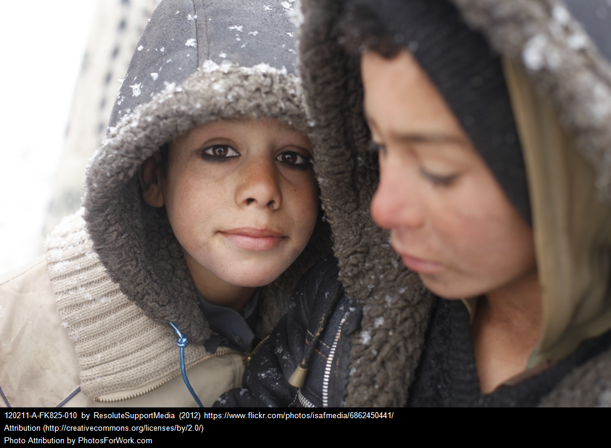
Who is coming?
Refugee Arrivals

Slide 28
Does Wisconsin receive a large number of people?
Refugee Arrivals
Texas
8,934
California
8,921
New York
5,830
Michigan
5,039
Ohio
4,857
WI
1,877
20th
Federal Fiscal Year
2016
(10.1.15 – 09.30.16)
Source: US Department of State

Slide 29
How many people have resettled in Wisconsin?
Refugee Arrivals
FFY 2010
834
FFY 2011
757
FFY 2012
797
FFY 2013
960
FFY 2014
1178
FFY 2015
1430
10/1/2009 – 9/30/2010
10/1/2010 – 9/30/2011
10/1/2011 – 9/30/2012
10/1/2012 – 9/30/2013
10/1/2013 – 9/30/2014
10/1/2014 – 9/30/2015
FFY 2016
1719
10/1/2015 – 9/30/2016
FFY 2017
660
10/1/2016 – 2/28/2017
Source: US Department of State

Slide 30
Where do people resettle in Wisconsin?
Refugee Arrivals
Federal Fiscal Year 2016 (10.1.15 – 09.30.16)
Milwaukee
Fox Valley
Madison
Other
867
139
118
54
33
16
16
16
6
4
4
3
2
1
1
1
Burma
Congo
Somalia
Iraq
Syria
Afghanistan
Eritrea
Pakistan
Sudan
Ethiopia
Indonesia
Bhutan
Zambia
Cambodia
Kenya
Rwanda
Congo
Syria
Afghanistan
Pakistan
Iraq
Burma
Cuba
Sudan
Burundi
Iran
Iraq
Bhutan
Afghanistan
Syria
Laos
Burma
Ethiopia
Burma
Somalia
Syria
Afghanistan
China
Ukraine
Iraq
Sudan
Vietnam
75
37
26
22
13
9
3
3
2
1
38
23
18
10
7
1
1
89
29
19
3
3
3
1
1
1
1281
191
98
149
Source: US Department of State

Slide 31
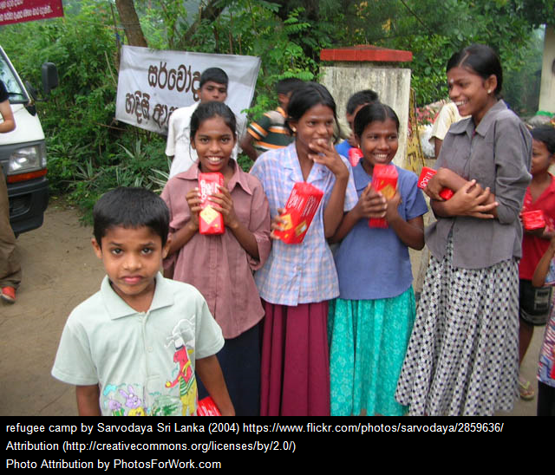
Who is coming?
Cultural and Ethnic Groups

Slide 32
Where do people resettle in Wisconsin?
Refugee Arrivals
Federal Fiscal Year 2017 so far… (10.1.16 -2.28.17)
Milwaukee
Fox Valley
Madison
Other
175
76
54
35
24
8
8
7
3
3
1
Burma
Somalia
Iraq
Syria
Congo
Eritrea
Indonesia
Vietnam
Afghanistan
Sudan
Thailand
Congo
Syria
Pakistan
Iraq
Burma
Sudan
Iraq
Syria
Bhutan
Iran
India
Nepal
Burma
Somalia
Syria
Iraq
34
11
6
5
3
1
27
12
11
2
1
1
13
26
5
4
394
60
54
23
Source: US Department of State

Slide 33
Questions / Concerns
Contact Us
Contact the State of WI Refugee Programs Section:
Natasa Torbica
Natasa.torbica@wisconsin.gov
414-270-4722
https://dcf.wisconsin.gov/refugee

Slide 34
World Refugee Day is on June 20th!

Slide 35
Refugee Health Promotion Program
Savitri Tsering Refugee Health Coordinator

Slide 36
Refugee Health Promotion Program (RHPP)
Department of Children and Families (DCF) Refugee Services Section (RSS) grant funded by the Office of Refugee Services (ORR)
funded for 3 years
sustainable approach to health promotion services for recently arrived refugees.
Objectives
Increase health literacy
Improve access to health and wellness services
Reduce gaps in services
Assure availability of affordable care and insurance

Slide 37
RHPP
Funded four bilingual Community Health Workers (CHWs) in Milwaukee
Medical interpretation training
40 hours CHW training
Focus group summer 2015
Health orientation and education workshops in native language on critical health topics

Slide 38
RHPP Focus Groups
Focus groups used to identify:
healthcare needs existing within the respective communities and
ethno-medical models held by refugees which influence health beliefs and healthcare utilization.
The results helped CHWs to identify the health-related issues to prioritize as topics for health education workshops.

Slide 39
RHPP Focus Groups
Based on focus groups’ results, priorities of each ethnic group were collected.
Variation in priorities of health topics between groups.
Preferred methods in how refugees would like to receive health information:
In-person and one-on-one
In workshops and groups
Directly with health care providers

Slide 40
RHPP Focus Group Results 9/15/2015
Top Priorities | Medium Priorities | Low Priorities
Food/nutrition education in order to live a healthy lifestyle Interpretation/language services to be able to schedule appointments independently | Transportation to medical appointments Understanding health insurance coverage Accessing vision and dental services Navigating the U.S. health care system Chronic disease education and management Employment and economic stability Receiving all required immunizations | Culturally appropriate care and trusting health care providers Community safety Smoking Medication management Stress management Alcohol abuse
Notes:
Spend time on this.

Slide 41
RHPP Health Education Workshops
CHWs facilitated health education workshops
Eating healthy in the United States (US)
Basic health care in the US
What is a Health Maintenance Organization (HMO) insurance plan and how to select the best HMO coverage for your family
How to schedule non-emergency medical transportation for doctor visits
Coping with stress and sleeping disorders
Women’s reproductive health and how to use contraceptives
Prescriptions

Slide 42
Future Directions
2017 is the final year of the grant; Wisconsin must re-compete
$200, 000 maximum funding
Evaluate sustainability of the health promotion services
Integrate additional needs into the program
How can your group’s work influence this effort?

Slide 43
Background Information
Cultural Orientation Resource Center
http://www.culturalorientation.net/learning/backgrounders
CDC Refugee Health Profiles
http://www.cdc.gov/immigrantrefugeehealth/profiles/
Available refugee health profiles include:
Bhutanese Refugees
Congolese Refugees
Iraqi Refugees

Slide 44
Background information
Ethnomed https://ethnomed.org/
HealthReach https://healthreach.nlm.nih.gov/default.aspx
Think Cultural Health http://www.thinkculturalhealth.org/
Notes:
EthnoMed contains information about cultural beliefs, medical issues and related topics pertinent to the health care of immigrants to the US, many of whom are refugees fleeing war-torn parts of the world.
HealthReach is a national collaborative partnership that has created a resource of quality multilingual, multicultural public health information for those working with or providing care to individuals with limited English proficiency
Resources include:
•Health education materials in various languages and formats (brochures, fact sheets, videos)
•Provider tools (including best practices, cultural information, and effective use of interpreters)
•Special collections on Emergency and Disaster, Women’s Health and Mental Health
Think Cultural Health: cultural health is a special discipline that covers the health and accurate description of a particular culture.

Slide 45
Background Information
Cultural Orientation Resource Center
http://www.culturalorientation.net/learning/backgrounders
CDC Refugee Health Profiles
http://www.cdc.gov/immigrantrefugeehealth/profiles/
Available refugee health profiles include:
Bhutanese Refugees
Congolese Refugees
Iraqi Refugees

Slide 46
Background information
Ethnomed https://ethnomed.org/
HealthReach https://healthreach.nlm.nih.gov/default.aspx
Think Cultural Health http://www.thinkculturalhealth.org/
Notes:
EthnoMed contains information about cultural beliefs, medical issues and related topics pertinent to the health care of immigrants to the US, many of whom are refugees fleeing war-torn parts of the world.
HealthReach is a national collaborative partnership that has created a resource of quality multilingual, multicultural public health information for those working with or providing care to individuals with limited English proficiency
Resources include:
•Health education materials in various languages and formats (brochures, fact sheets, videos)
•Provider tools (including best practices, cultural information, and effective use of interpreters)
•Special collections on Emergency and Disaster, Women’s Health and Mental Health
Think Cultural Health: cultural health is a special discipline that covers the health and accurate description of a particular culture.

Slide 47
Background Information
International Rescue Committee
http://www.rescue.org/sites/default/files/migrated/where/united_states_salt_lake_city_ut/refugee-backgrounders.pdf
Books
Mosby's Pocket Guide to Cultural Health Assessment, 4th Edition
Transcultural Health Care: A Culturally Competent Approach, 4th Edition by Larry D. Purnell PhD RN FAAN

Slide 48
Top 5 health issues for refugees in WI
Latent tuberculosis infection (LTBI)
Dental/oral care
Vision
Hepatitis B
Hypertension

Slide 49
Questions?
Savitri Tsering
Refugee Health Coordinator
Division of Public Health
Wisconsin Department of Health Services
(608) 267-3733
Savitri.Tsering@wisconsin.gov
Notes:
General questions about refugee health in Wisconsin.

